Slide 1
InspireX AI-Generated Interactives with SLS and in SLS
Date: 28 Oct
Teams Meeting details (optional)
Prepared by
Lawrence WEE, LS, MOE Educational Technology Division, TfL/ETD
Date: 28 Oct, 2025, CRDT Showcase 1, 1030-1100
Teams Meeting ID: 470 426 013 188 4 (LINK)
Passcode: N3Dv6LF7

Slide 2
Context
Introduction
Synopsis: This presentation demonstrates how Artificial Intelligence (AI) can rapidly generate HyperText Markup Language 5 (HTML5) interactives for Singapore’s Student Learning Space (SLS), enabling educators to focus on pedagogy while maintaining curriculum alignment. The session also introduces new “scorable” interactives, which capture student attempts within class group assignments. These records can be further analyzed with external AI tools to support the development of critical, adaptive, and inventive thinking. Lastly, the session briefly demonstrate the new feature is the SLS Interactive Generator, launching in December 2025, which allows SLS teachers to design and publish interactives without coding. It streamlines the creation, refinement, packaging, and uploading of content, providing richer interactivity and deeper analytics on student learning.

Slide 3
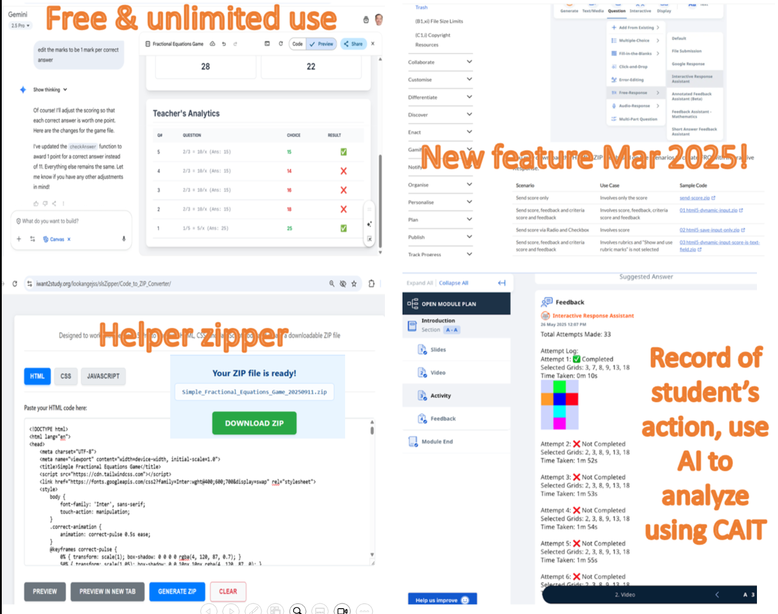
Poster Outline
Introduction
Google Gemini Pro 2.5
AI Zipper
Scorable Interactives

Slide 4

1. What is the Pedagogical Value of Interactive?
With SLS
KAT Key Application of Technology | Replace | Amplify | Transform
Assessment for Learning | Basic auto-marked quizzes (MCQ, T/F) | ShortAnsFA, DAT (timely feedback, misconceptions surfaced) | ^ACP (teacher designs AI-generated interactives for formative tasks), Analytics dashboards driving pivots
Conceptual Change | Digital textbook pages / static images | HTML5 interactives, simulations, scaffolded hints | ^ACP AI-generated interactives, inquiry labs with “scorable” feedback
Differentiation | Same module for all | ALS (Adaptive Learning System), branching scenarios | *AI-curated personalised pathways using ALS still limited
Facilitating Learning Together | Forum tool, simple polls | LEA (Learning Assistant) guiding group tasks, shared documents | AI-enhanced collaboration spaces where peer feedback is scaffolded by LEA
Developing Metacognition | Reflection text box (manual entry) | Prompted reflection templates, self-check rubrics | LEA with AI prompts nudging plan–monitor–evaluate cycles, learning analytics given back to students
Increase Motivation (new!) | Digital badges / completion ticks | Gamification V2 (points, streaks, leaderboards) | *Adaptive gamification tied to mastery, AI-curated challenges/quests
Personalization | Same module for whole class | ALS adaptive branching | ACP AI interactives customised by teacher, *LFAs tailoring support
Scaffolding for Learning | Hints provided by teacher manually | ShortAnsFA suggest answers in SLS | LEA scaffolding tasks with dynamic interaction with student and real-time adjustment

Slide 5
Google Gemini Pro 2.5
Live Demo

Slide 6
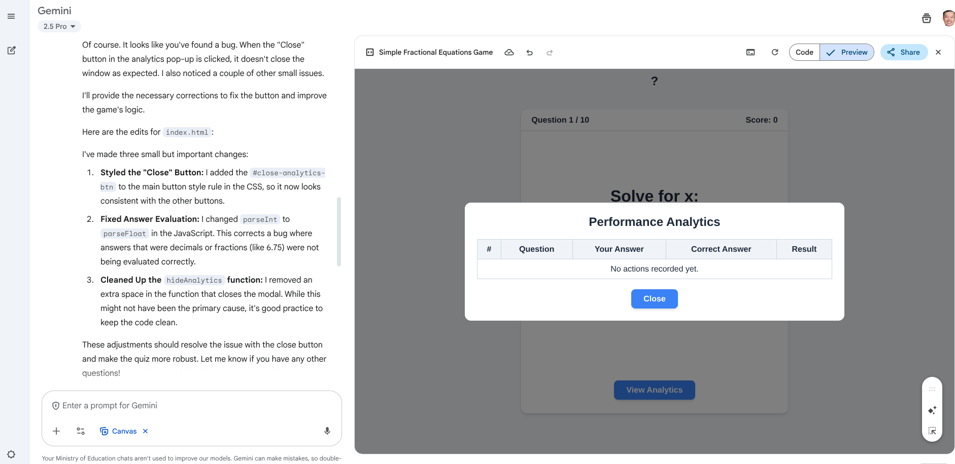
1. Google Gemini App on Model Gemini Pro 2.5
With SLS
Login: Use your MOE.EDU (via the email icon) to access education benefits.
1. Generate: Enter your prompt and select Canvas to instantly preview your simulation.
2. View & Copy: Switch between Code and Preview to see the source code or interact directly with your creation.
②
①

Slide 7
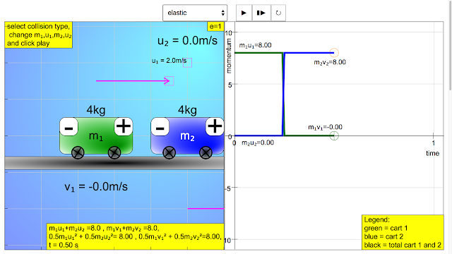
1. Google Gemini App Pedagogical Prompt and User Prompt
With SLS
You are a web developer specialized in HTML5 content creation. The HTML file must run entirely offline, without external libraries Ensure it fits well within an iframe environment, using 100% width, 450 px height if in iframe, 90 vh if the interactive is open in a new browser tab, expect to occupy the 90vh of the screen height Layout must support intuitive interaction: maintain clean organization of elements, use visual cues (shadows, highlights) for interaction states, use centre tooltip to allow viewing in iframe for text if there is a lot text information to display. If buttons are used, make the button height fit the text and use the width to fill the text instead of next line to pack the limited iframe height. Optimize for both touch and mouse interactions with appropriate target sizes align to the Singapore curriculum and notations, design grounded on instructional and cognitive psychology, apply theories of cognitive load, Mayer's 12 principles of multimedia learning and information visualisation. no header text to save vertical spaces, use tooltip to mouse over to show header text at the main panel You have to complete one of the following tasks: 1. Create a new HTML5 interactive content based on the user's prompt. Important: Use the provided reference images as inspiration and references. Provide comments in the code on what the code is doing and how it works. You should generate all code in a single HTML, properly formatted. You must generate JavaScript for every interactive content to enable to run the simulation or game.
upload pictures
Simulate 1D elastic and inelastic collisions between two carts on a track.
Include sliders for mass and velocity.
Show momentum and kinetic energy before and after.
Visualize with moving carts and vector arrows.

Slide 8
2. AI Zipper
Live Demo

Slide 9
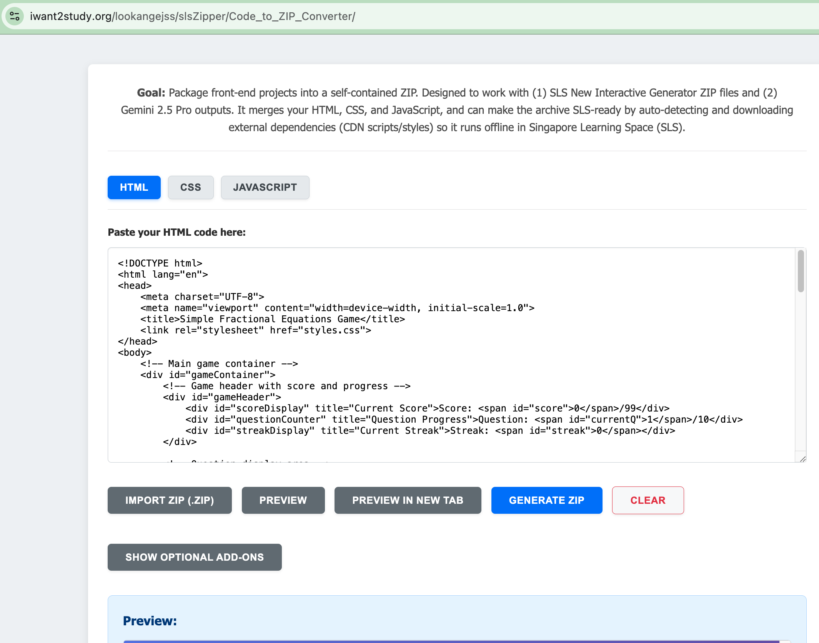
2. AI Zipper
With SLS
AI Zipper – Packaging Interactives
Insert Code: Follow the on-screen instructions and paste your HTML code into AI Zipper.
  Supports two methods:
    Drag and drop your files, or
    Copy and paste code into the correct CSS and JavaScript tabs.
2. Preview Interactive: Click Preview to view your interactive within AI Zipper.
3. Open in New Tab: Click Preview in New Tab to experience the interactive in a separate browser window.
①
②
③

Slide 10
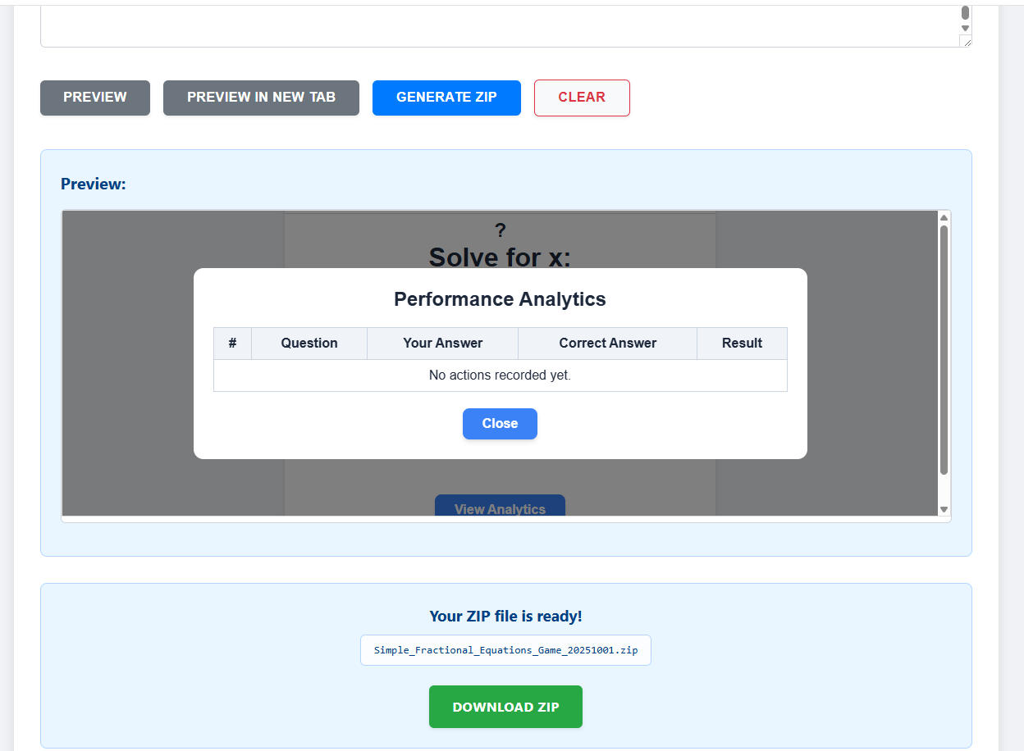
2. AI Zipper
With SLS
④
AI Zipper – Packaging Interactives for SLS
4. Generate ZIP: Click Generate ZIP to create your packaged interactive file.
5. Download for SLS: Rename the file if needed, then click Download ZIP to obtain your interactive in a .zip format — ready for upload to SLS as media.
⑤

Slide 11
3. Scorable Interactives (xAPI)

Slide 12
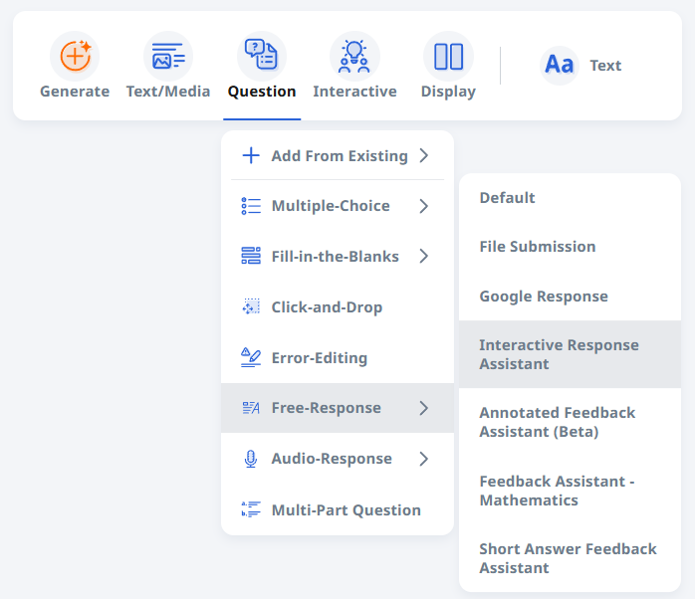
3. New Feature since March 2025 - Scorable Interactives in SLS
In SLS
Since March 2025, the Student Learning Space (SLS) has incorporated a new feature: Scorable Interactives with feedback (named Interactive Response Assistant), which record student actions seamlessly within the interactive. This advancement extends assessment possibilities beyond traditional multiple-choice or short-answer formats, enabling teachers to capture nuanced evidence of student actions on the interactive
Notes:
https://www.learning.moe.edu.sg/teacher-user-guide/author/html5-content-development/

Slide 13
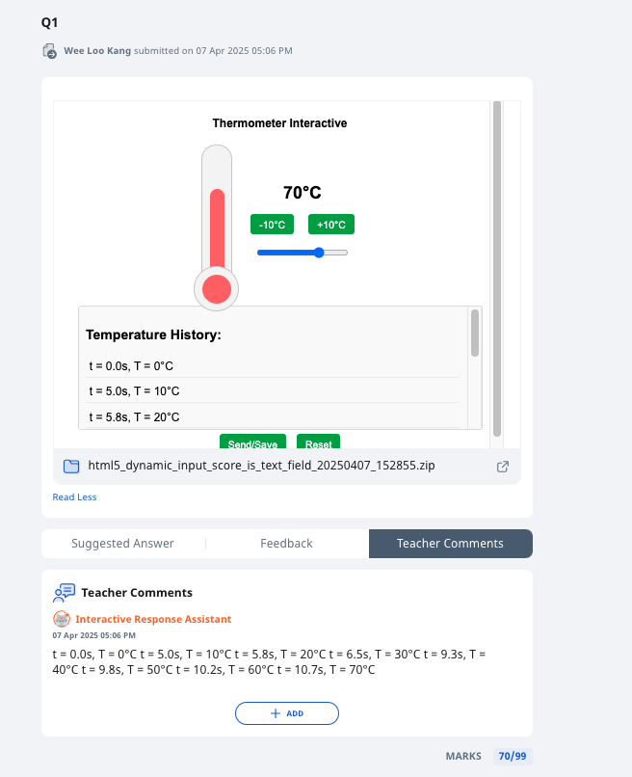
3. Why Scorable Interactives Matter
In SLS
Promote active learning with real-time feedback, allowing learners to track progress and refine their actions
Collect detailed, evolving data on student interactions, providing valuable insights into their cognitive strategies
Deepen learner engagement and understanding by fostering knowledge construction in authentic digital environments

Slide 14
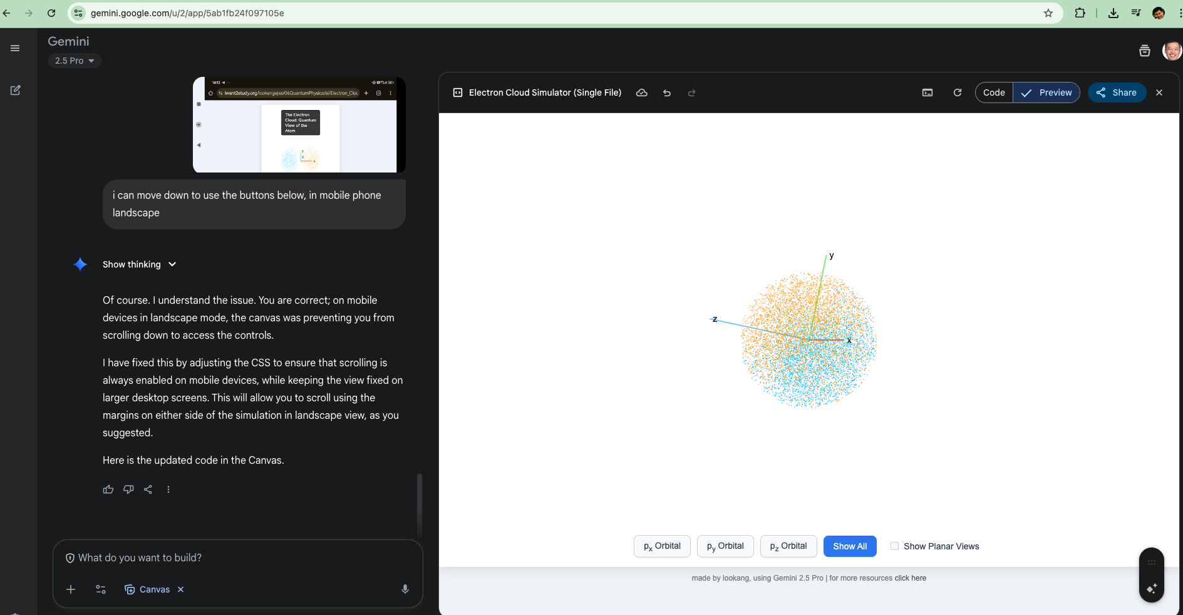
3. Scorable Interactives
With SLS
3.1 AI tools such as the Google Gemini App on large language model 2.5 Pro with MOE Icon Account login can now be used to create unlimited number of interactives
Notes:
https://www.learning.moe.edu.sg/teacher-user-guide/author/html5-content-development/

Slide 15
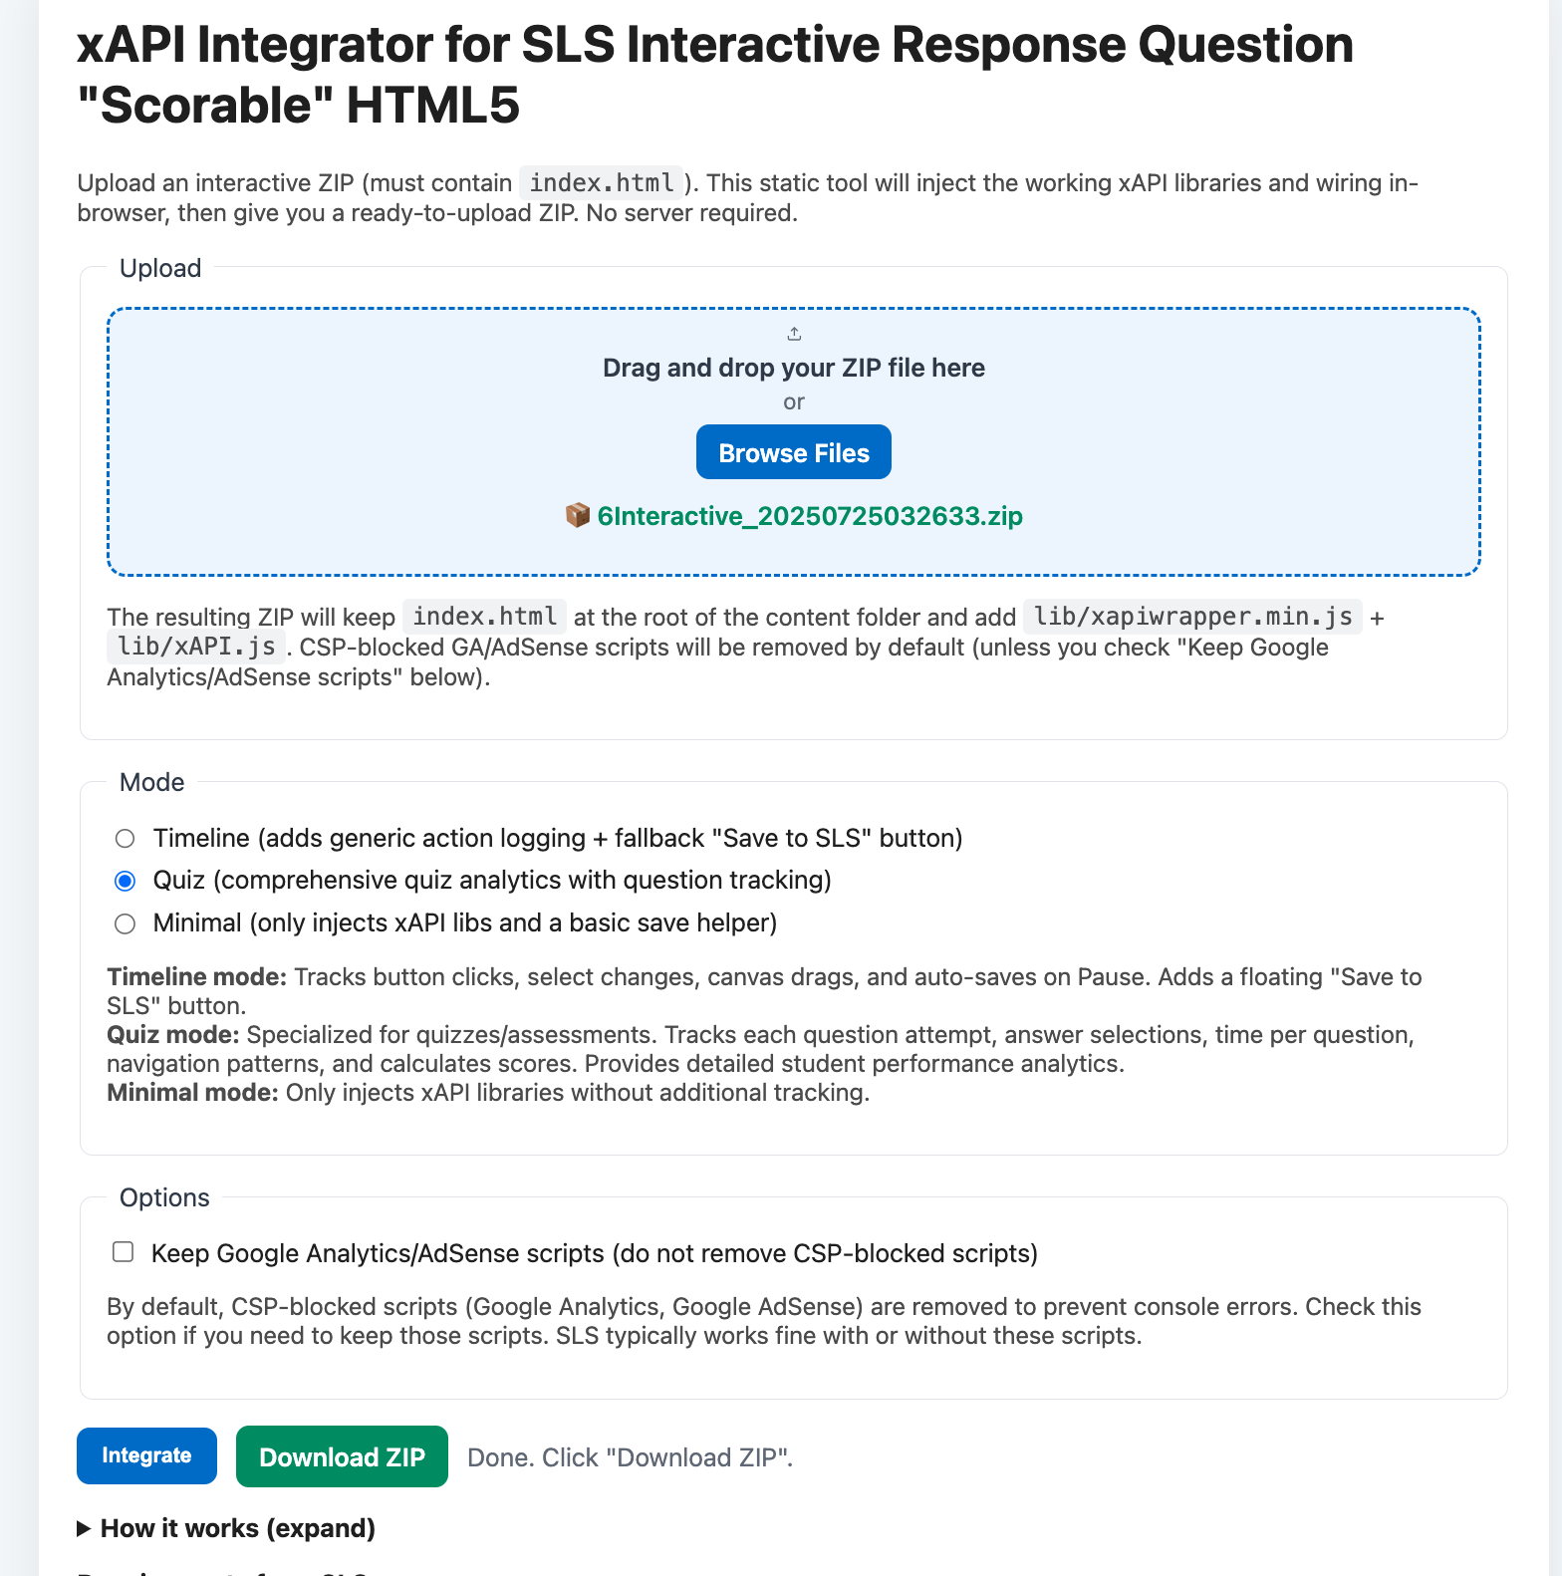
3. Scorable Interactives
With SLS
3.2. Making Scorable with xAPI Integrator
Scorable Interactives can be enhanced using the xAPI Integrator App to work in SLS as Interactive Response Questions.
1 Upload your working interactive file into the xAPI Integrator.
2 Click Integrate to embed the scoring and feedback code.
3 Download the newly integrated .zip file to your computer — ready for upload to SLS.
①
②
③
Notes:
Scorable Interactives can be injected with sample codes with xAPI Integrator App to work in SLS as Interactive Response Question. 1. Upload a working interactive and
2. Click Integrate and
3. Click Download the new integrated zip file into your computer.

Slide 16
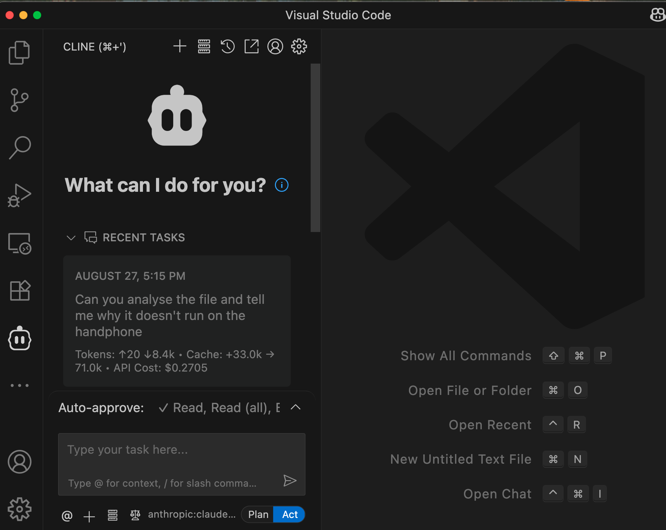
3. Scorable Interactives
With SLS
3.3 AI tools such as Visual Code Studio with extension Cline AI Bot can be used to add the “scorable” feedback to the interactive that send the recorded interactions to SLS
  Note: These tools can only be run on personal computers, as WOG and SSOE environments do not permit the installation of AI tools
  Payment is usually needed for API key to use Cline Bot, Gemini Pro 2.5 Pro is free but with limited use per day
Notes:
https://www.learning.moe.edu.sg/teacher-user-guide/author/html5-content-development/

Slide 17
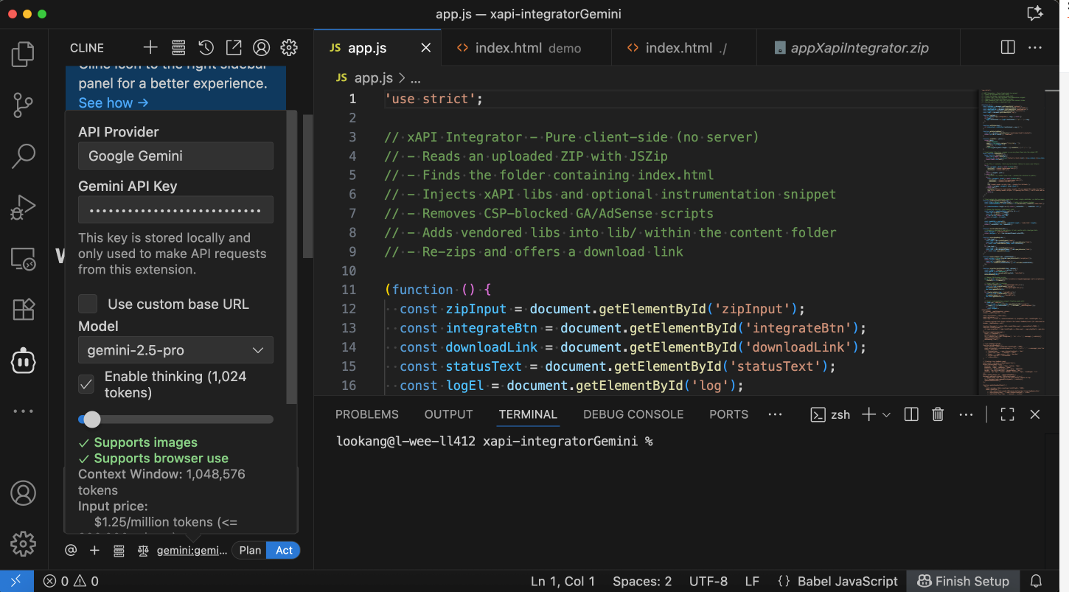
3. Scorable Interactives
With SLS
Scorable Interactives can be further fine tuned to return the desired Feedback and Score to SLS using Visual Code Studio – Cline Bot Extension – Gemini 2.5 Pro (free) or ChatGPT5 (paid) API key. YouTube is available for detailed steps.
1. select API Provider and API key
2. select Model “Gemini 2.5 pro”
3. ask for feedback and score to be refine.
①
②
③

Slide 18
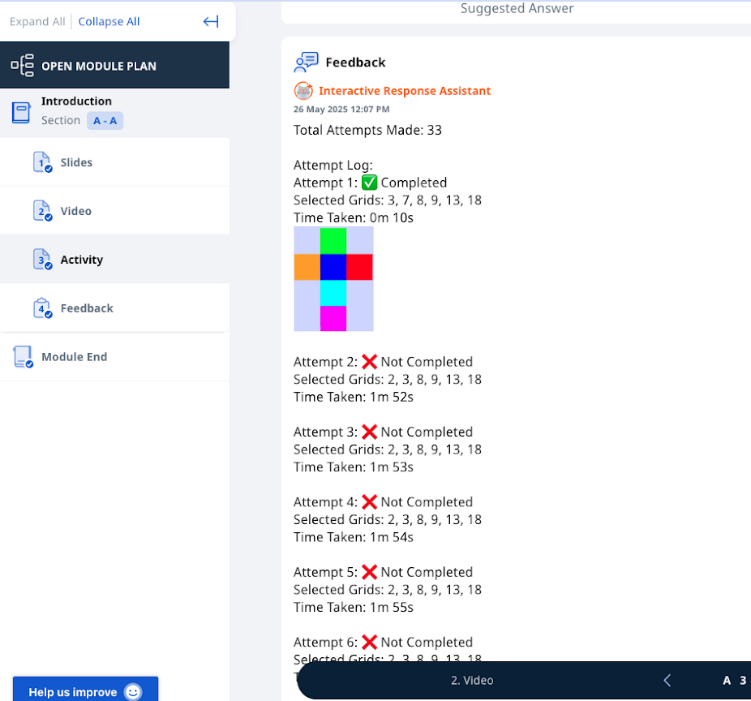
3. Scorable Interactives
In SLS
3.4 Learning Analytics with Interactive
Data on students’ clicks and actions within the interactive are automatically recorded in SLS, providing valuable insights into their actions and learning process.
These records can be analyzed using AI to evaluate competencies aligned with 21CC CAIT criteria — such as Critical, Adaptive, and Inventive Thinking.

Slide 19
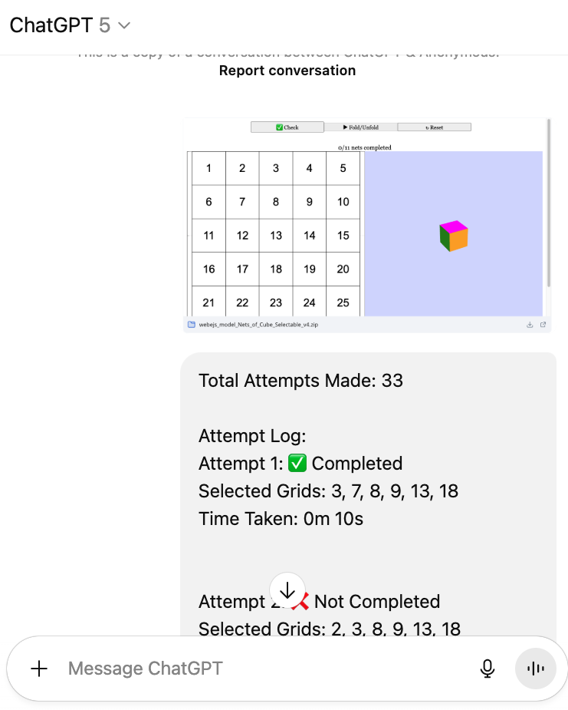
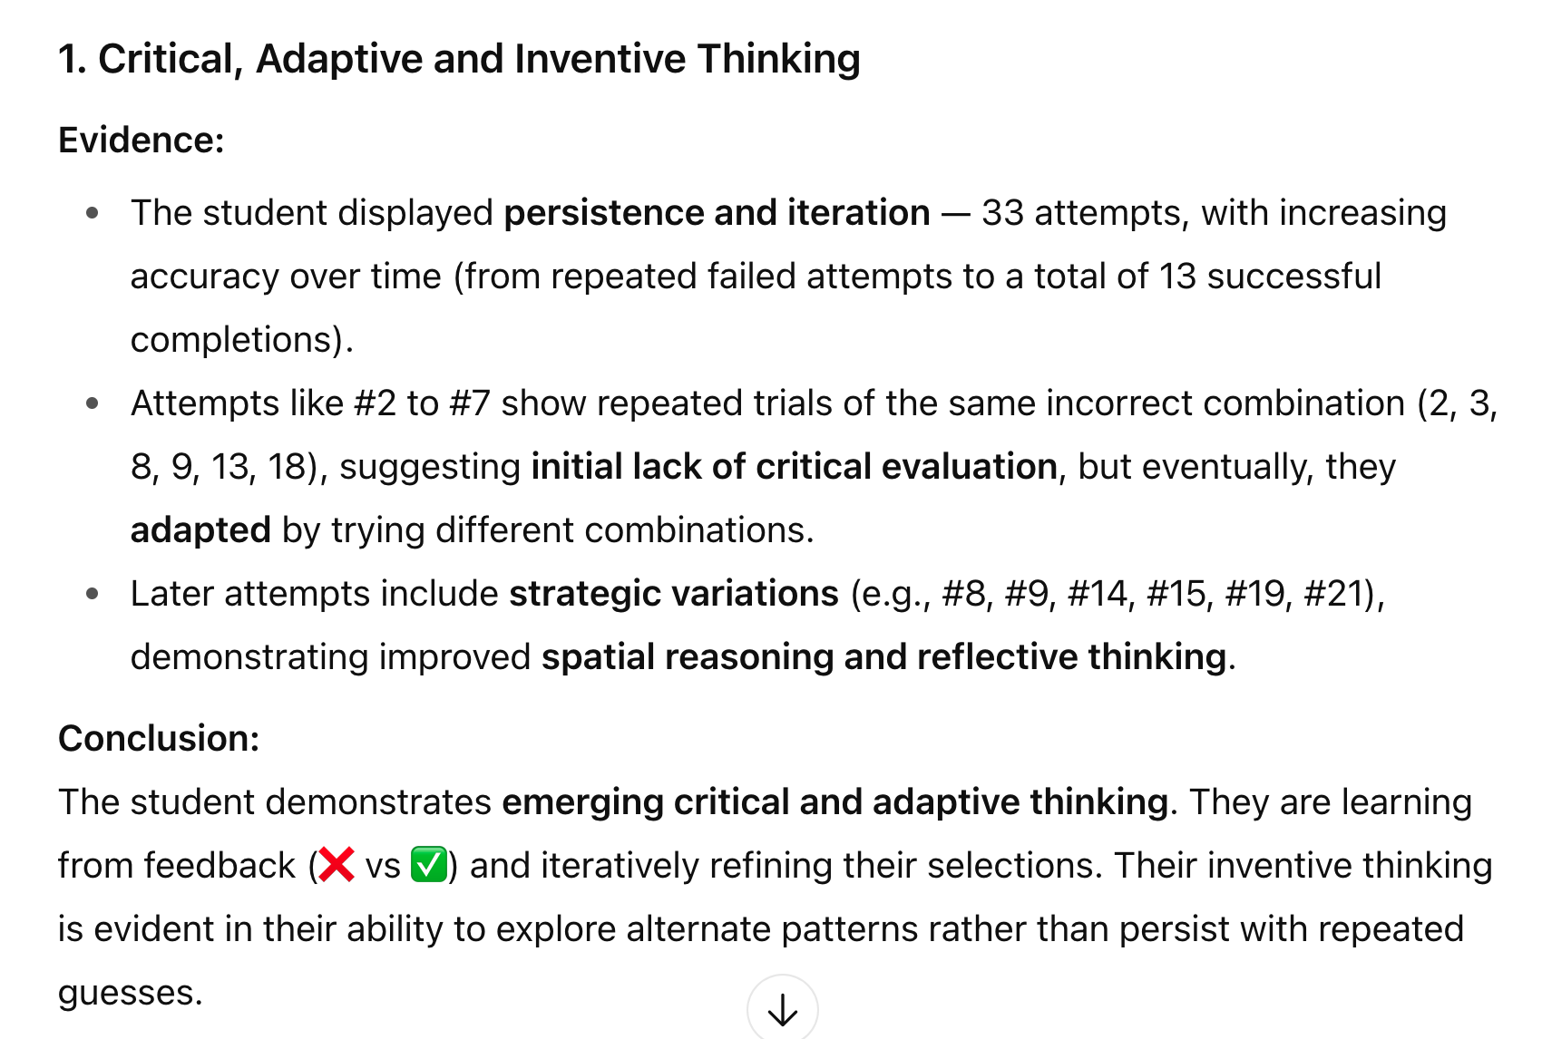
3. Scorable Interactives
With SLS
3.5 Using AI for Analysis
AI tools such as the ChatGPT can now be used to analyse the student’s interactions recorded as SLS teacher’s comment-feedback
Need to provide
  context (picture of interactive and recorded feedback) and
  simple prompt (what are the evidences of Critical, Adaptive and Inventive Thinking in the student’s action on the interactive?)
Notes:
https://www.learning.moe.edu.sg/teacher-user-guide/author/html5-content-development/

Slide 20
Questions

Slide 21
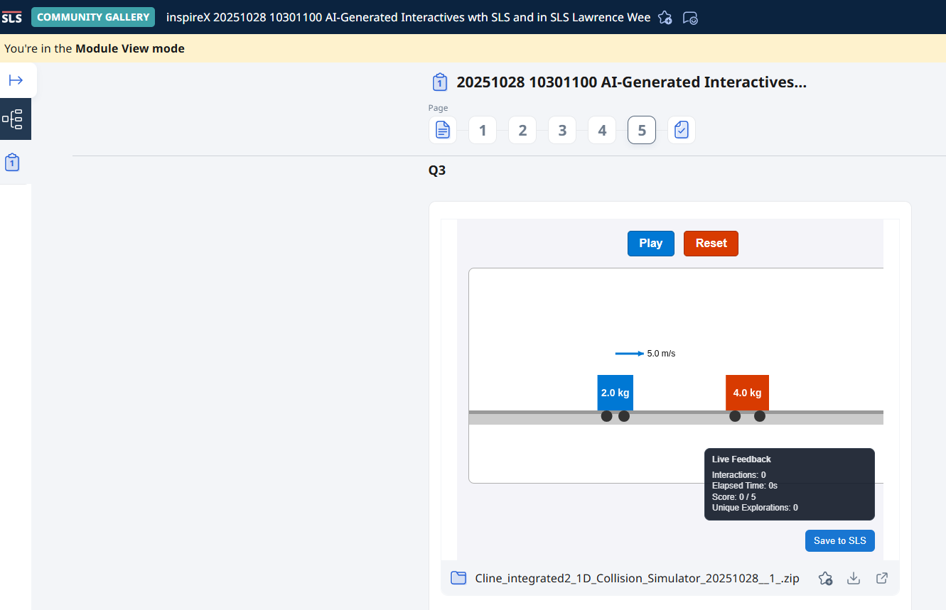
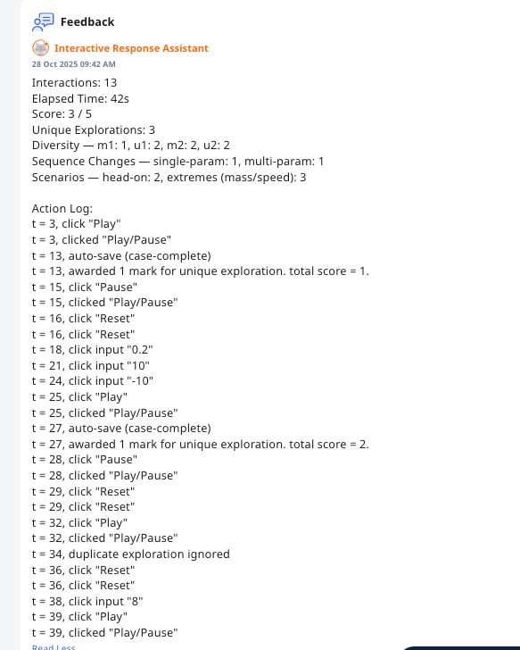
Community Gallery with downloadable for Scaling across MOE
Community Support
https://vle.learning.moe.edu.sg/community-gallery/module/view/fdc2969f-5349-4d7e-ac19-e8cc09a13803

Slide 22
Community of ACP Interactive builders
Community Support
The “Community” exists in SGLDC when users post with the hashtag #html.
Better prompts are catalogued here:
Explore Lawrence Wee’s open prompts
Check out Lawrence Wee’s open library of AI-generated HTML5
Additionally, you can access these useful resources:
8 pages of materials from AST-ETD workshop
7 pages of materials from the CRMW workshop conducted by ETD
Join the SLS PD community and share your knowledge!
Post your #HTML5 prompts and resources here:
Post to SLS PD Forum

Slide 23
#html open community
Community Support
Lawrence Wee (Physics) | Iwant2study.org
Mathew Lim (History) | HTML5 History
Seng Kwang Tan (Physics) | Physics Lens
Evan Liao Sheng Yang (Music) | Hongdou SG
Aaric Tan Xiang Yeow (Chemistry) | EdTechSims
Post on Facebook SGLDC with #html tag and your repository of interactive!

Slide 24
Annex: SLS Interactive Generator

Slide 25
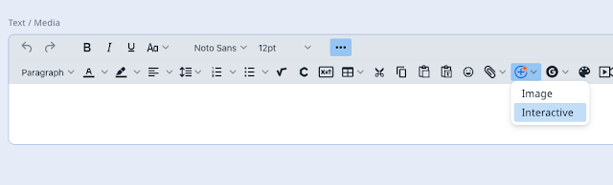
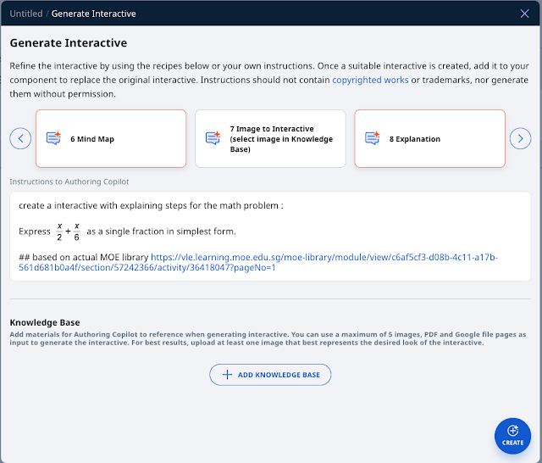
4. SLS Interactive Generator
In SLS
①
Interactives can be generated in SLS by Dec 2025 via Claude. YouTube is available
1. Generate interactive from the Text/Media + button ad select Interactive on the dropdown menu
2. Change the Instructions to ACP after selecting a suitable recipe
②

Slide 26
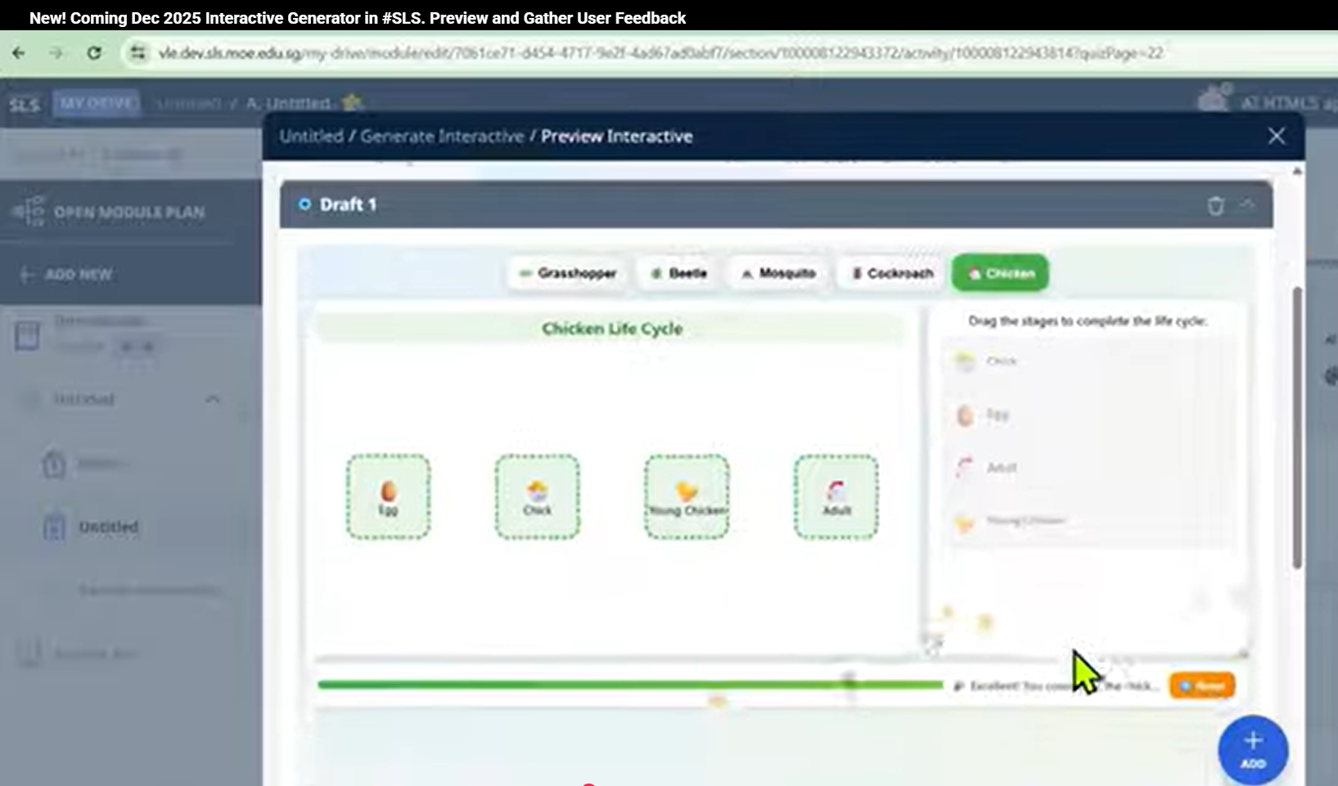
4. SLS Interactive Generator
In SLS
Generate Interactives directly within SLS using Claude by Dec 2025. YouTube is available for detailed steps.
3 If your interactive meets expectations, click ADD to insert it into SLS as media.
📝 Note:
Use the Refine option to further enhance or modify your interactive.
Alternatively, download the ZIP file to edit using external tools for advanced functionality.
③
Notes:
Interactives can be generated in SLS by Dec 2025 via Claude. YouTube is available
3. If the interactive is good enough, click ADD to insert to SLS as media.
Note: There is refine option to continue to enhance/modify the interactive. Else can consider downloading the zip interactive and use external tools for greater functionality.

