Slide 1
P2 Thinking Aloud Task: Volume

Slide 2
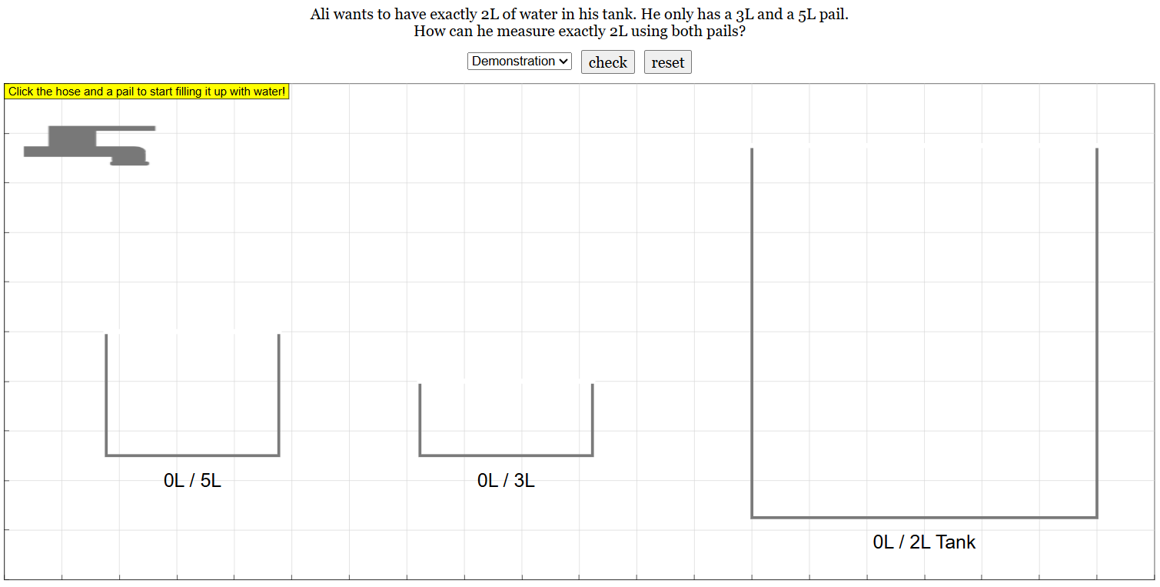
What is the Mini-Game about?
The Mini-Game presents tasks that you need to apply your learning of addition and subtraction through volume.
Notes:
parallel task of P2A textbook thinking aloud p.84

Slide 3
How to Play:
1. Read the question. Start with the Demonstration, then move on to the different Tasks
Question

Slide 4
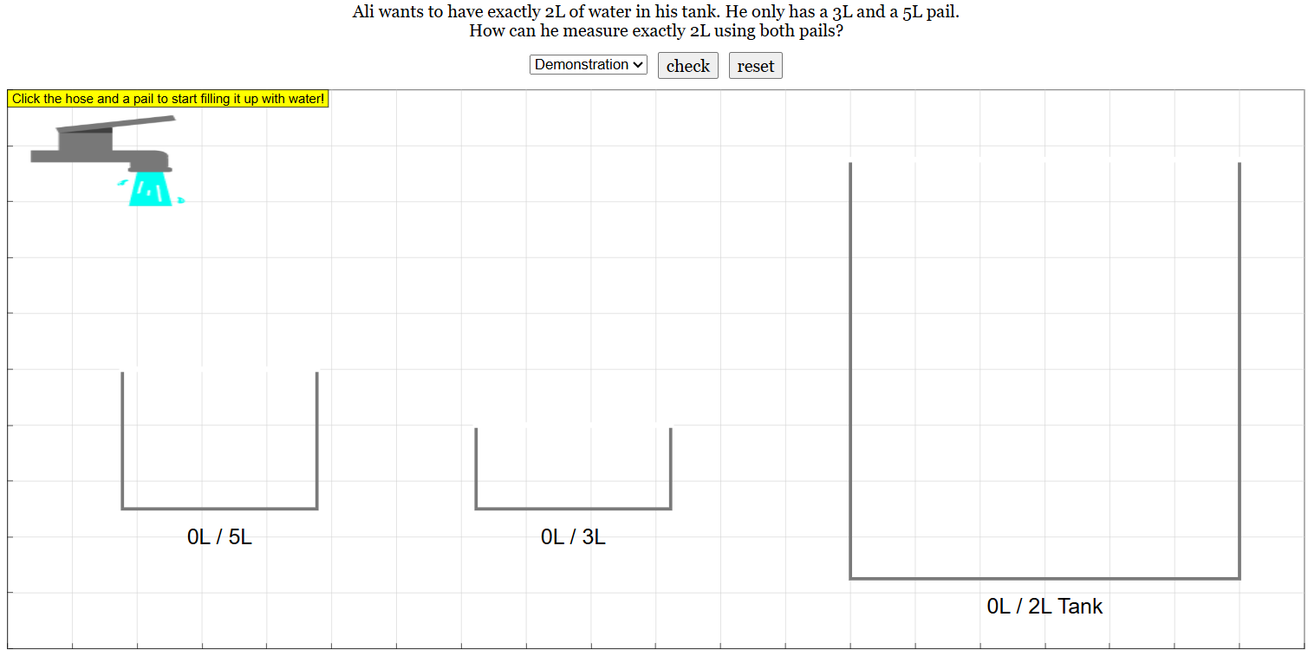
2. Click on the hose to get started
Click on
the hose

Slide 5
3. Click on a pail to fill it up with water
Click on one of the pail

Slide 6
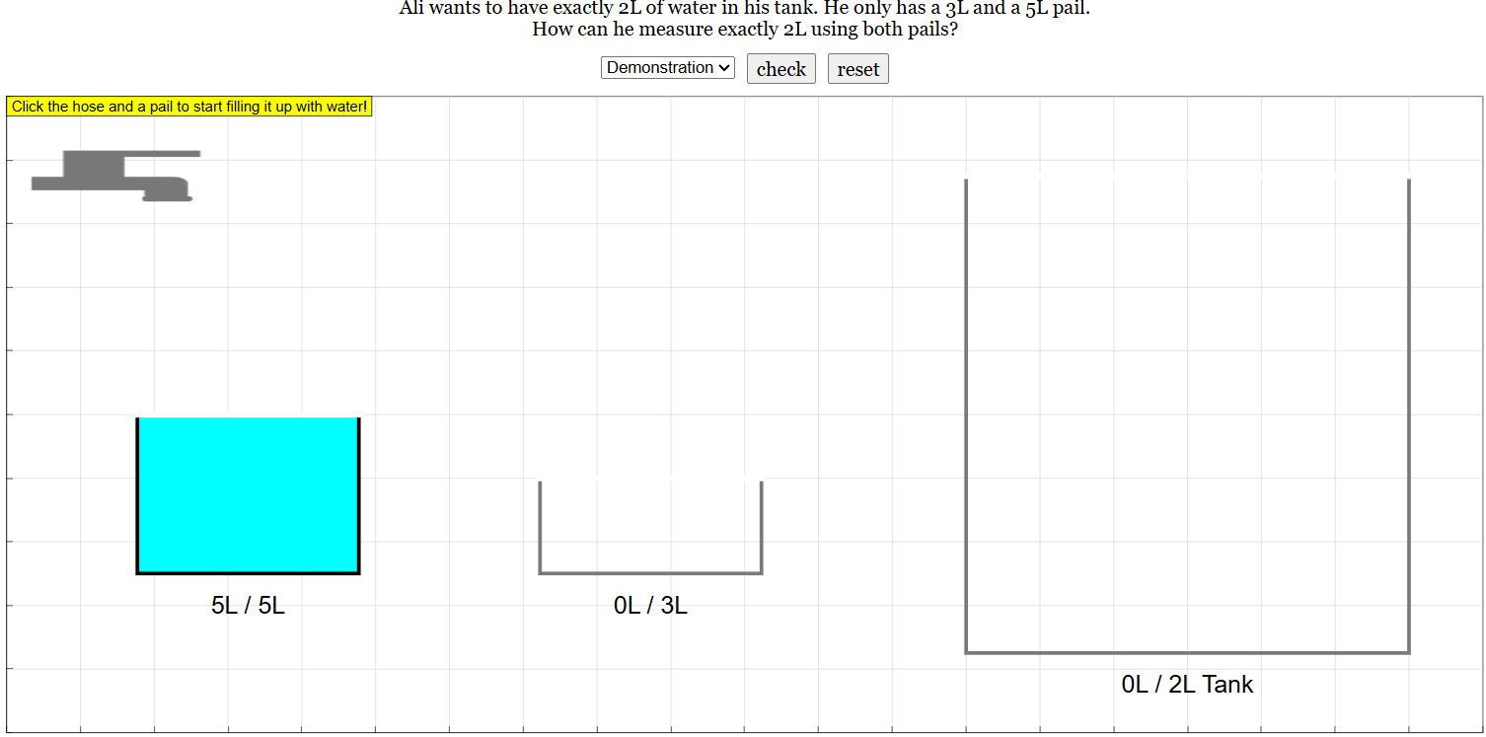
4. Click on two pails to transfer water
First click on this pail
Then click on the pail you want to transfer water to

Slide 7
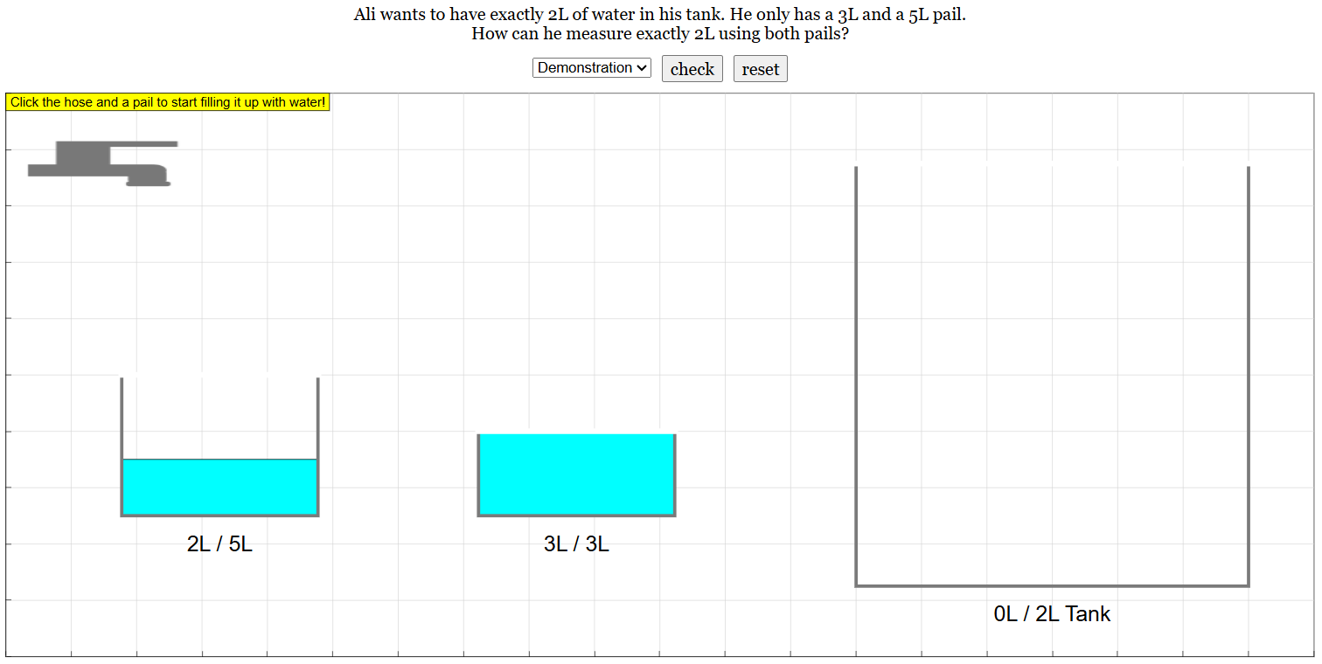
Case #1: Water Transferred Successfully

Slide 8
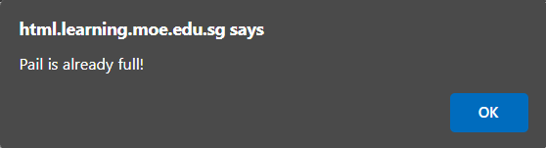
Case #2: Unsuccessful transfer - Pail is full

Slide 9
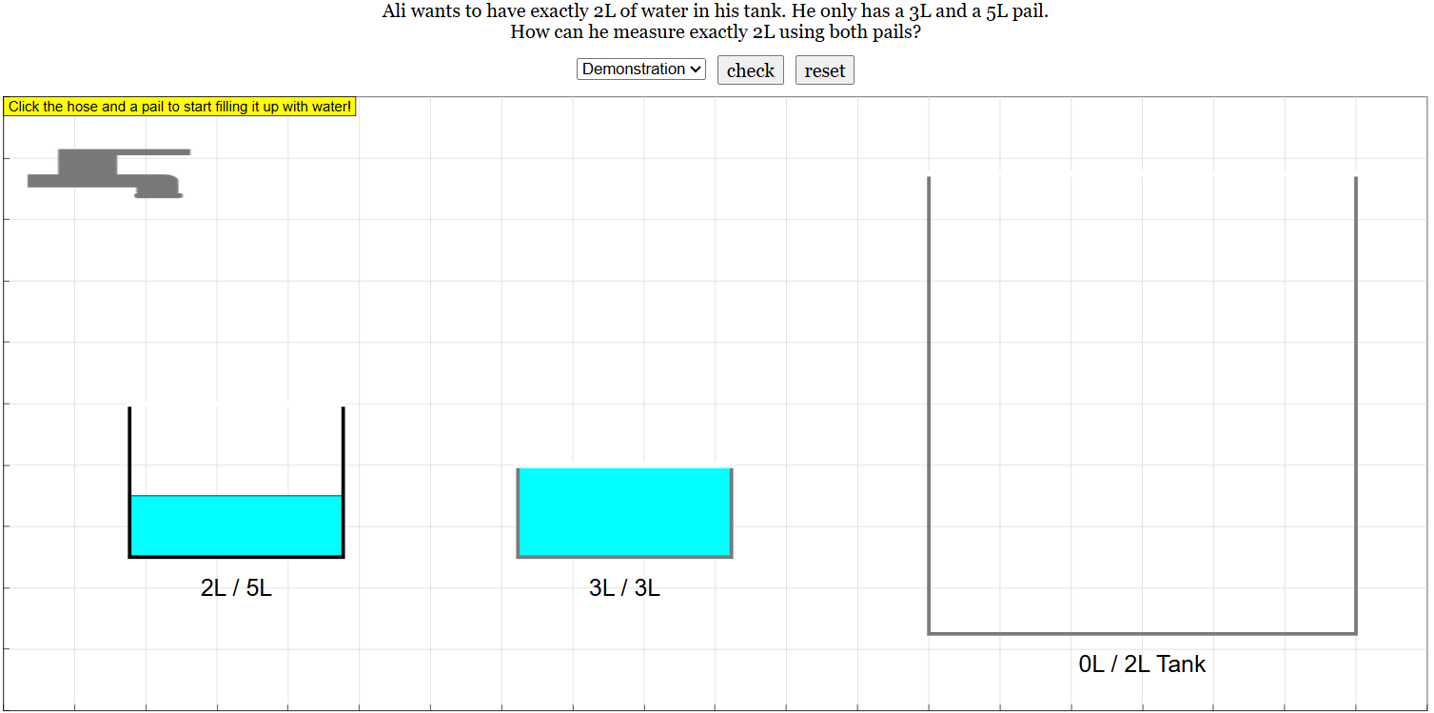
5. Click on a pail, then the tank to transfer water
First click on this pail
Then click on the tank to transfer water

Slide 10
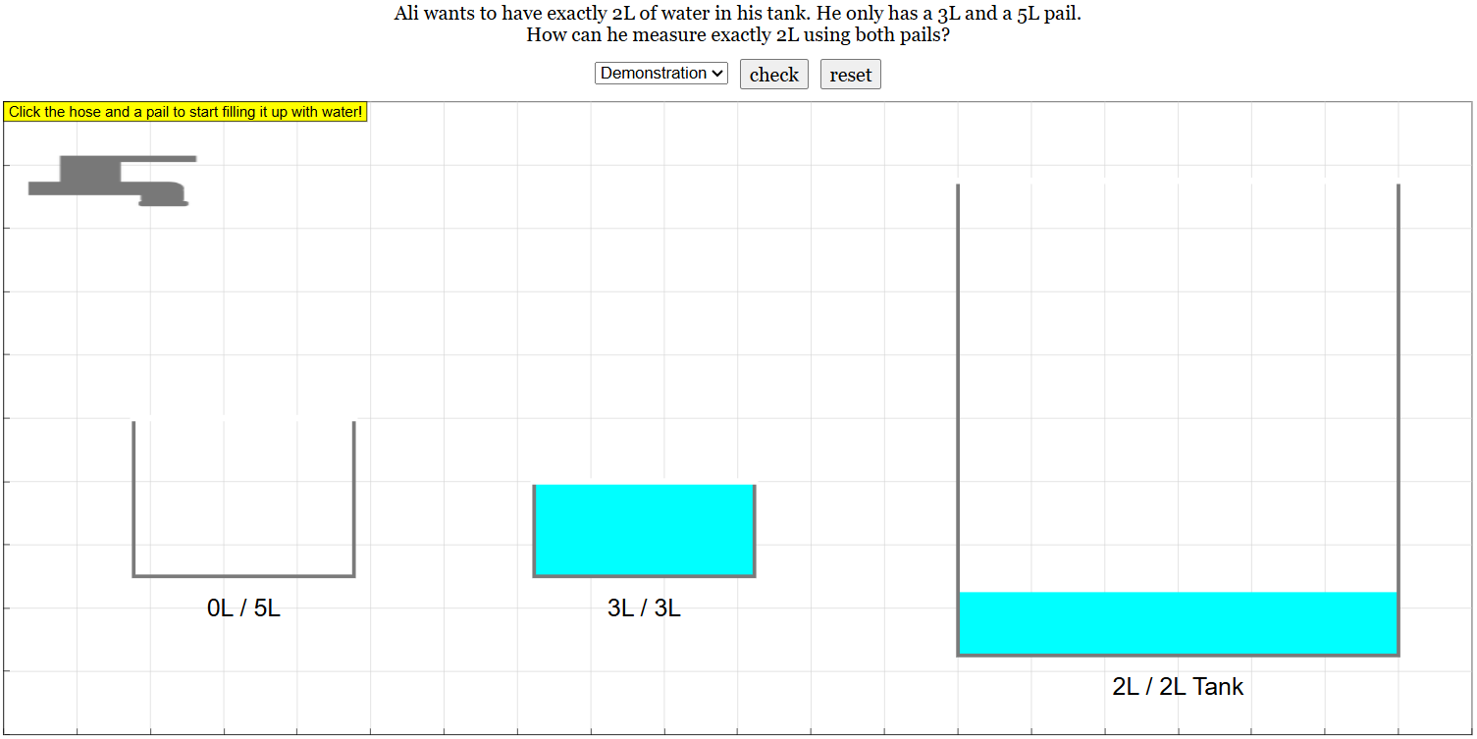
Water Transferred Successfully

Slide 11
6. Press the Check button once you're done

Slide 12
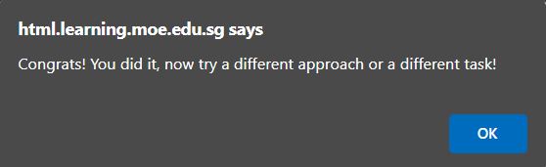
Case #1: Correct Answer

Slide 13
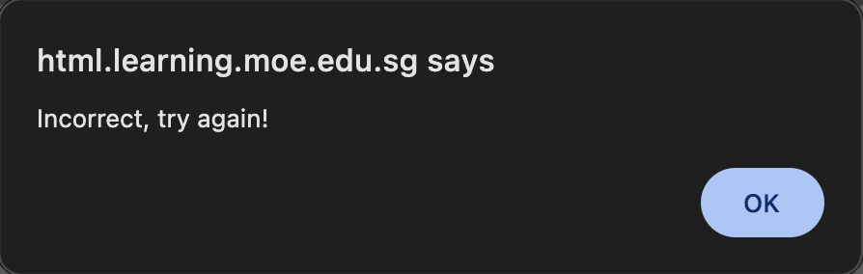
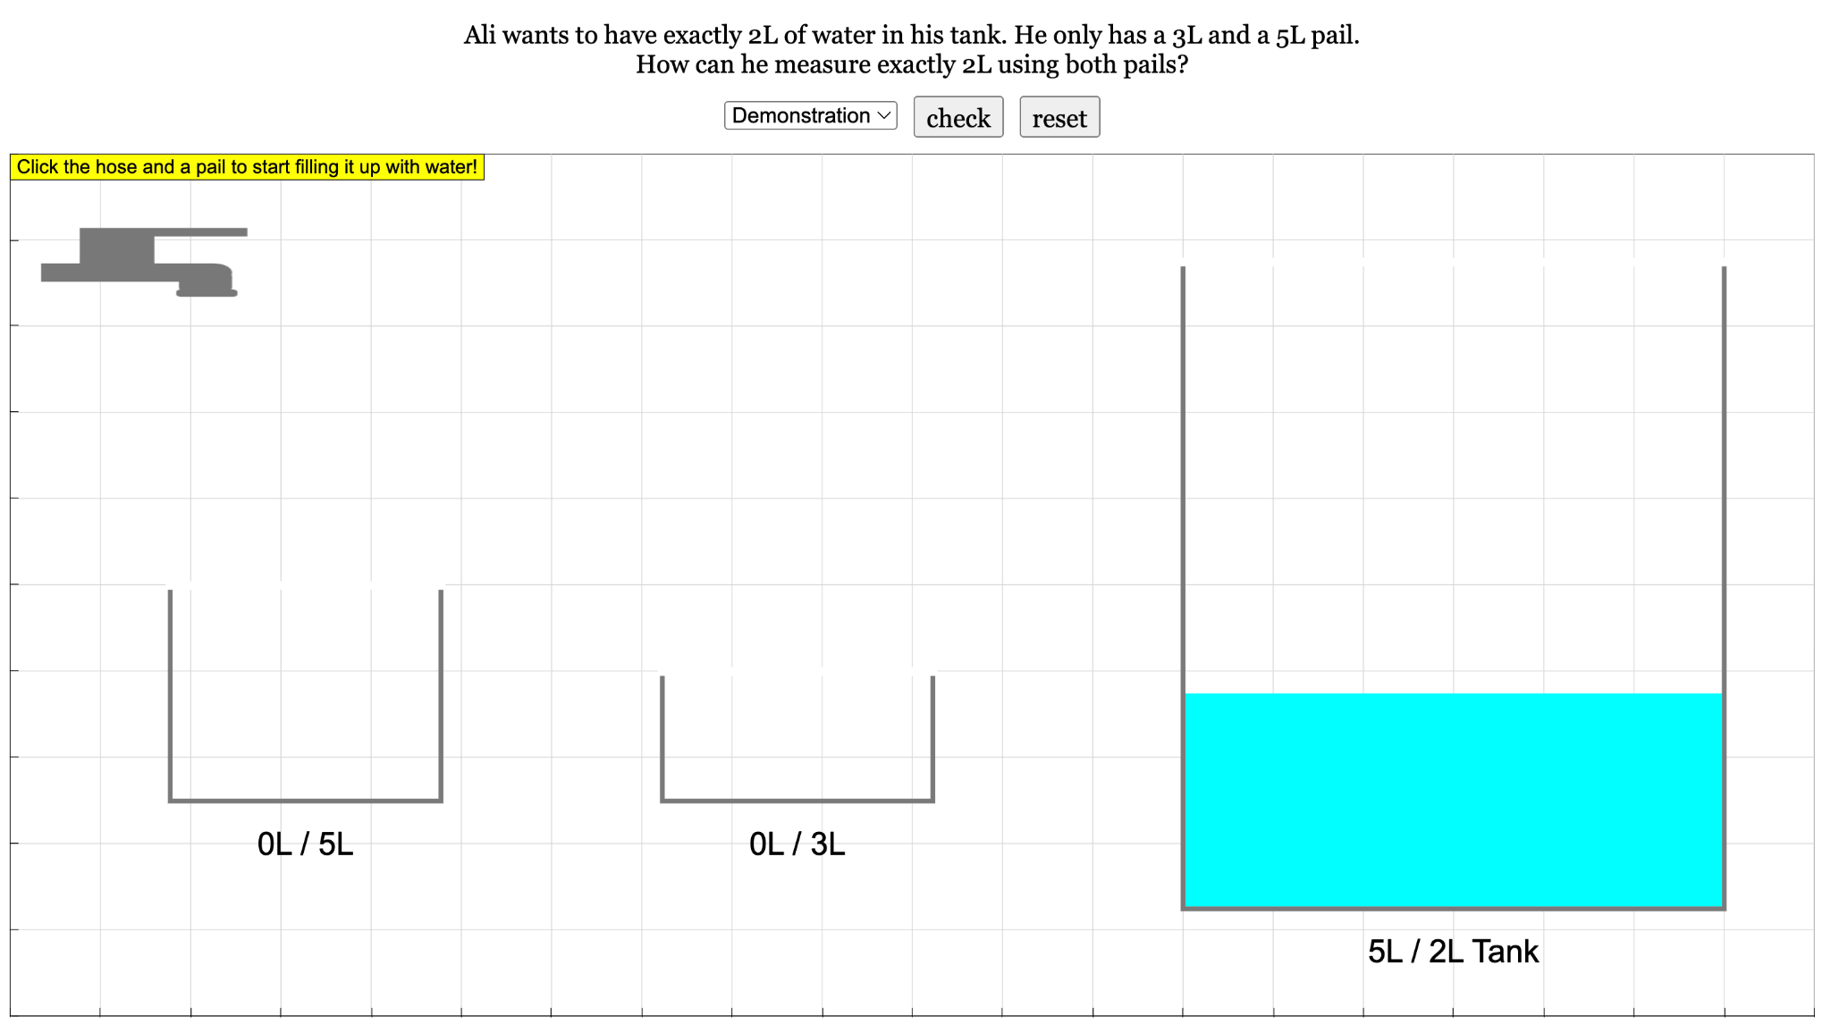
Case #2: Incorrect Answer

Slide 14
7. If you make a mistake, press the Reset button to try again

