Slide 1
The Knight’s Move
26 Apr 2021

Slide 2
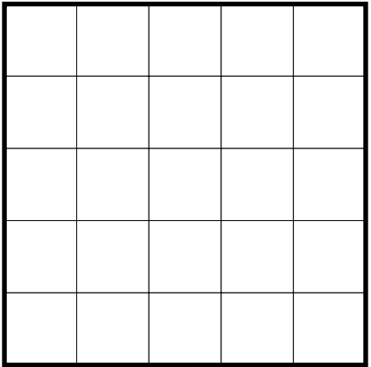

How the Knight Moves

Slide 3
How the Knight Moves

Slide 4
How the Knight Moves
5
22
17
12
7
16
11
6
21
18
23
4
19
8
13
10
15
2
25
20
3
24
9
14
1

Slide 5

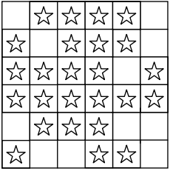
Jumping from Star to Star
17
8
14
9
3
16
7
18
10
13
15
11
4
2
21
6
19
12
5
20
1

Slide 6
Jumping from Star to Star

Slide 7
Jumping from Star to Star

Slide 8
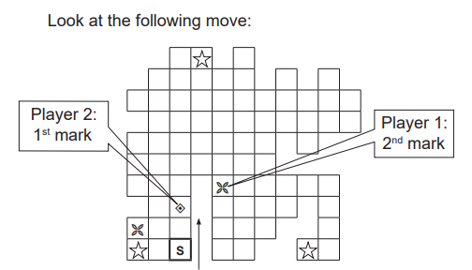

Slide 9
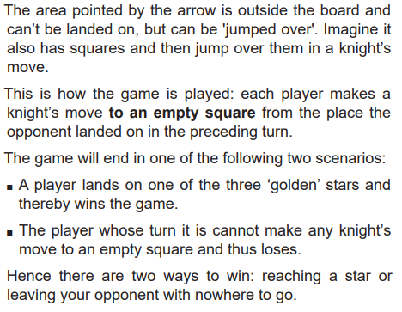

Slide 10
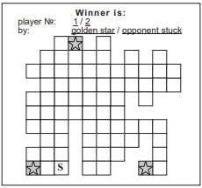
How the Knight Moves

Slide 11
How the Knight Moves

Slide 12
How the Knight Moves

Slide 13


Thank You
Notes:
13

