Slide 1
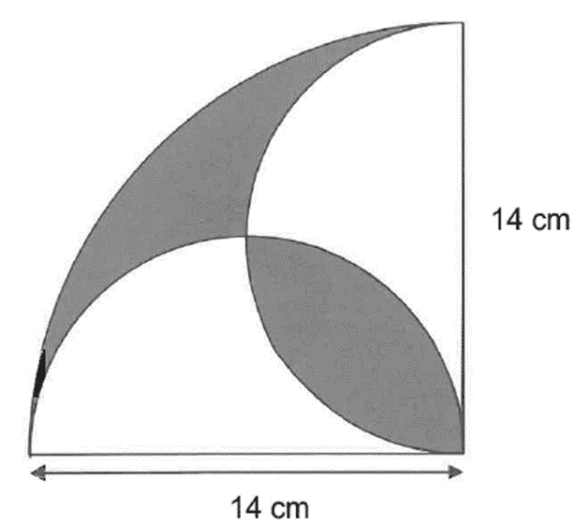
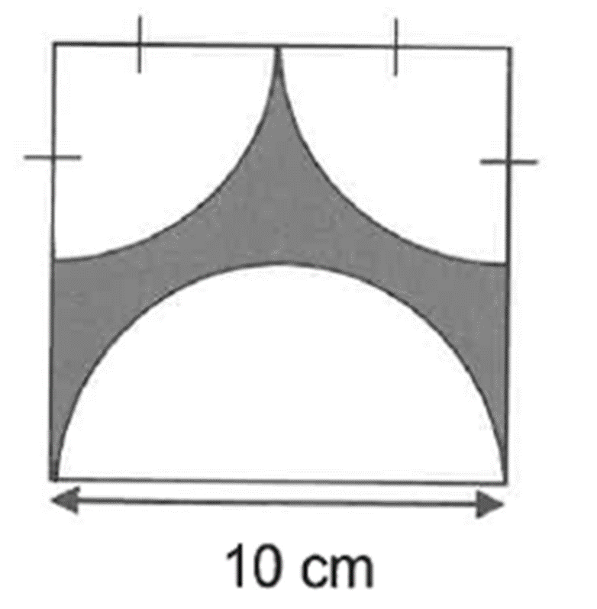
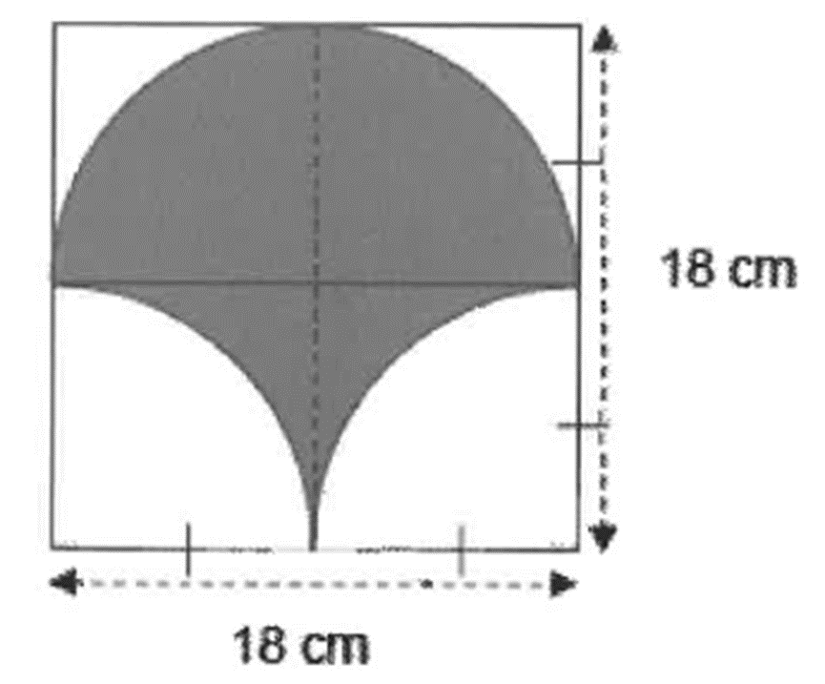
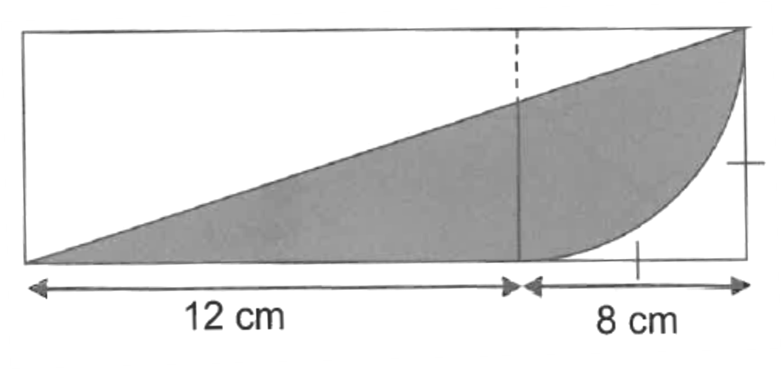
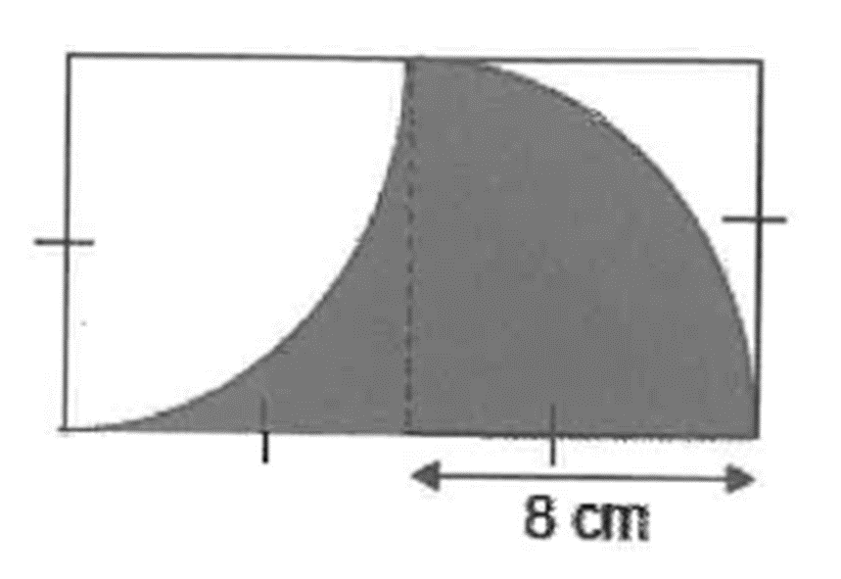
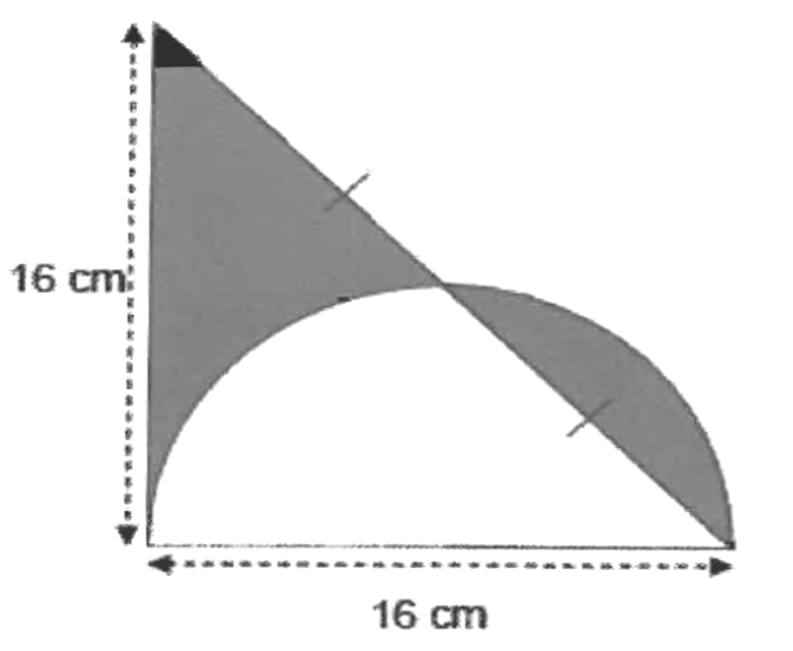
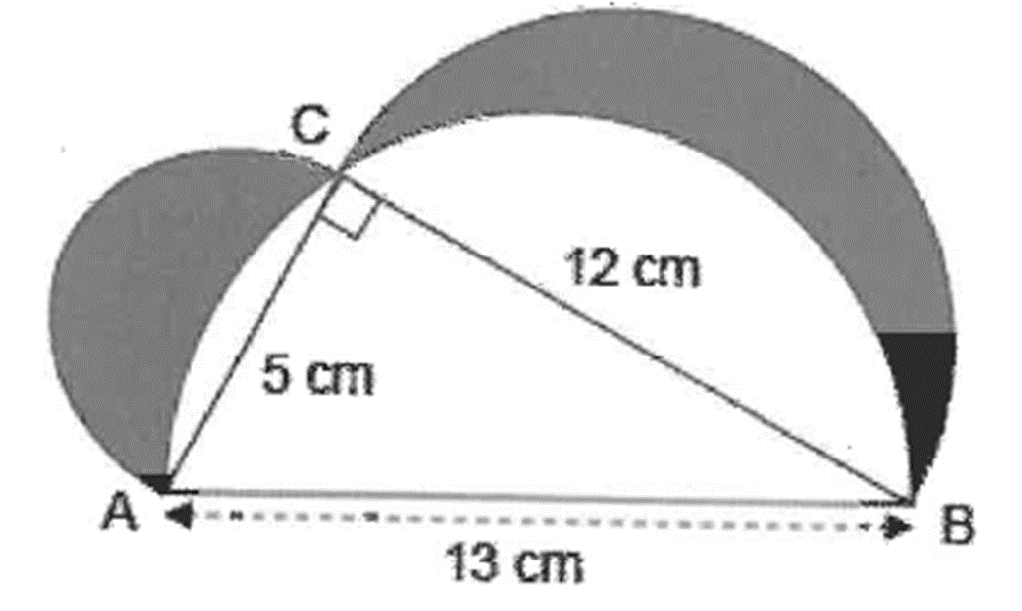
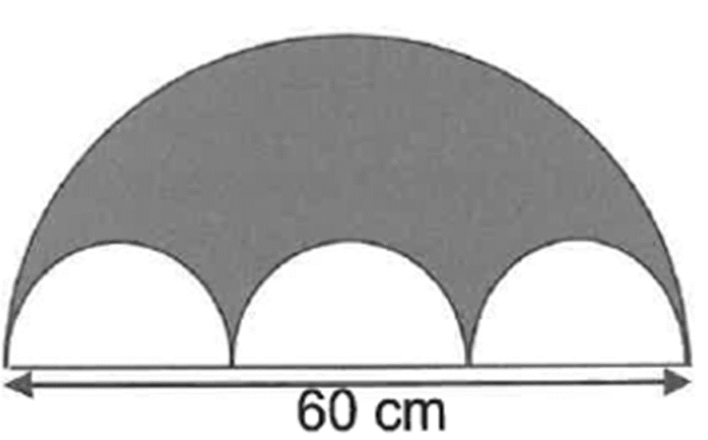
Circles PLUS

Slide 2

The figure is made up of 3 semicircles and a right-angled triangle. Find the area of the shaded part, rounding off your answer to the nearest whole number.

Slide 3
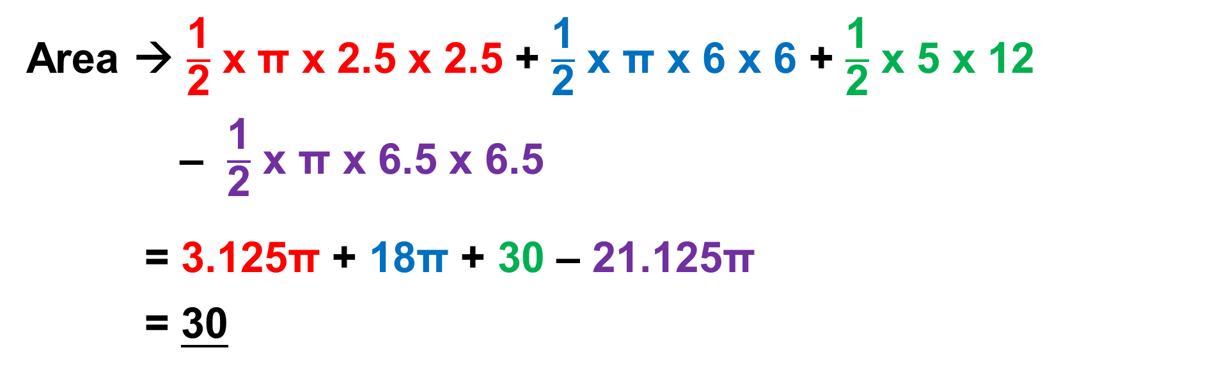
Strategy : Small semi circle + Medium semi circle + triangle
– Big semi circle
Area → $\frac{\text{1}}{\text{2}}$ x π x 2.5 x 2.5 + $\frac{\text{1}}{\text{2}}$ x π x 6 x 6 + $\frac{\text{1}}{\text{2}}$ x 5 x 12
– $\frac{\text{1}}{\text{2}}$ x π x 6.5 x 6.5
= 3.125π + 18π + 30 – 21.125π
= 30

Slide 4
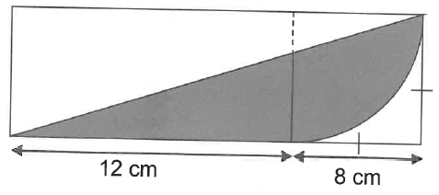
The figure is made up of a rectangle, a square and a quadrant. Find the area of the shaded part, rounding off your answer to the nearest whole number.

Slide 5
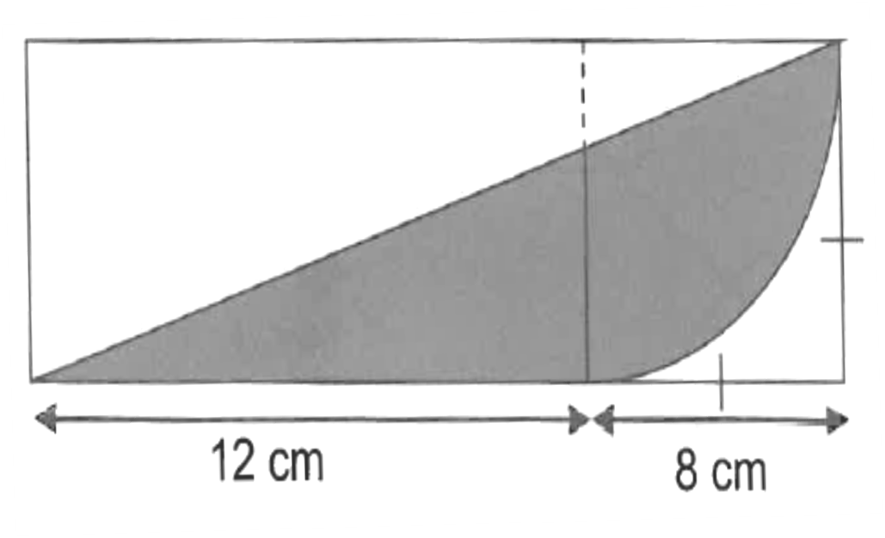
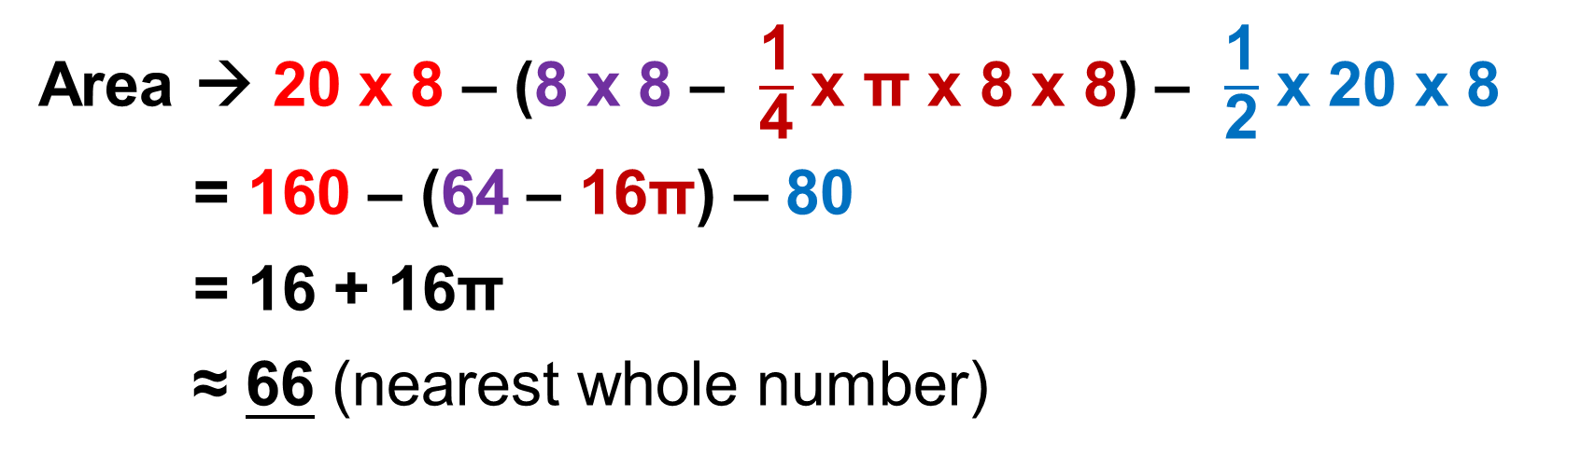
Strategy : Rectangle – corner (square – quad) – triangle
Area → 20 x 8 – (8 x 8 – $\frac{\text{1}}{\text{4}}$ x π x 8 x 8) – $\frac{\text{1}}{\text{2}}$ x 20 x 8
= 160 – (64 – 16π) – 80
= 16 + 16π
≈ 66 (nearest whole number)

Slide 6

The figure shows a shaded part bounded by 2 quadrants. Calculate the area and perimeter of the shaded part, rounding off your answer to the nearest whole number.

Slide 7
Strategy :
Area → 1 Square (cut & paste)
Area → 8 x 8
= 64

Slide 8
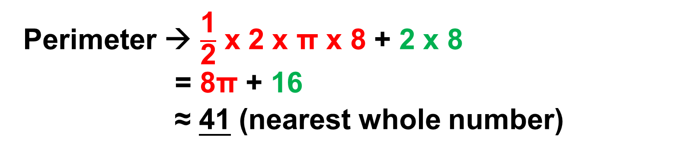
Strategy :
Perimeter → Semi circle + 2 radii (rotation quad)
Perimeter → $\frac{\text{1}}{\text{2}}$ x 2 x π x 8 + 2 x 8
= 8π + 16
≈ 41 (nearest whole number)

Slide 9
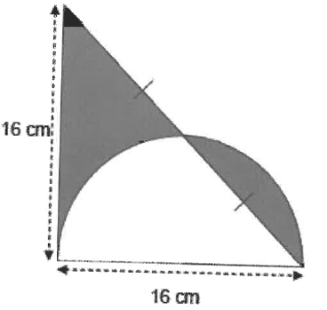
The figure is made up of a semi-circle and an isosceles triangle of side 16 cm. Find the total area of the shaded parts, rounding off your answer to the nearest whole number.

Slide 10
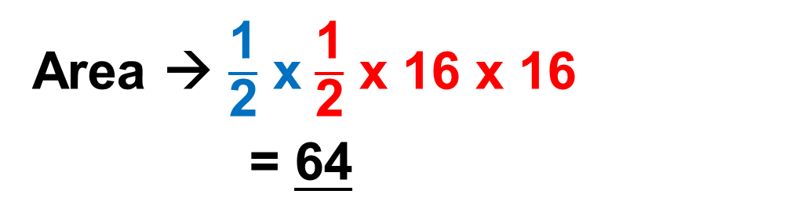
Strategy : half triangle (cut & paste)
Area → $\frac{\text{1}}{\text{2}}$ x $\frac{\text{1}}{\text{2}}$ x 16 x 16
= 64

Slide 11
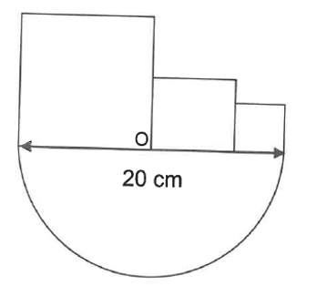
The figure shows 3 different squares and a semicircle with centre O. If the diameter of the semicircle is 20 cm, find the perimeter of the figure, rounding off your answer to the nearest whole number

Slide 12
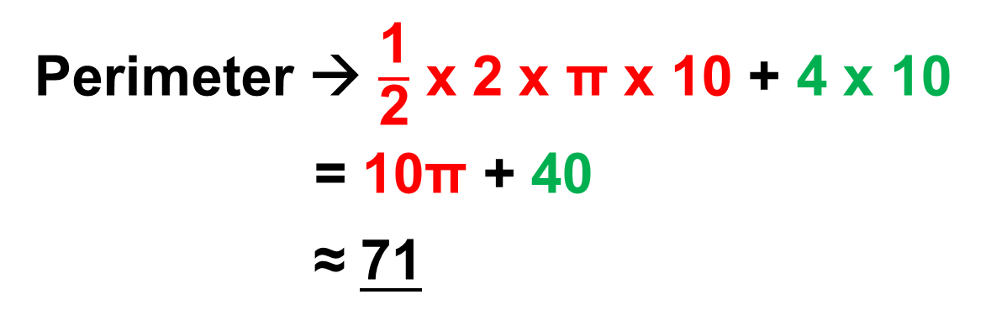
Strategy : Semi circle + 4 radii (pop out)
Perimeter → $\frac{\text{1}}{\text{2}}$ x 2 x π x 10 + 4 x 10
= 10π + 40
≈ 71

Slide 13

Find the area of the shaded part rounding your answer to the nearest whole number.

Slide 14
Strategy : 1 rectangle (cut & paste)
Area → 18 x 9
= 162

Slide 15

The figure below is formed by using a big semicircle and 3 small semi-circles with radii of 30 cm and 10 cm respectively. Find the perimeter and area of the shaded part. Round off your answers to the nearest whole number.

Slide 16
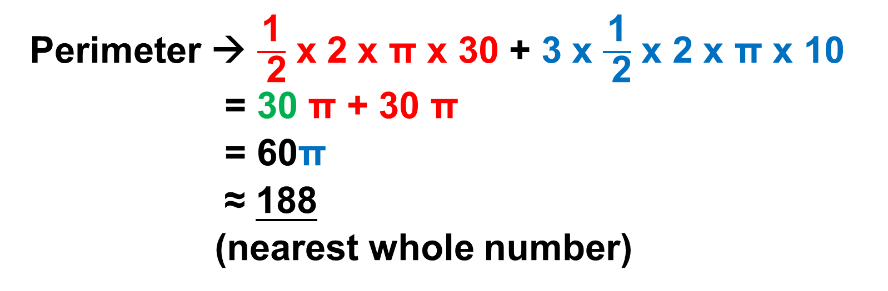
Strategy :
Perimeter → Big Semi circle + 3 Small Semi circles
Perimeter → $\frac{\text{1}}{ \text{2}}$ x 2 x π x 30 + 3 x $\frac{\text{1}}{ \text{2}}$ x 2 x π x 10
= 30 π + 30 π
= 60π
≈ 188
(nearest whole number)

Slide 17

Strategy :
Area → Big Semi circle – 3 Small Semi circles
Area → $\frac{\text{1}}{\text{2}}$ x π x 30 x 30 – 3 x $\frac{\text{1}}{\text{2}}$ x π x 10 x 10
= 450 π – 150 π
= 300 π
≈ 942
(nearest whole number)

Slide 18

Find the perimeter and area of the shaded part, rounding your answers to the nearest whole number.

Slide 19
Strategy :
Perimeter → Big Circle + 2 radii
Perimeter → 2 x π x 5 + 2 x 5
= 10 π + 10
≈ 41
(nearest whole number)

Slide 20
Strategy :
Area → Square – Circle (cut & paste)
Area → 10 x 10 – π x 5 x 5
= 100 – 25 π
≈ 21
(nearest whole number)

Slide 21

Find the perimeter and area of the shaded part..

Slide 22
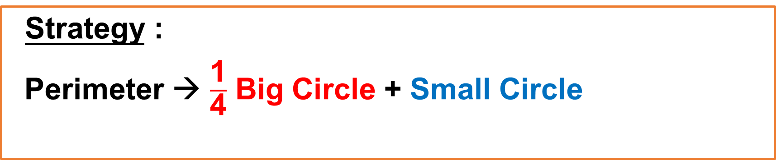
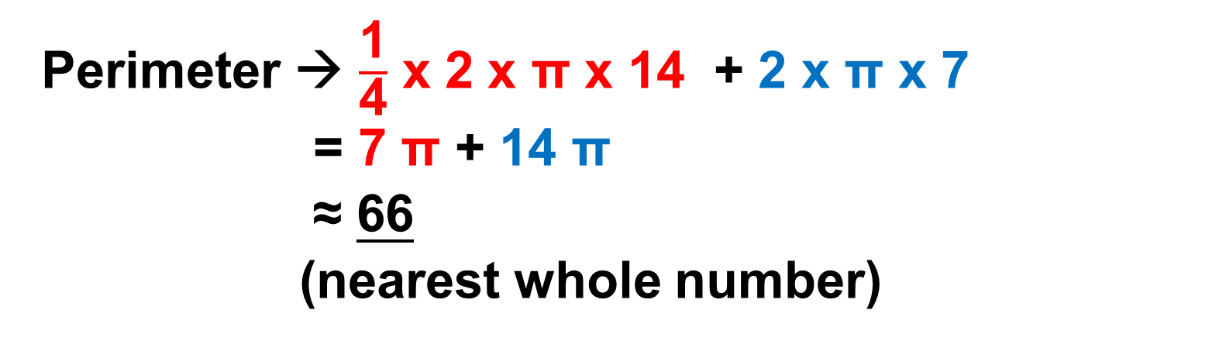
Strategy :
Perimeter → $\frac{\text{1}}{\text{4}}$ Big Circle + Small Circle
Perimeter → $\frac{\text{1}}{\text{4}}$ x 2 x π x 14 + 2 x π x 7
= 7 π + 14 π
≈ 66
(nearest whole number)

Slide 23

Strategy :
Area → Quarter Circle – Triangle
Area → $\frac{\text{1}}{ \text{4}}$ x π 14 x 14 – $\frac{\text{1}}{ \text{2}}$ x 14 x 14
= 49 π – 98
≈ 56
(nearest whole number)

Slide 24
The End

