Slide 1
Cube Nets Minigame Guide

Slide 2
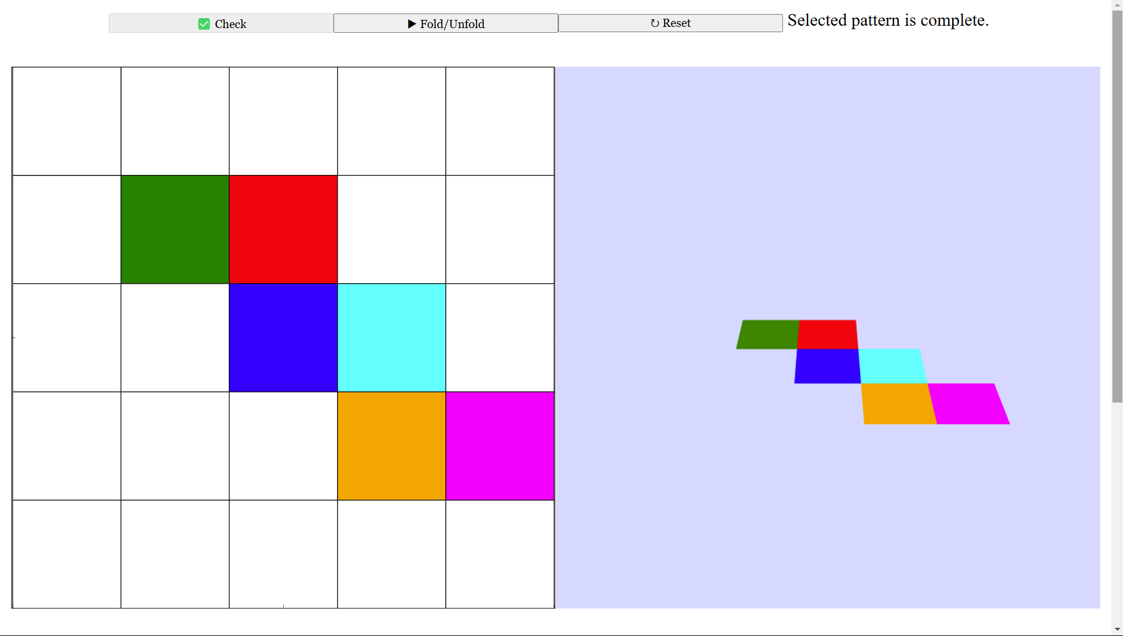
What is the Cube Nets Minigame?
A fun way to learn about the nets of a cube.
Highlight the squares on a 5x5 grid to form a net of a cube.
Check if the net can fold into a cube using a 3D animation.
Experiment with different net patterns of a cube!

Slide 3
How to Play
Click on the grids to highlight them and create a net.
Click the ✅ Check button to see if the net is:
Complete (valid net).
Incomplete (missing sides).
Invalid (cannot form a cube).
View the 3D animation to see the cube unfold into the selected net. Click the ▶ Fold/Unfold button to fold or unfold the 3D cube.
Click the ↻ Reset button to clear the grid and try a new net.

Slide 4
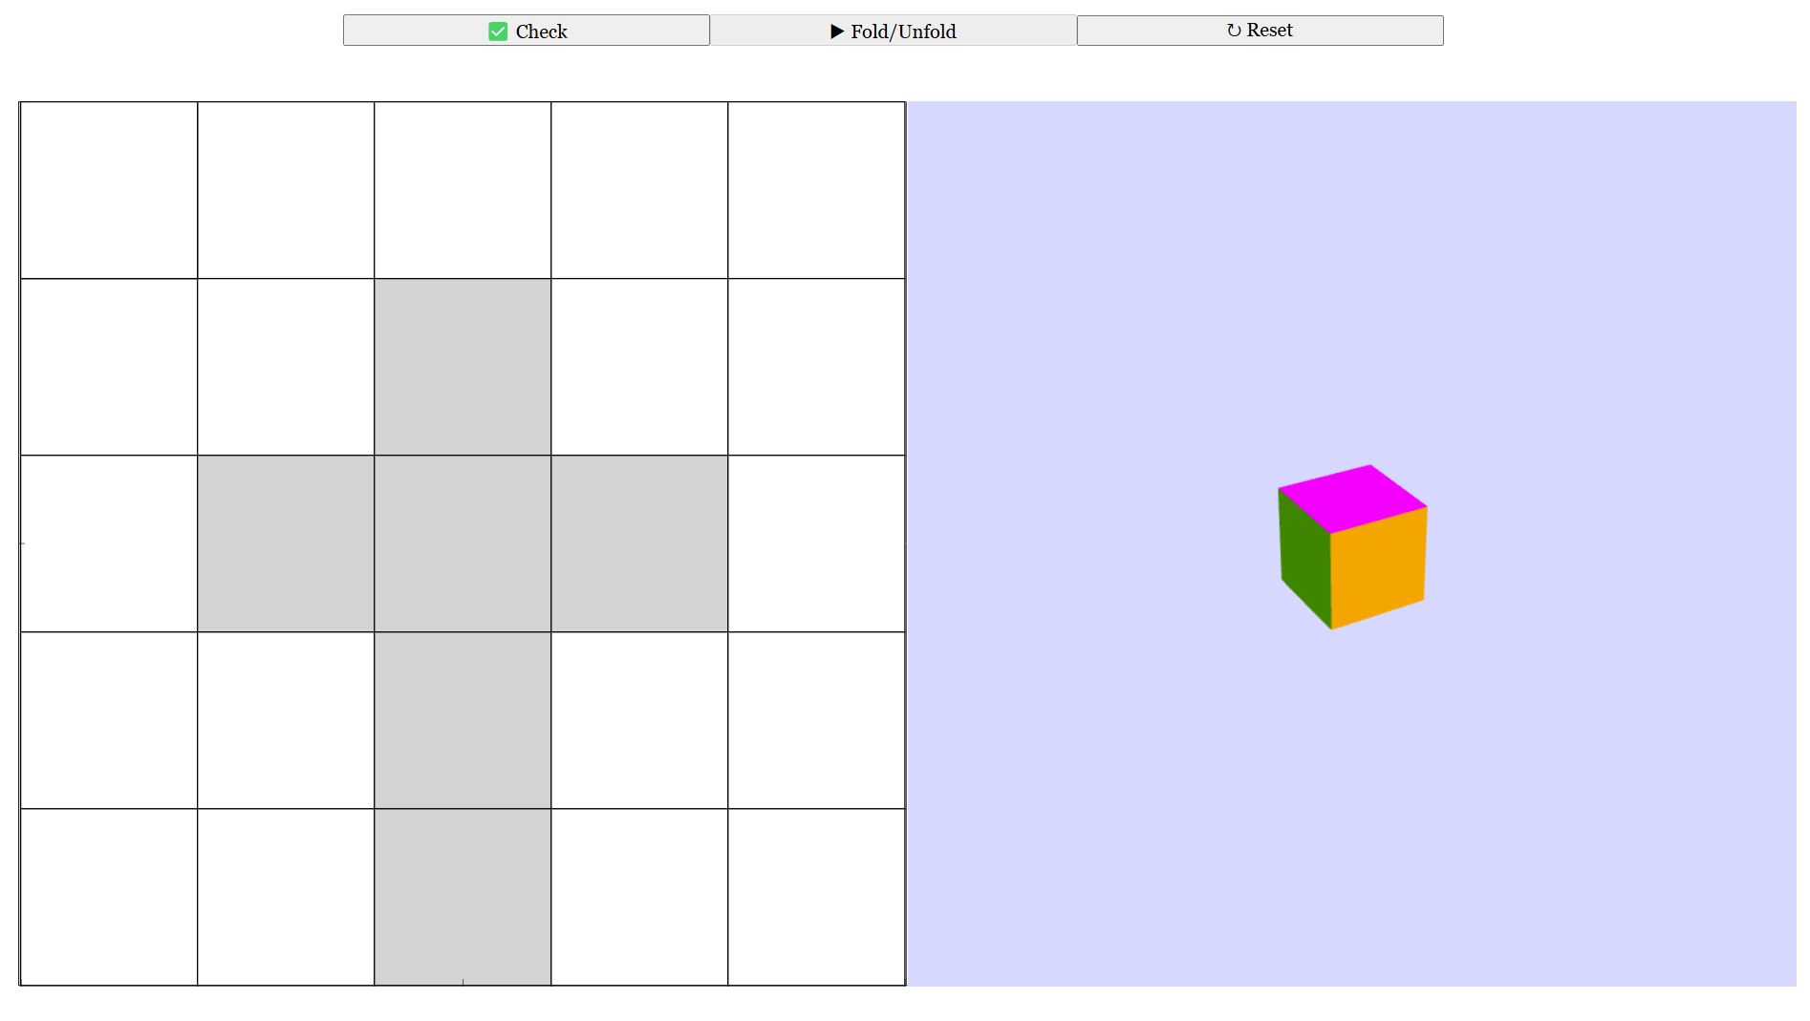
1. Click on the grids to highlight them and create your pattern.

Slide 5
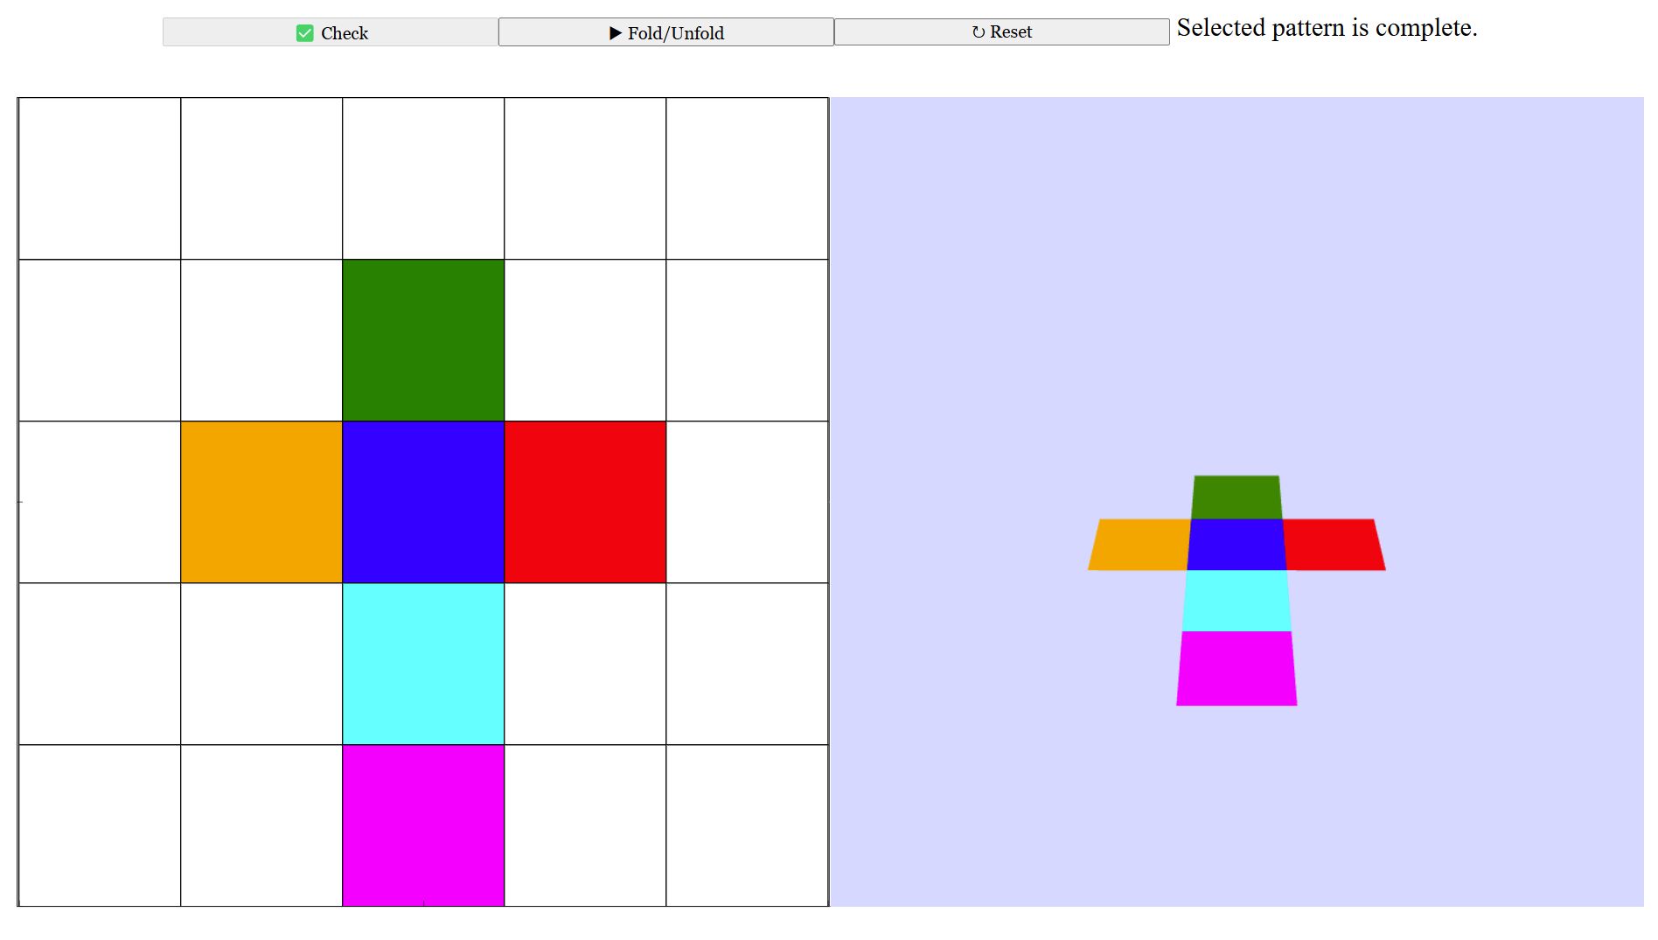
2. Click the ✅ Check button to see if your pattern is complete, incomplete or invalid.

Slide 6
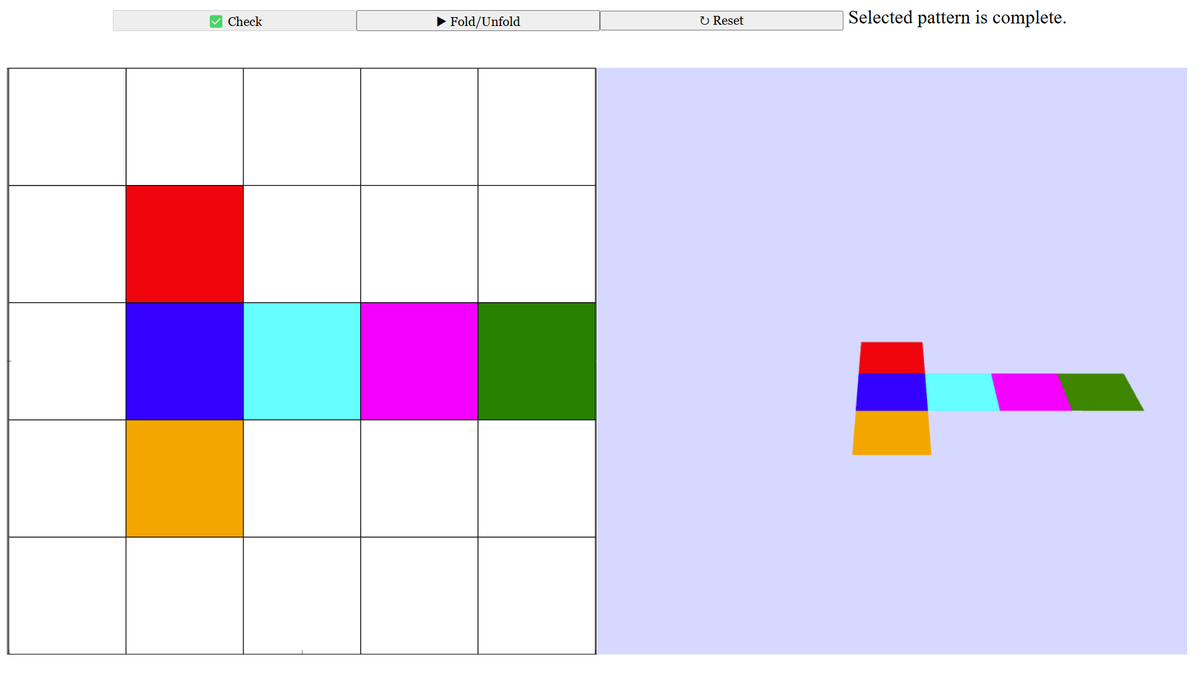
Case #1: Complete (valid net)

Slide 7
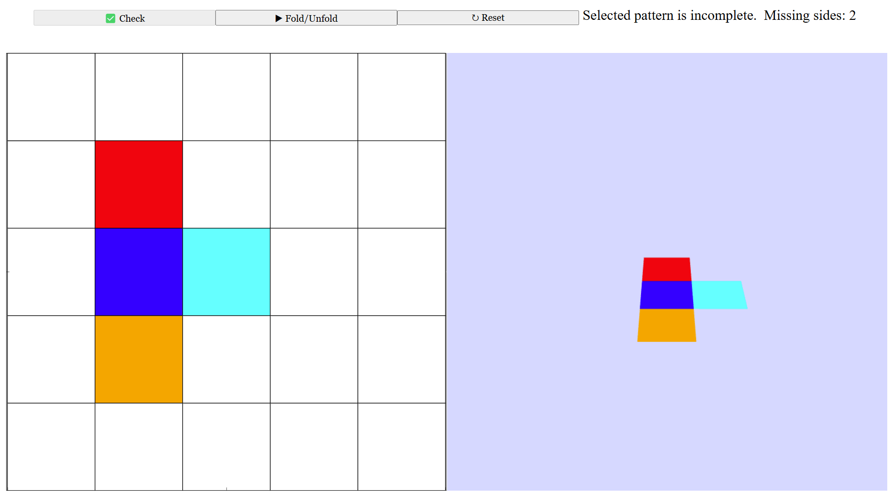
Case #2: Incomplete (missing sides)

Slide 8
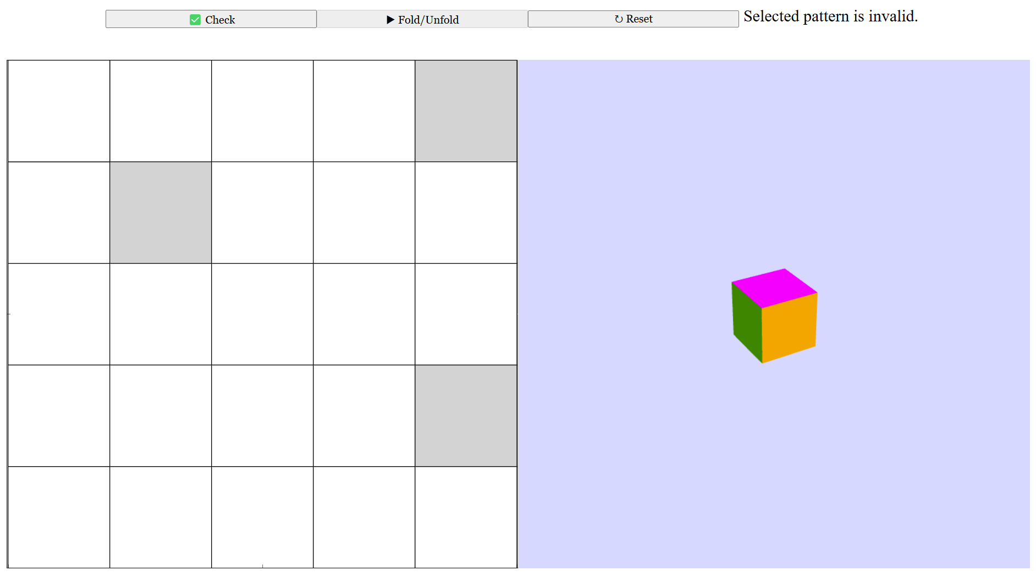
Case #3: Invalid (cannot form a cube)

Slide 9
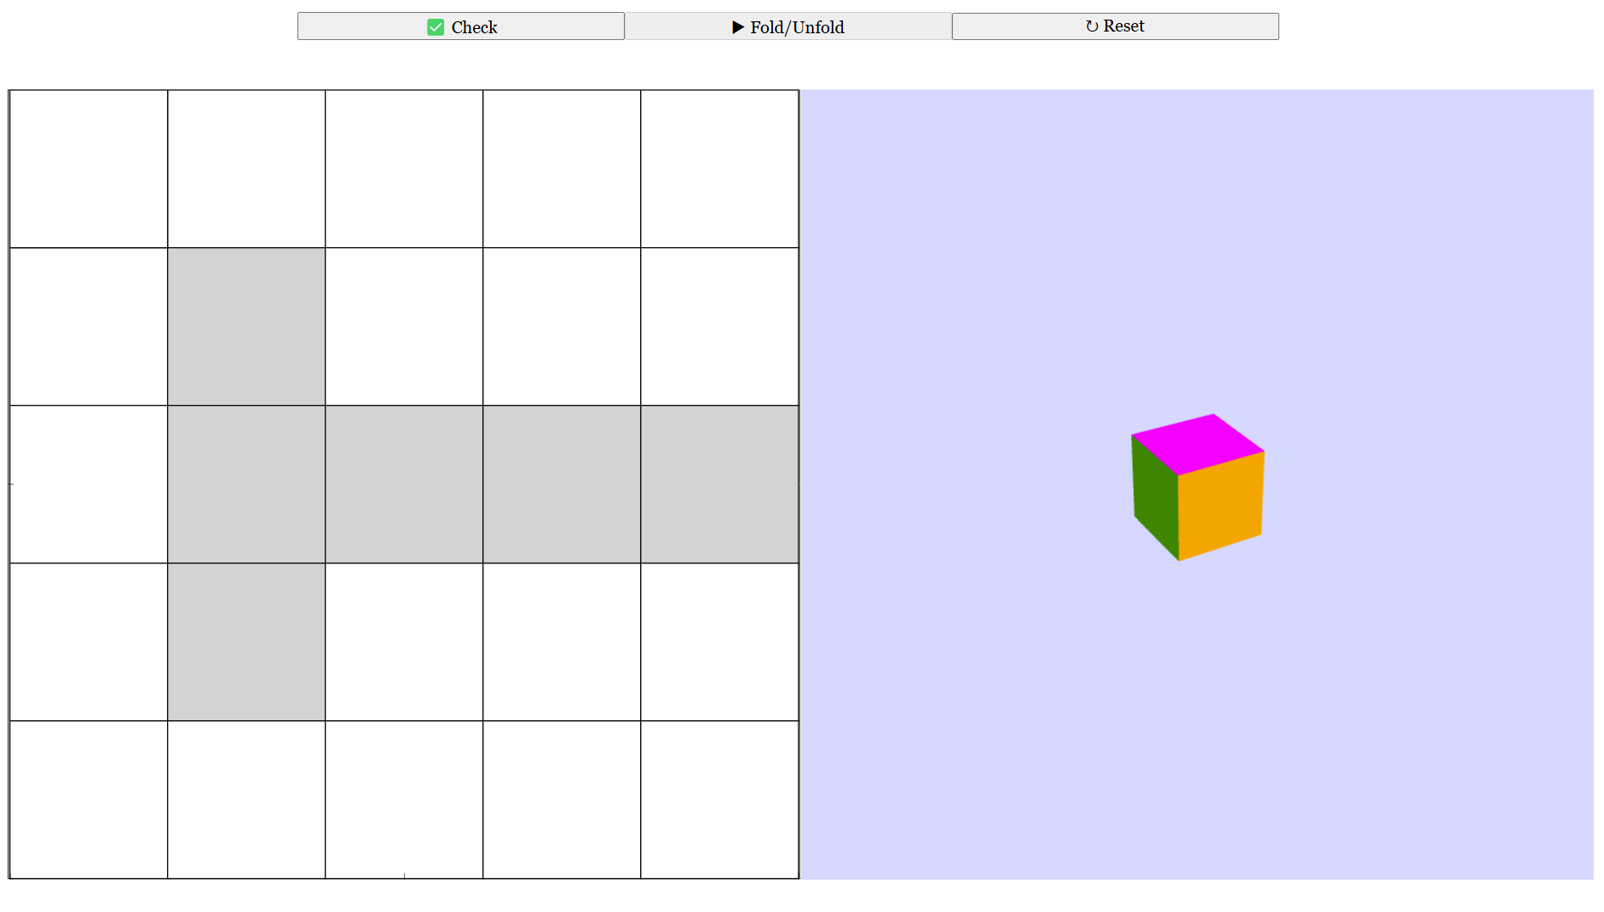
3. Click the ▶ Fold/Unfold button to fold or unfold the 3D cube.

Slide 10
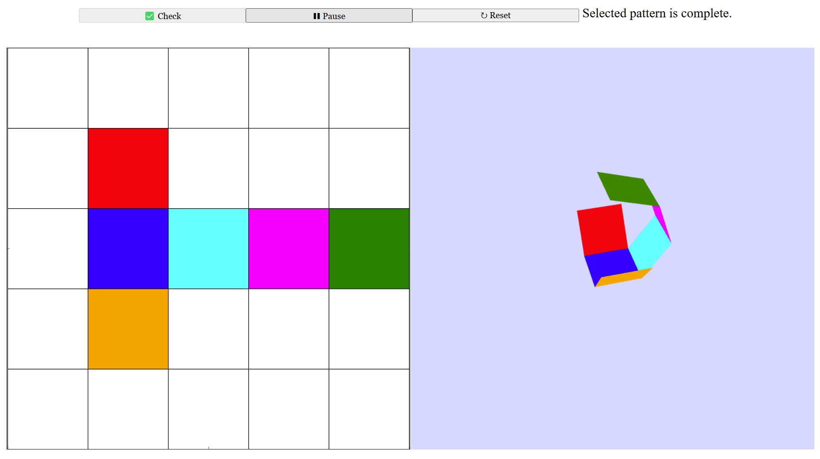
3. Click the ▶ Fold/Unfold button to fold or unfold the 3D cube.

Slide 11
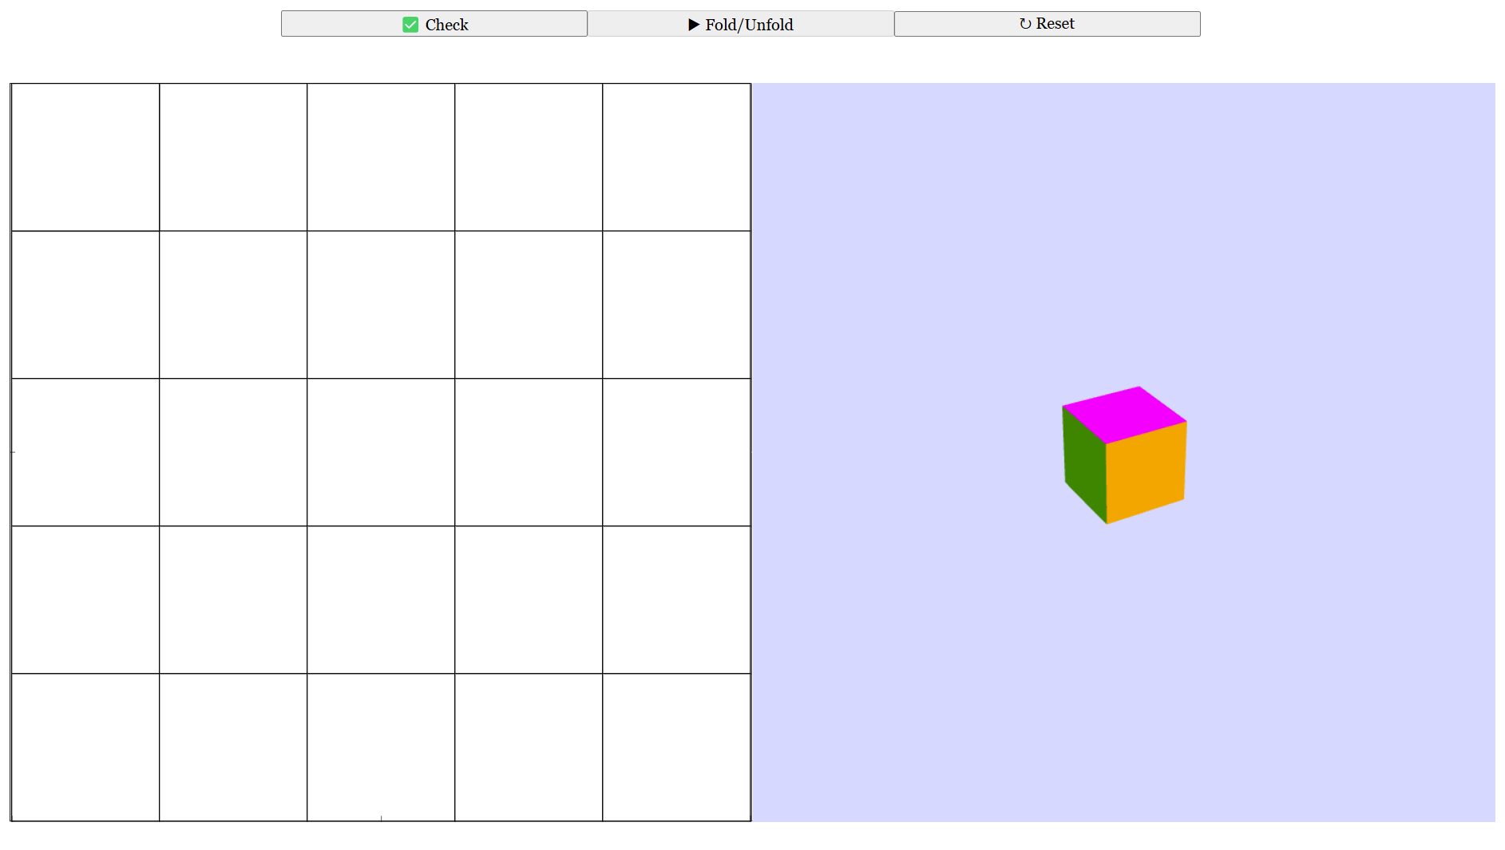
4. Click the ↻ Reset button to clear the grid and try a new pattern.

