Slide 1
Travel Shortest Distance Mini-Game

Slide 2
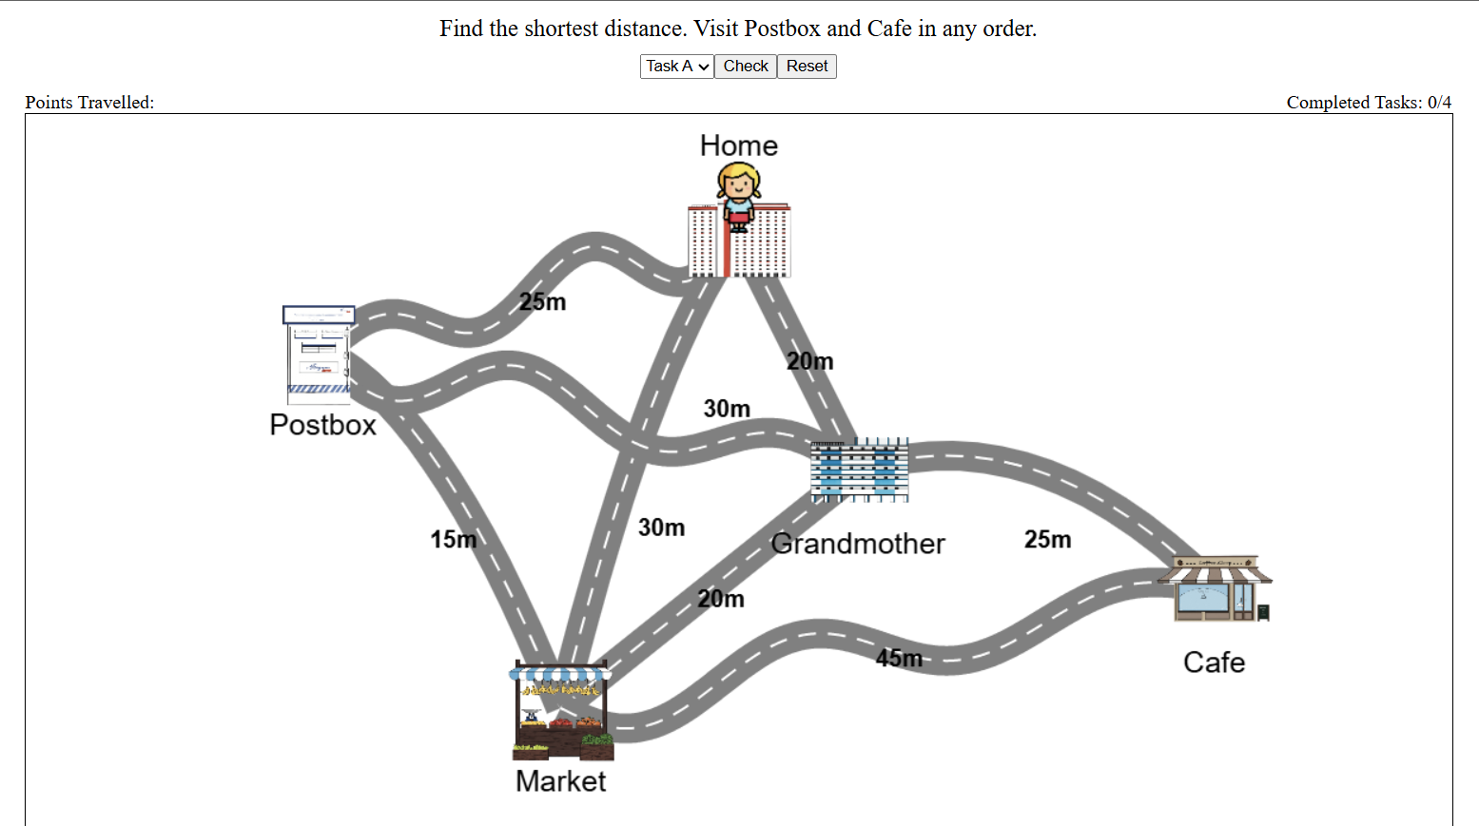
What is the Travelling Shortest Distance Mini-Game?
The Mini-Game helps you learn Length by adding and subtracting to find the travelled distance

Slide 3
How to Play
Choose a task and read the question.
Double click on a location to move.
Press the Check button to see if it’s correct.
If you make a mistake, press the Reset button to try again.
Then move on to Task B, C and lastly D.

Slide 4
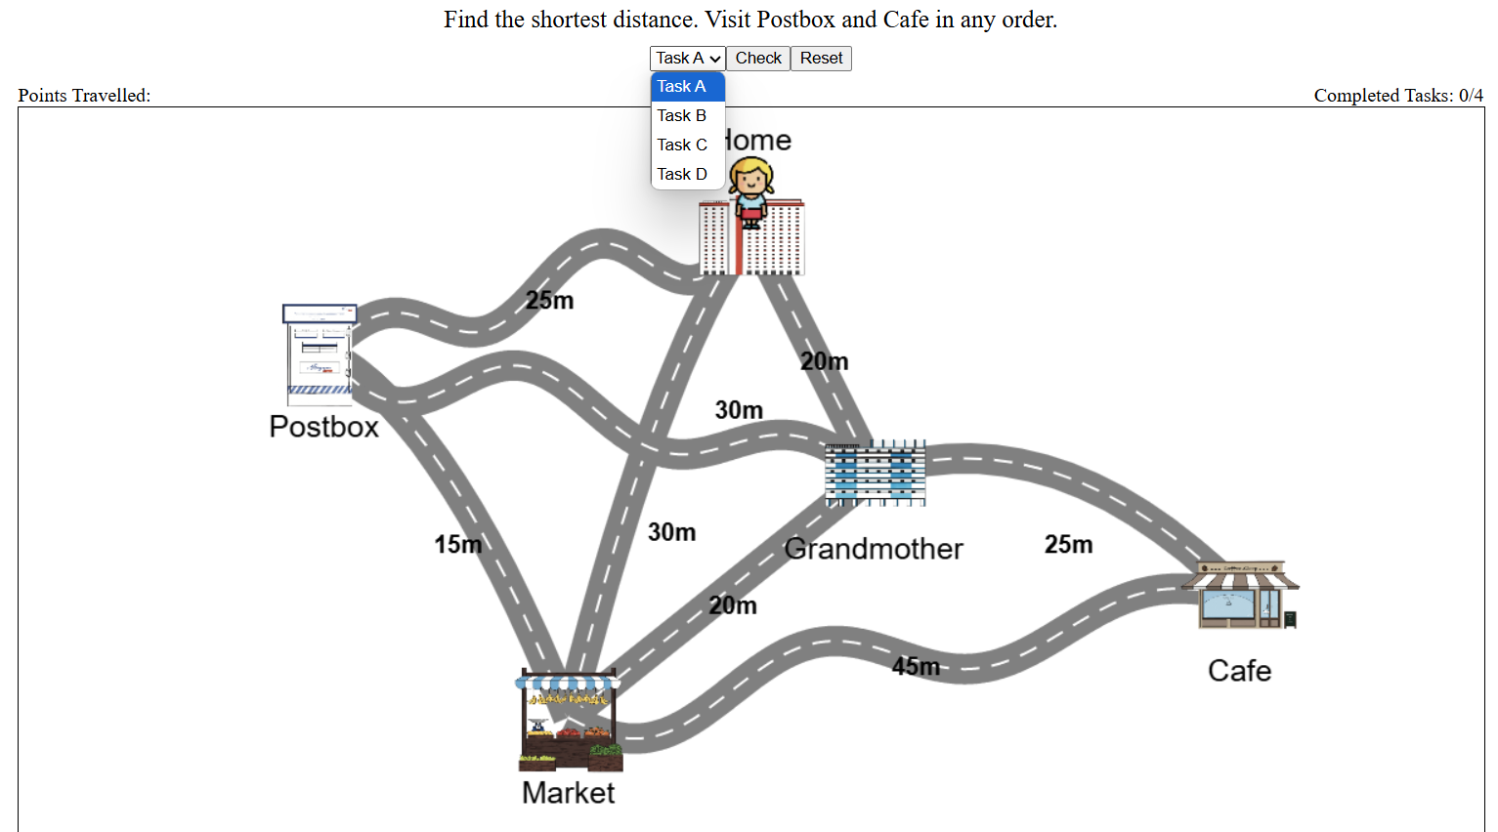
1. Choose a task and read the question.

Slide 5
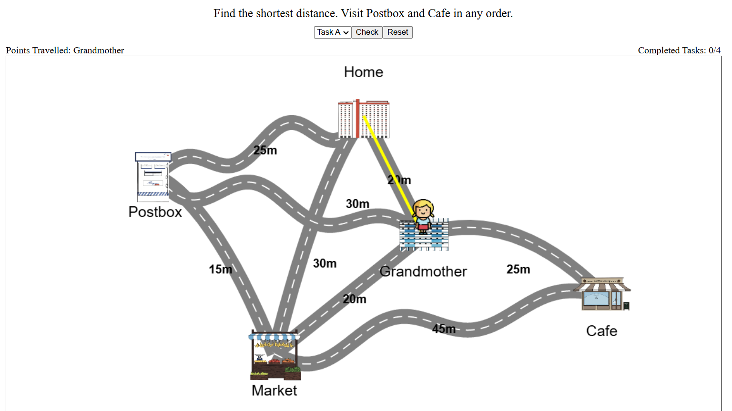
2. Double click on a location to move.

Slide 6
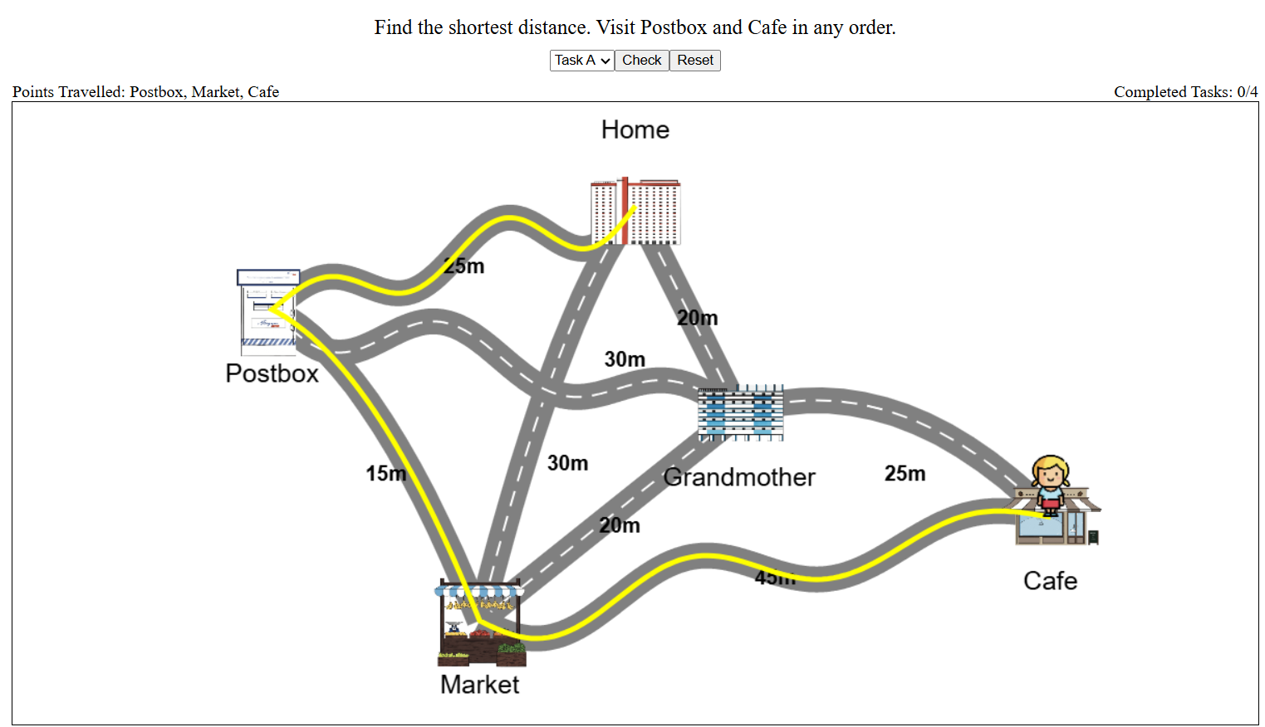
3. Press the Check button to see if it’s correct.

Slide 7
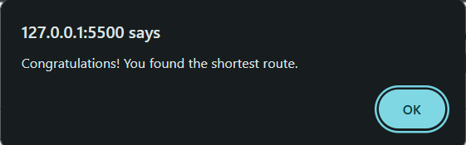
Case #1: Correct Answer

Slide 8
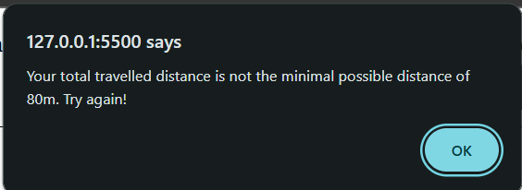
Case #2: Incorrect Answer

Slide 9
4. If you make a mistake, press the Reset button to try again.

Slide 10
Task Types
Visit specified locations in any order.
Visit specified location in order.
Visit any locations in any order.

Slide 11
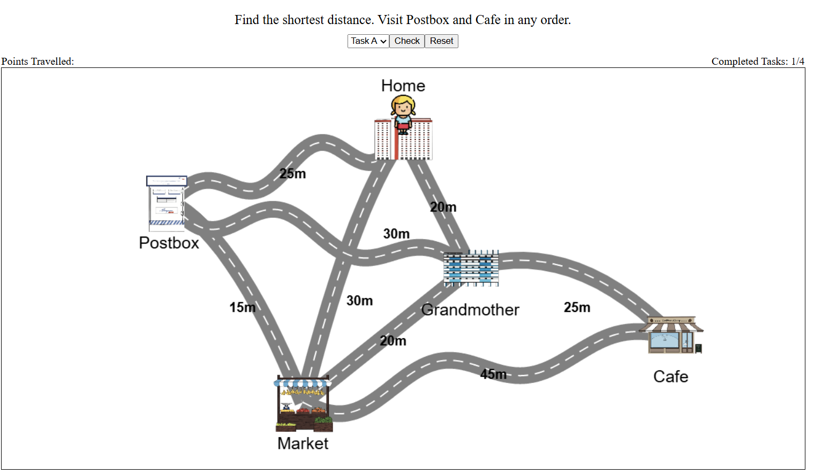
1. Visit specified locations in any order.

Slide 12
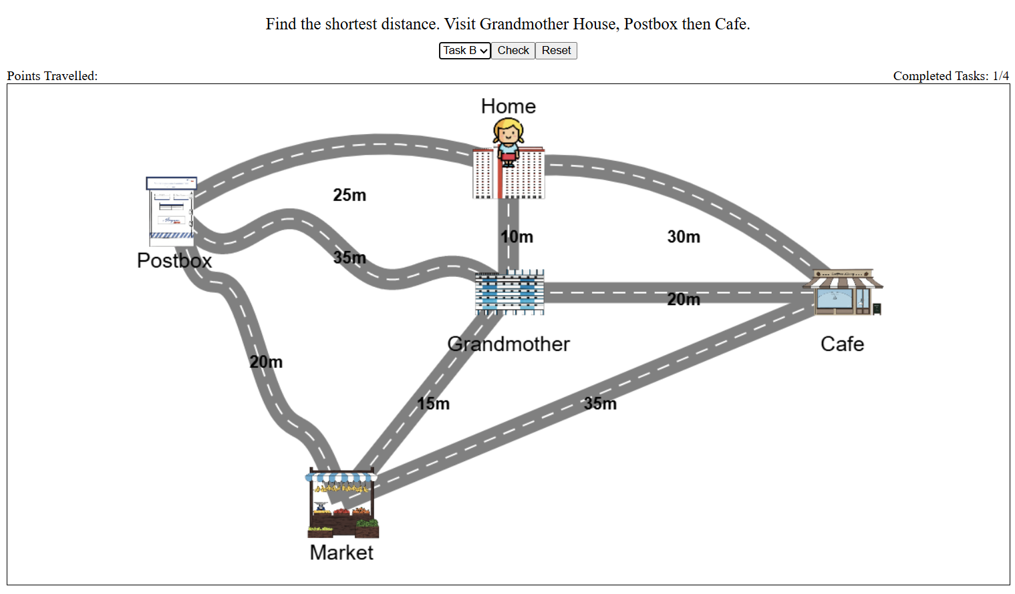
2. Visit specified location in order.

Slide 13
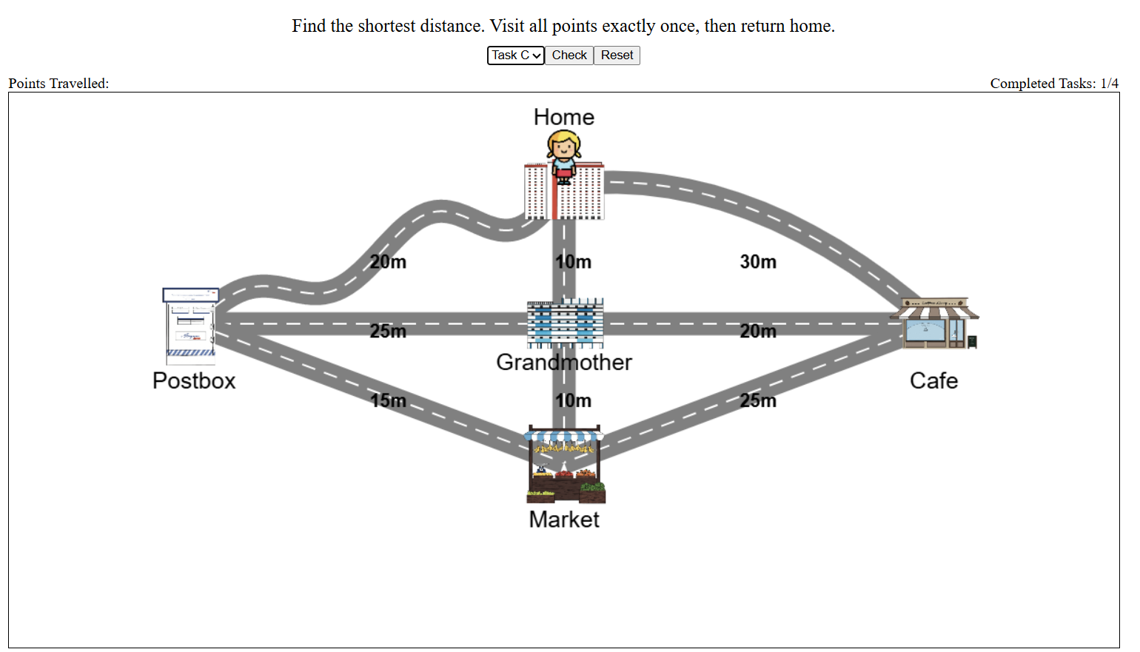
3. Visit any locations in any order. (Return to Start)

Slide 14
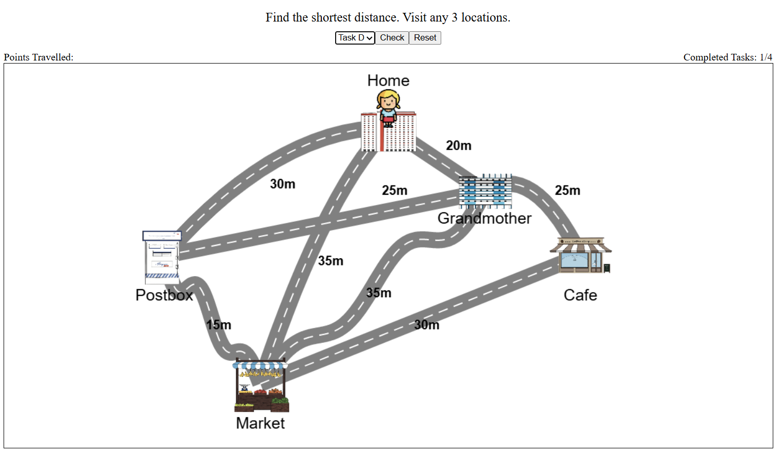
4. Visit any locations in any order.

