Slide 1
Line Symmetry Minigame

Slide 2
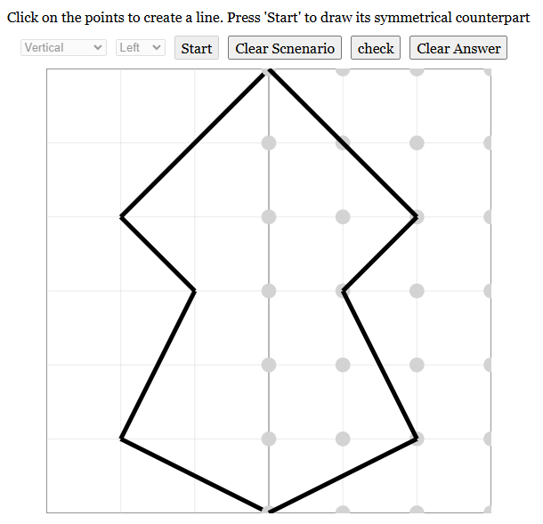
What is the Line Symmetry Minigame?
The Line Symmetry Minigame helps you learn symmetry by creating figures and their reflections.
You start by drawing line on the side with the circles to create a figure.
Then, you draw the matching reflection on the other side.

Slide 3
How to Play
Click on the points on the side with circles to draw lines to create a figure.
Press the Start button.
On the opposite side, draw the symmetrical reflection of the figure drawn.
Press the Check Answer button to see if it’s correct.
If you make a mistake, press the Clear Answer button to try again.
To create a new figure, press the Clear Scenario button to reset the original figure drawn.

Slide 4
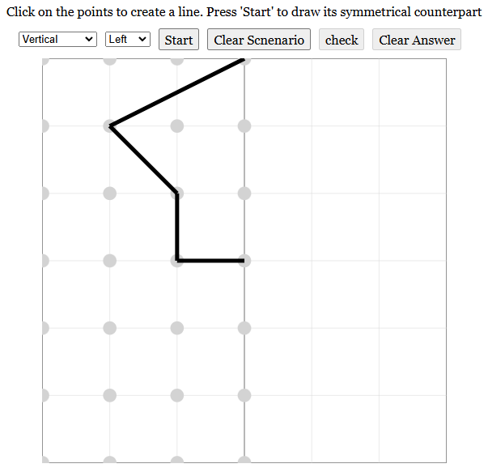
1. Click on the points on the side with circles to draw lines to create a figure

Slide 5
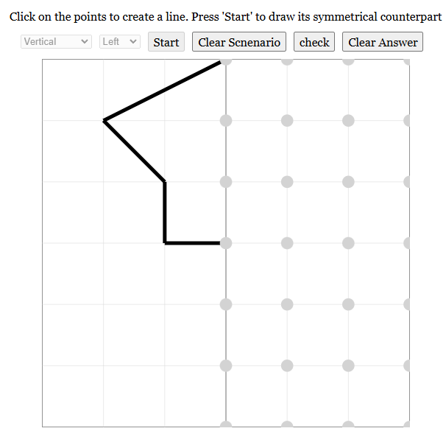
2. Press the Start button.

Slide 6
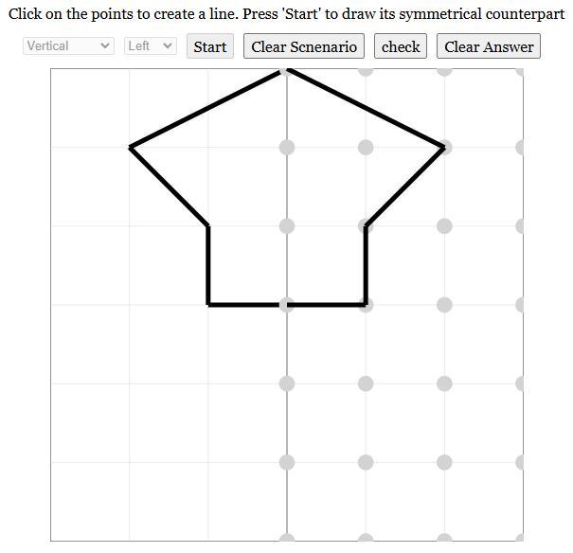
3. On the opposite side, draw the symmetrical reflection of the figure drawn.

Slide 7
4. Press the Check Answer button to see if it’s correct.

Slide 8
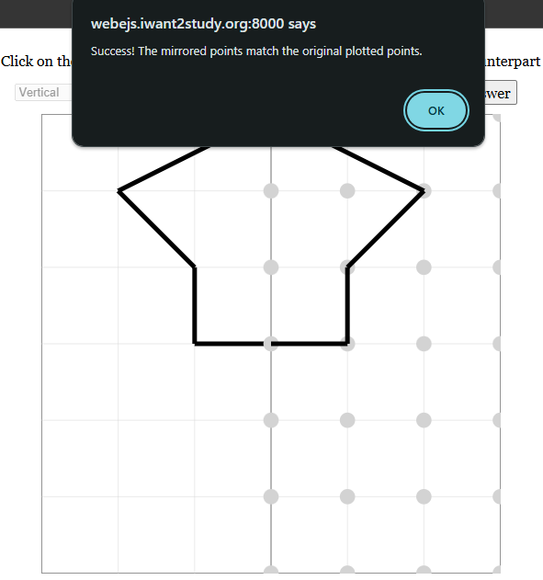
Case #1: Correct Answer

Slide 9
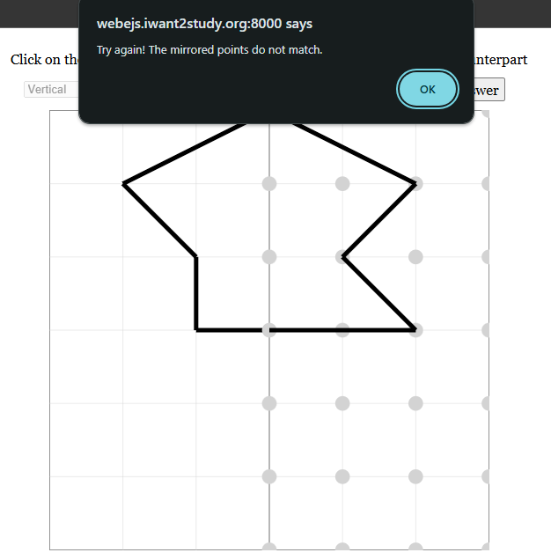
Case #2: Incorrect Answer

Slide 10
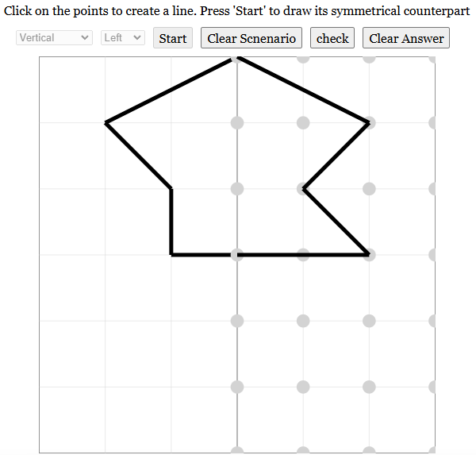
5. If you make a mistake, press the Clear Answer button to try again.

Slide 11
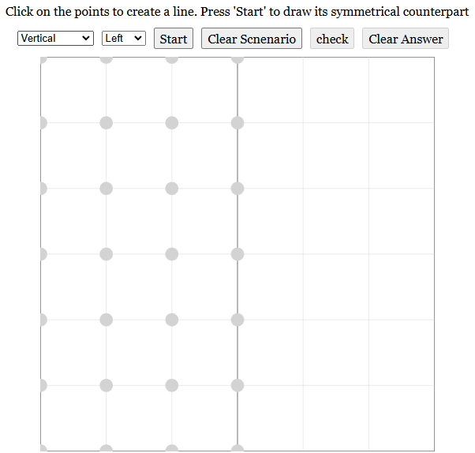
6. To create a new figure, press the Clear Scenario button to reset the original figure drawn.

Slide 12
Line Types
Vertical Grid: Symmetry line runs vertically down the middle.
Horizontal Grid: Symmetry line runs horizontally across the middle.
Diagonal (+): Symmetry line runs diagonally from bottom-left to top-right.
Diagonal (-): Symmetry line runs diagonally from top-left to bottom-right.
Swapping Sides
Vertical and Diagonal Grids: Choose Left to start on the left. Choose Right to start on the right.
Horizontal Grid: Choose Top to start on top. Choose Bottom to start on the bottom.

Slide 13
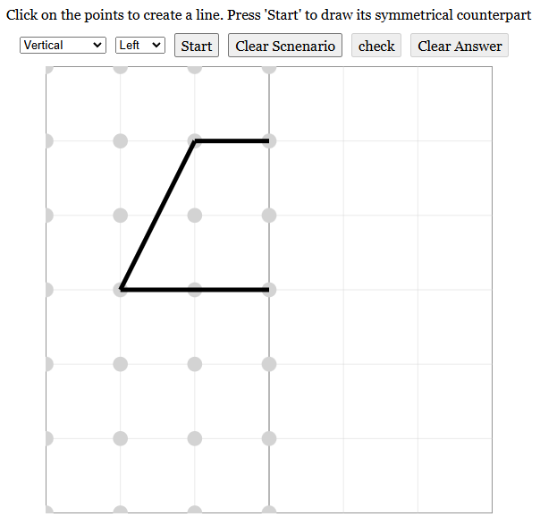
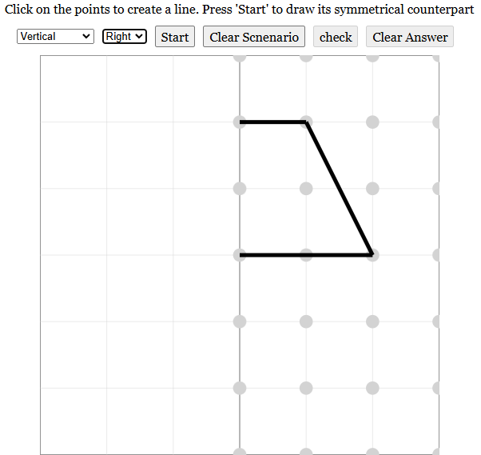
Grid #1: Vertical Grid
Vertical (Left)
Vertical (Right)

Slide 14
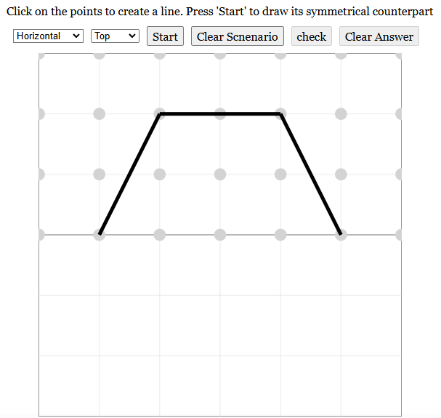
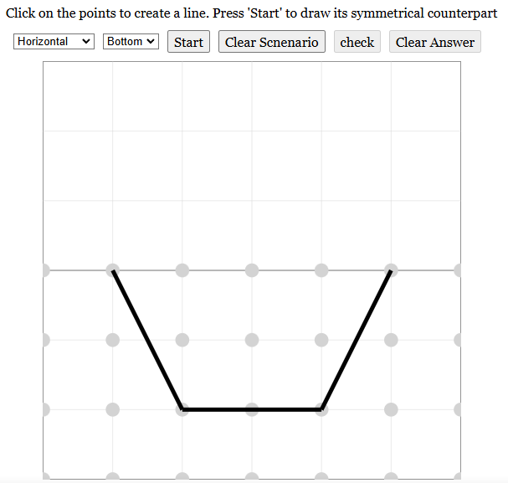
Grid #2: Horizontal Grid
Horizontal (Top)
Horizontal (Bottom)

Slide 15
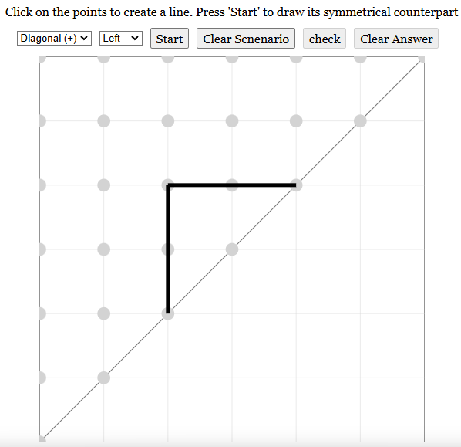
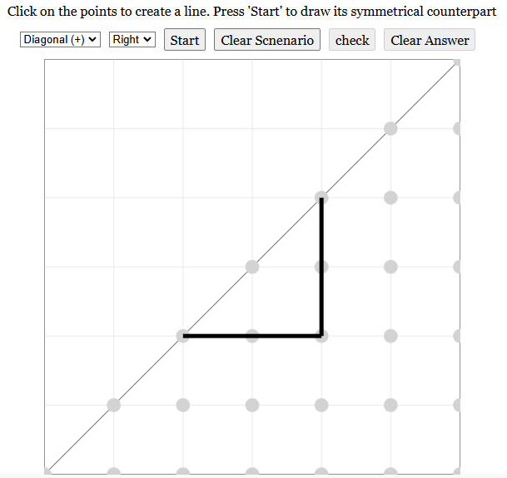
Grid #3: Diagonal (+) Grid
Diagonal (+) (Left)
Diagonal (+) (Right)

Slide 16
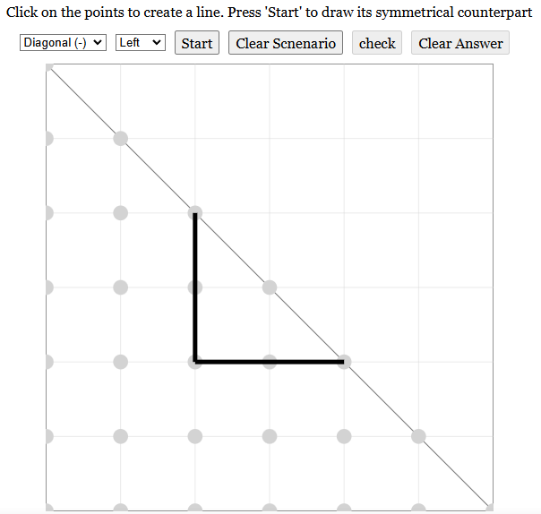
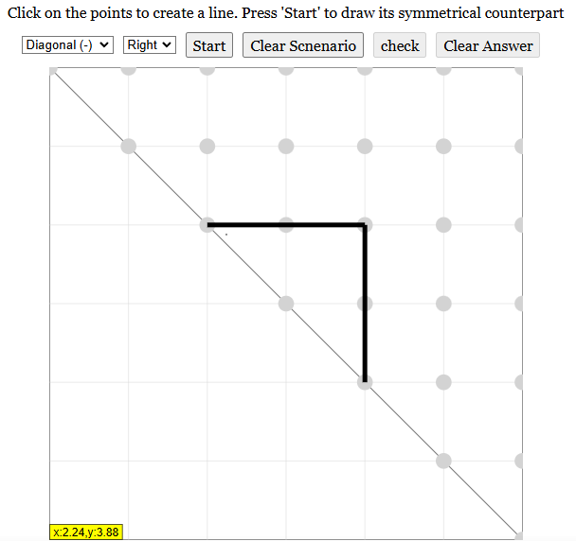
Grid #4: Diagonal (-) Grid
Diagonal (-) (Left)
Diagonal (-) (Right)

