Slide 1
Isometric Drawing Minigame

Slide 2
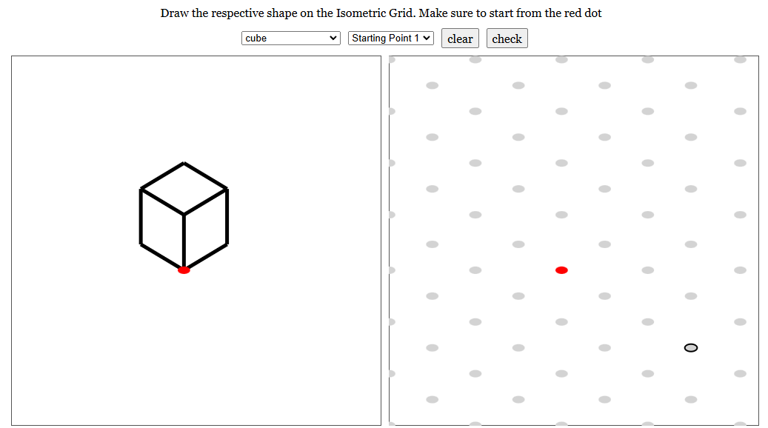
What is the Isometric Minigame?
The Isometric Drawing Minigame helps you learn visualization by recreating given shapes onto an isometric grid
You start by picking a shape and a starting point.
Then, you draw the shape on the isometric grid starting from the red point.

Slide 3
How to Play
Choose a shape.
Choose a starting point.
Starting from the red point, draw the shape on the left on the isometric.
Press the Check button to see if it’s correct.
If you make a mistake, press the Clear button to try again.

Slide 4
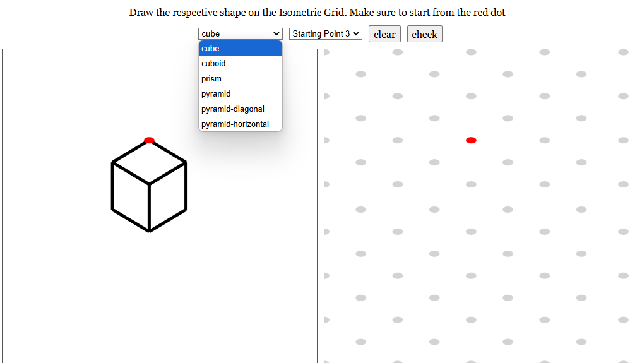
1. Choose a shape.

Slide 5
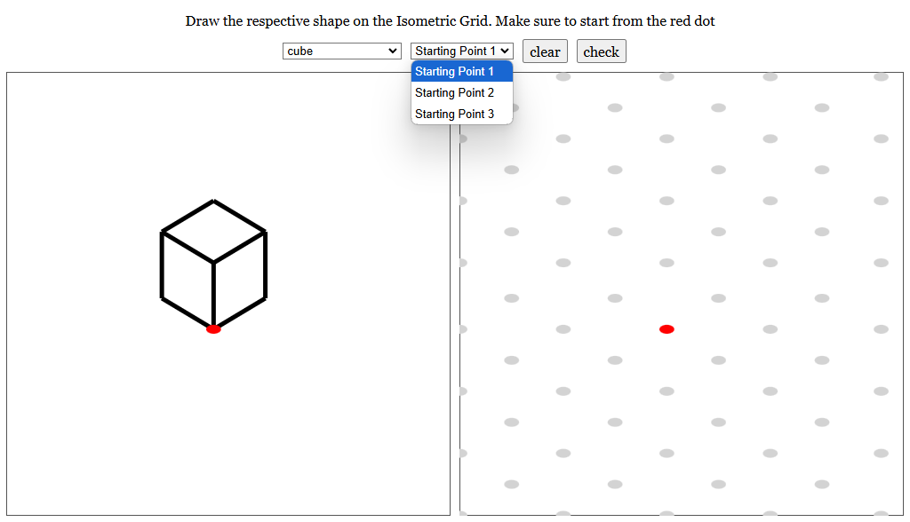
2. Choose a starting point.

Slide 6
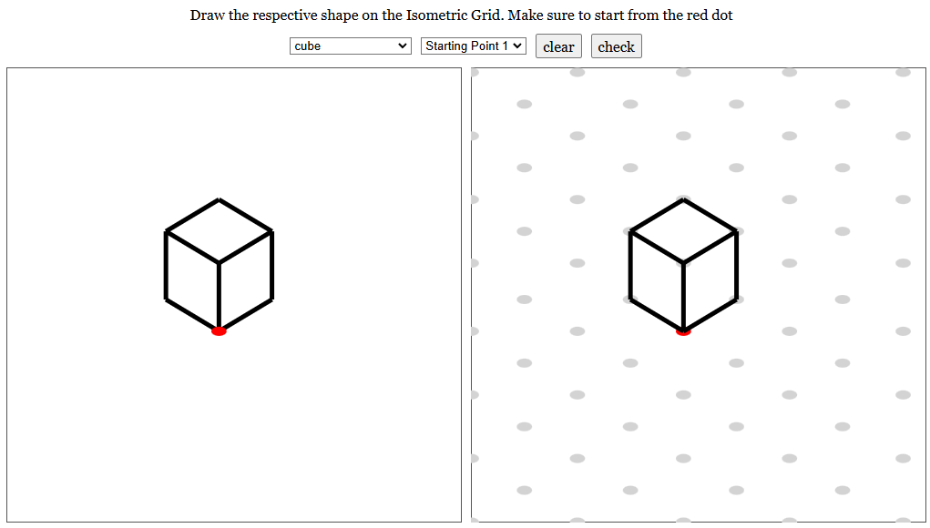
3. Starting from the red point, draw the shape on the left on the isometric.

Slide 7

4. Press the Check button to see if it’s correct.

Slide 8
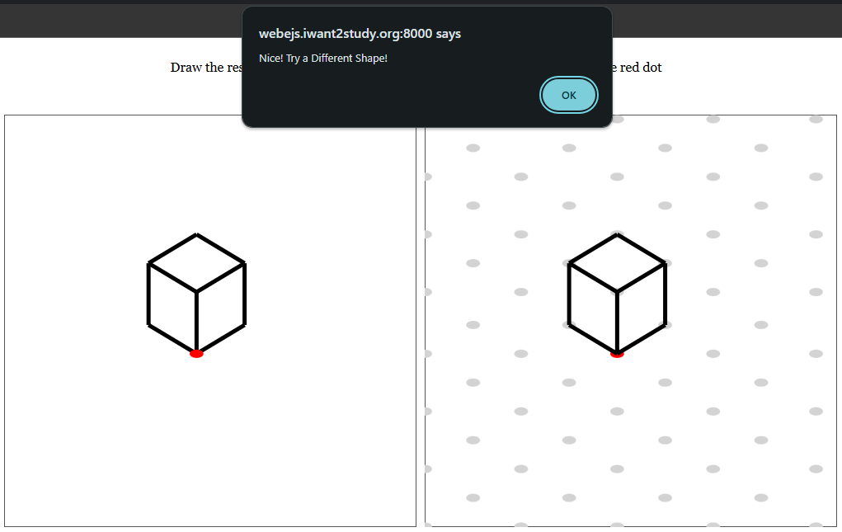
Case #1: Correct Answer

Slide 9
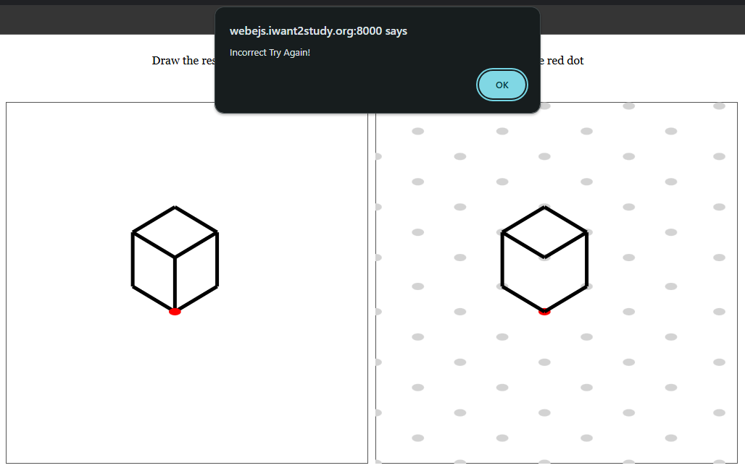
Case #2: Incorrect Answer

Slide 10
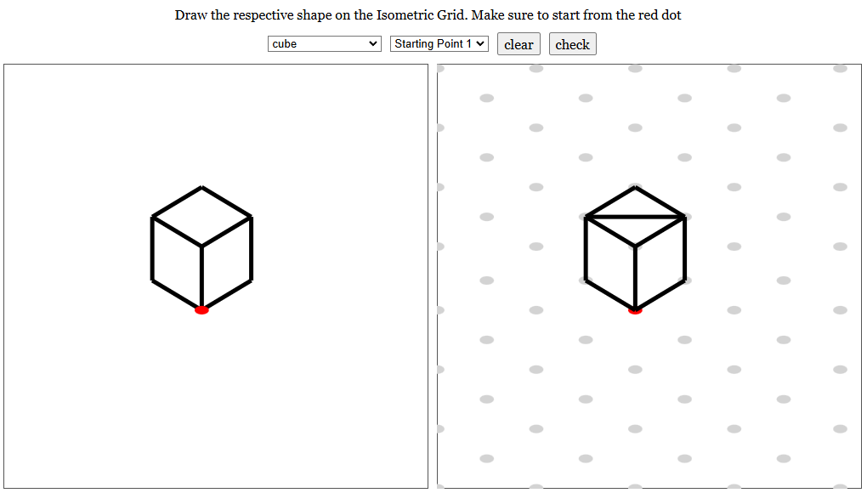
5. If you make a mistake, press the Clear button to try again.

Slide 11
Shape Types
Cube
Cuboid
Prism
Pyramid
Pyramid-Diagonal
Pyramid-Horizontal

Slide 12
Starting Points
Up to 3 different starting points per shape

