Slide 1
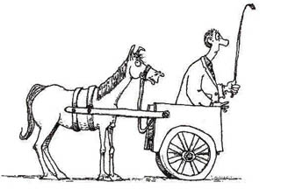
is it a Good question?
How may technology be further leveraged into the National Examinations?
What National Examinations Reforms should be made and how may technology be leveraged?
http://www.fun-learning-spanish.com/image-files/put-cart-before-horse.jpg
Notes:
http://www.fun-learning-spanish.com/image-files/put-cart-before-horse.jpg
https://gregarthur.files.wordpress.com/2011/10/cart-before-horse-2.jpg

Slide 2
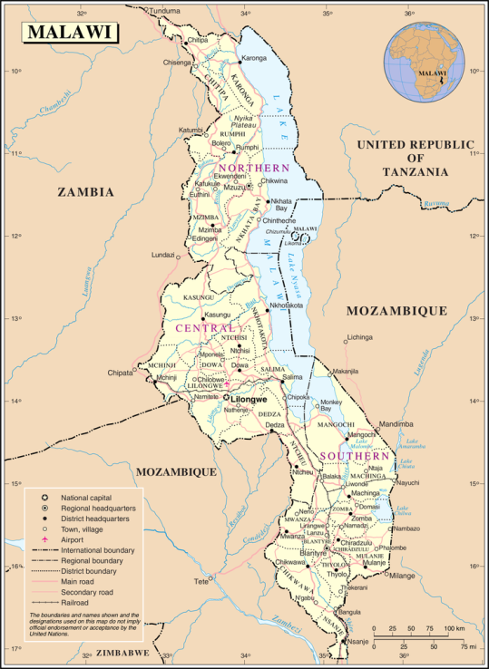
Issues
Political: Dealing with Public and Political Pressure
Practical: Implementing with Limited Resources
Security: Examination Security Concerns
Psychometric: Measurement Multiple Choice (teaching to test)
Psychometric: Measurement Scoring Free-Response Items
Reality: Really High Stakes
Fairness: Equity Issues in Assessment
Access: Computer-Based Testing
Chakwera, Elias, Khembo, Dafter, & Sireci, Stephen G. (2004). High-Stakes Testing in the Warm Heart of Africa: The Challenges and Successes of the Malawi National Examinations Board. education policy analysis archives, 12(29), n29.
Notes:
http://files.eric.ed.gov/fulltext/EJ852311.pdf

Slide 3
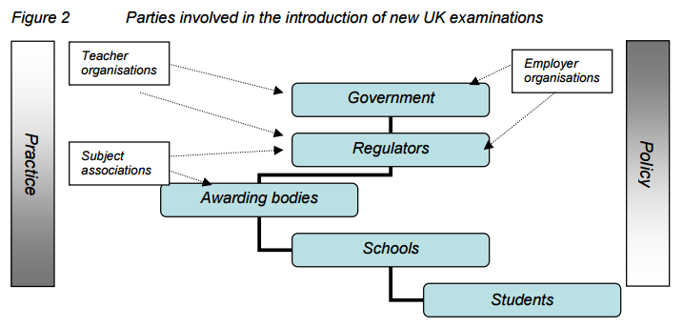
Management/multi agencies
Baird, Jo‐Anne, & Lee‐Kelley, Liz. (2009). The dearth of managerialism in implementation of national examinations policy. Journal of Education Policy, 24(1), 55-81.

Slide 4
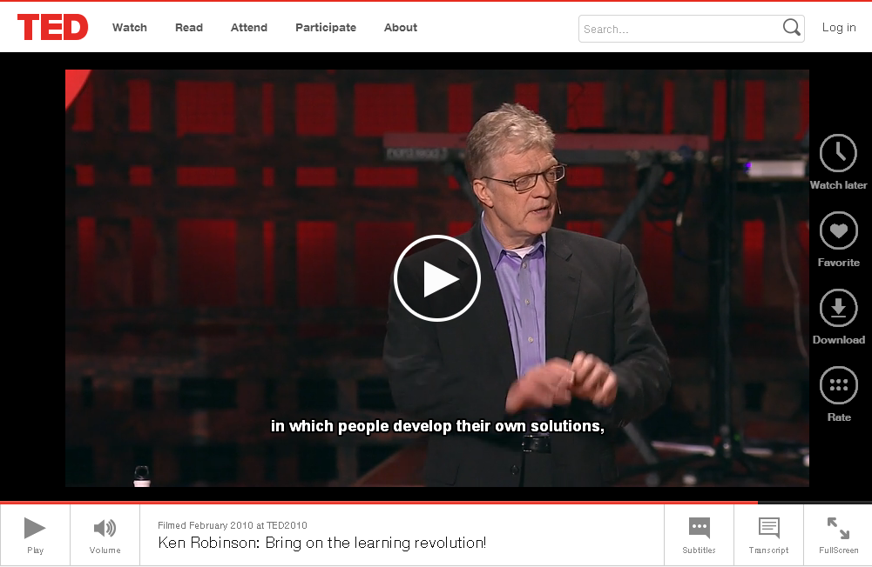
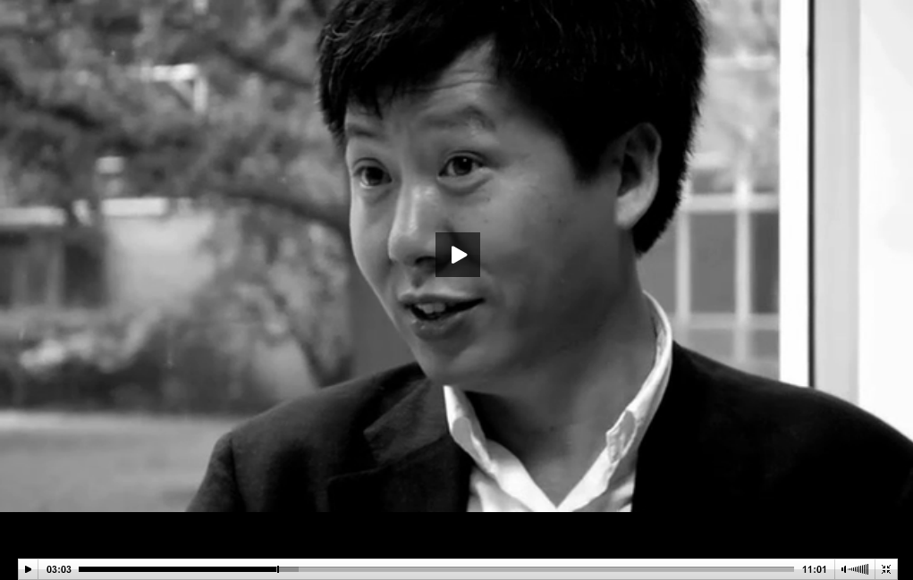
Agricultural Education
Professors of Education speak about even in International Conference Technology Learning and Teaching ICTLT
global competitiveness comes from a diversity of talents and recognition of individual passions and creativity.
In which people develop their own solutions
http://www.ted.com/talks/sir_ken_robinson_bring_on_the_revolution/
http://zhaolearning.com/2009/08/07/no-child-left-behind-and-global-competitiveness/

Slide 5

Possible System(s)
http://www.cito.com/
Monitoring Exams: variety of issues addressed
Play & Stimulating Teaching & Learning Tasks (Pyramid Method): well managed inter agencies coordinated effort
Portfolios: agricultural educational instrument to document a student's progress and results
How may technology be further leveraged into the National Examinations?
Balanced Educational Reforms drive appropriate technology used ☺

Slide 6
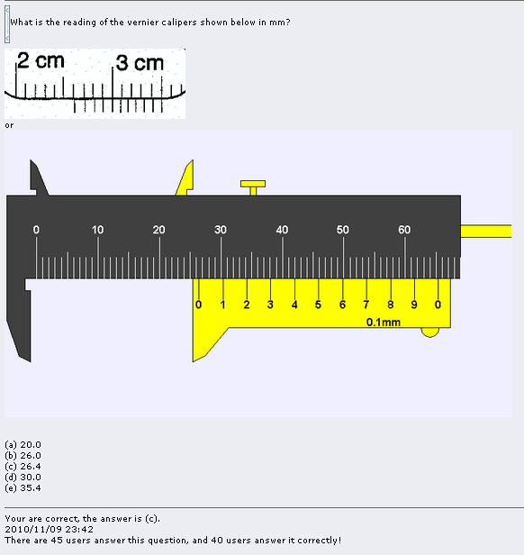
Prototype Monitoring Exams
http://www.phy.ntnu.edu.tw/ntnujava/index.php?topic=1992.0
1. Traditional and Computer Pictures
2. Multi Choice Questions
3. Feedback for Assessment

Slide 7
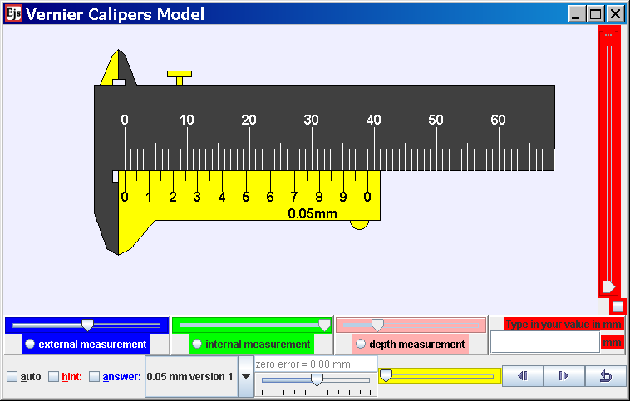
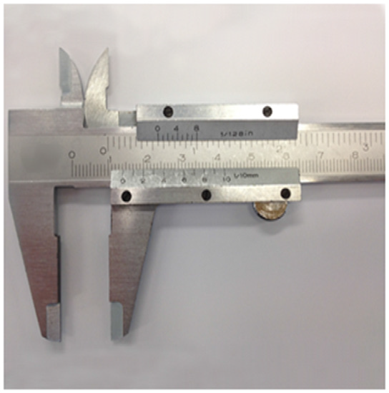
Stimulating Teaching & Learning Tasks + Real Life
Used by MOE-HQ, SEAB, Teachers, Students and Public
Wee, Loo Kang, & Ning, Hwee Tiang. (2014). Vernier caliper and micrometer computer models using Easy Java Simulation and its pedagogical design features—ideas for augmenting learning with real instruments. Physics Education, 49(5), 493.

Slide 8
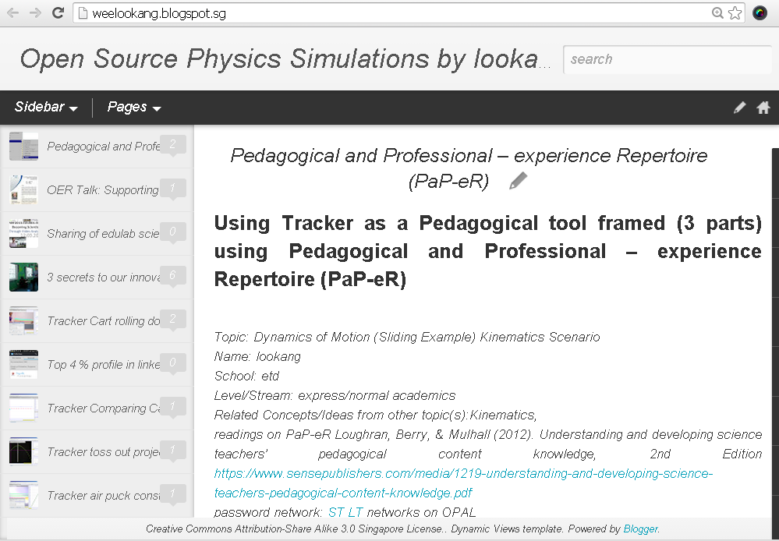
Personalized Portfolios
Search Key for Growth in Any Subject/Area

Slide 9
Now that educational reforms are determined, issues addressed, what are the technology to leverage on?
Reforms | Technology
Monitoring Exams | Learning Management Space, Big Data Analytics, Adaptive Feedback System, Automated Marking tool
Play & Stimulating Teaching & Learning Tasks | Open Source Interactive Tools, Mobile Learning tools, Real Apparatus, Games, Inquiry tools, 1to1 computing
Portfolios | Blogs, YouTube, Twitter, Facebook, arXiv, ResearchGate, Google Scholar, LinkedIn

