Slide 1
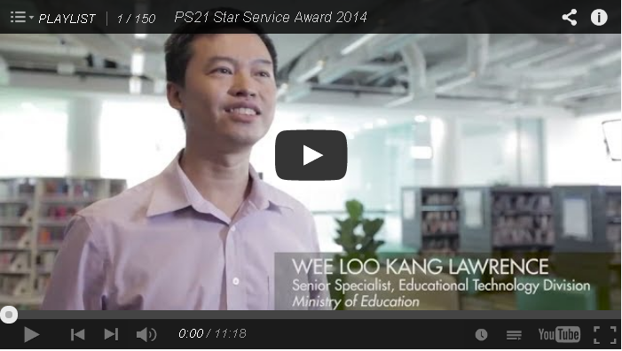


Open Educational Resources from Performance Task using Video Analysis and Modeling using Tracker and K12 science education framework.
黄 如 刚
https://www.cabrillo.edu/~dbrown/tracker/
http://www.compadre.org/osp/
http://weelookang.blogspot.sg/2014/06/invitation-to-ocpa8-conference-phys-ed.html
Notes:
Happy to be invited to talk and I am from a special place in MOE that aims to harness technology and technology in today’s technologically advance and internet connected world the new king is free education, manifest as probably MOOC, moodle etc.
OSP Tracker
Unique effort in Raffes girl school, like prof lai choy heng said

Slide 2
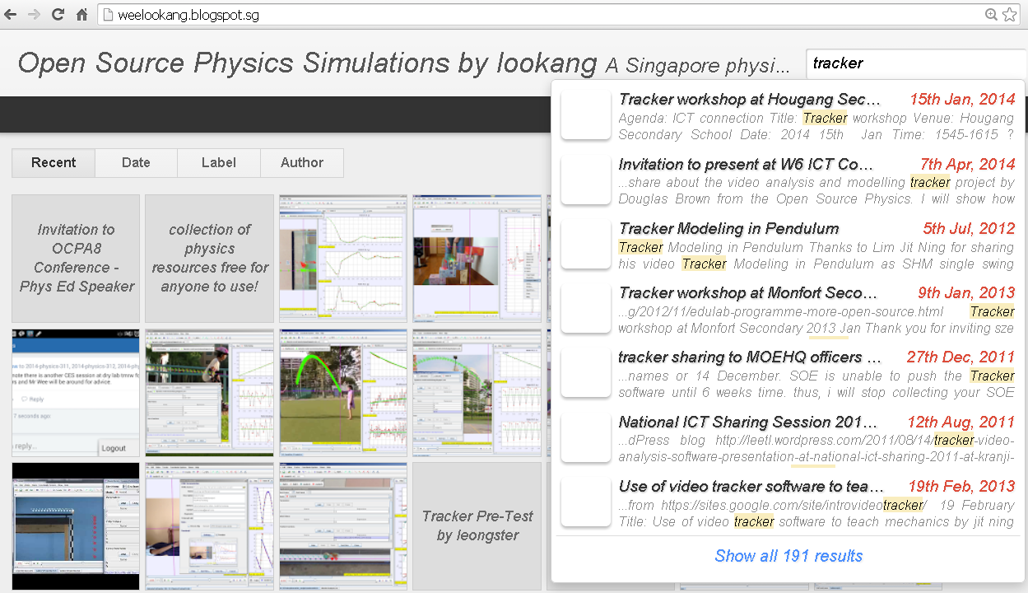
1. What? https://www.cabrillo.edu/~dbrown/tracker/
Tracker is Free, Open Sourced
Video and (analysis + model) are redistributable & modifiable
Notes:
Weelookang.blogspot.sg
Or you can google “Singapore physics teacher” and u can find my blog ☺

Slide 3
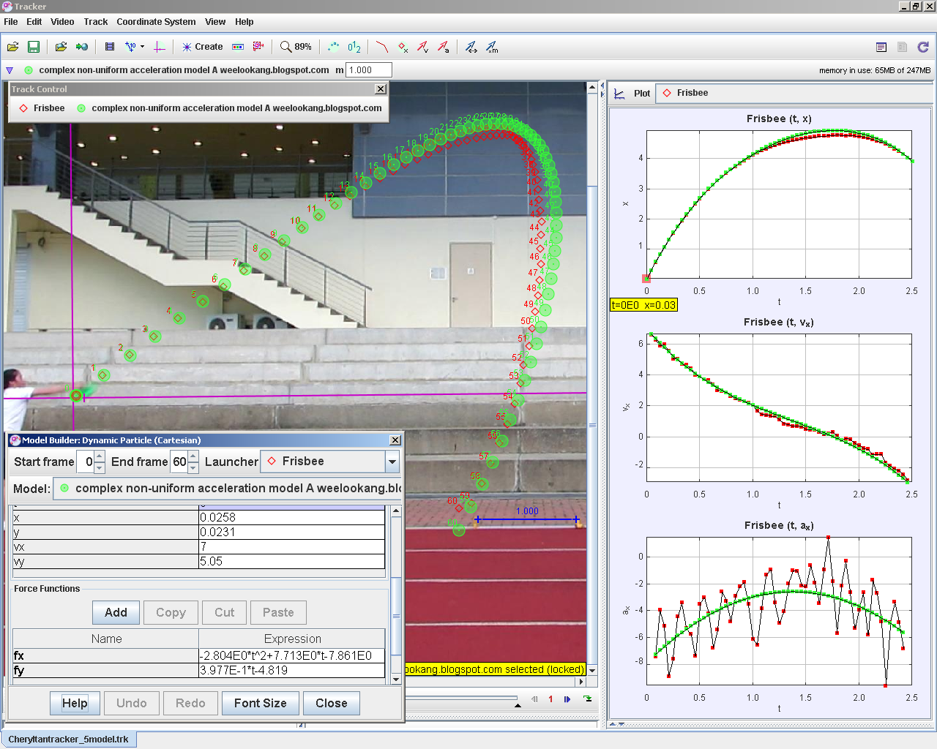
Free, modify & re-share
Change Phy Ed provide quality Physics educational resources (video & model-analysis)
2 Why?
Notes:
Why? Universal assess to educational resources as a basic human right especially in light of how low the cost is, how about people who cannot attend traditional courses, physical disabilities.
Change is automatic, but progress needs to be work on, with a vision –digital library of free educational resources, reason - benefit all regardless of race language or religion and emotion- Feel so alive everyday doing.

Slide 4
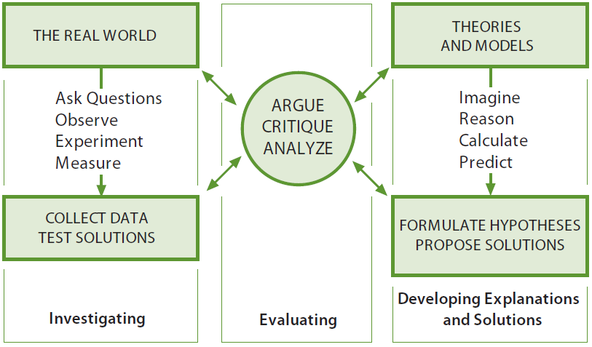

3. How? K12 Science Education Framework
Practice2:
Practice1:
Practice7: evidence based
Practice5: Mathematical Thinking &
Practice3:
Plan &
Practice4:
Practice8: Communicate
Practice6:
FIGURE 3-1 The three spheres of activity for scientists and engineers.
http://www.nap.edu/openbook.php?record_id=13165&page=45
Notes:
Quick Kathleen Koenig also talk about earlier

Slide 5
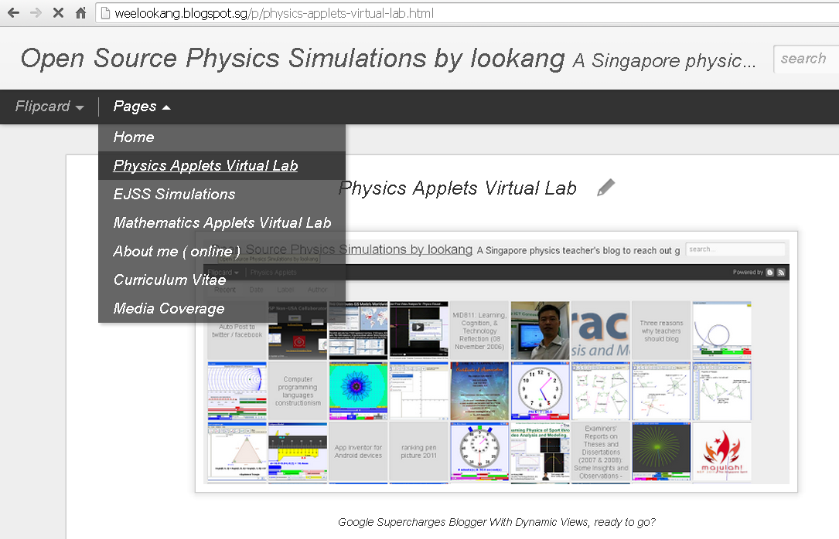
Personal reflections
Practice 1: Ask Questions
Practice 2: Use Models (use any simulations or Easy Java Simulations
Practice 5: Mathematical Thinking (tracker’s video modeling pedagogy)
Practice 8: Open Communications
Notes:
I have to say this are my Personal reflection and therefore allow to speak.
Thanks chair of OCPA prof kwek for inviting me here

Slide 6
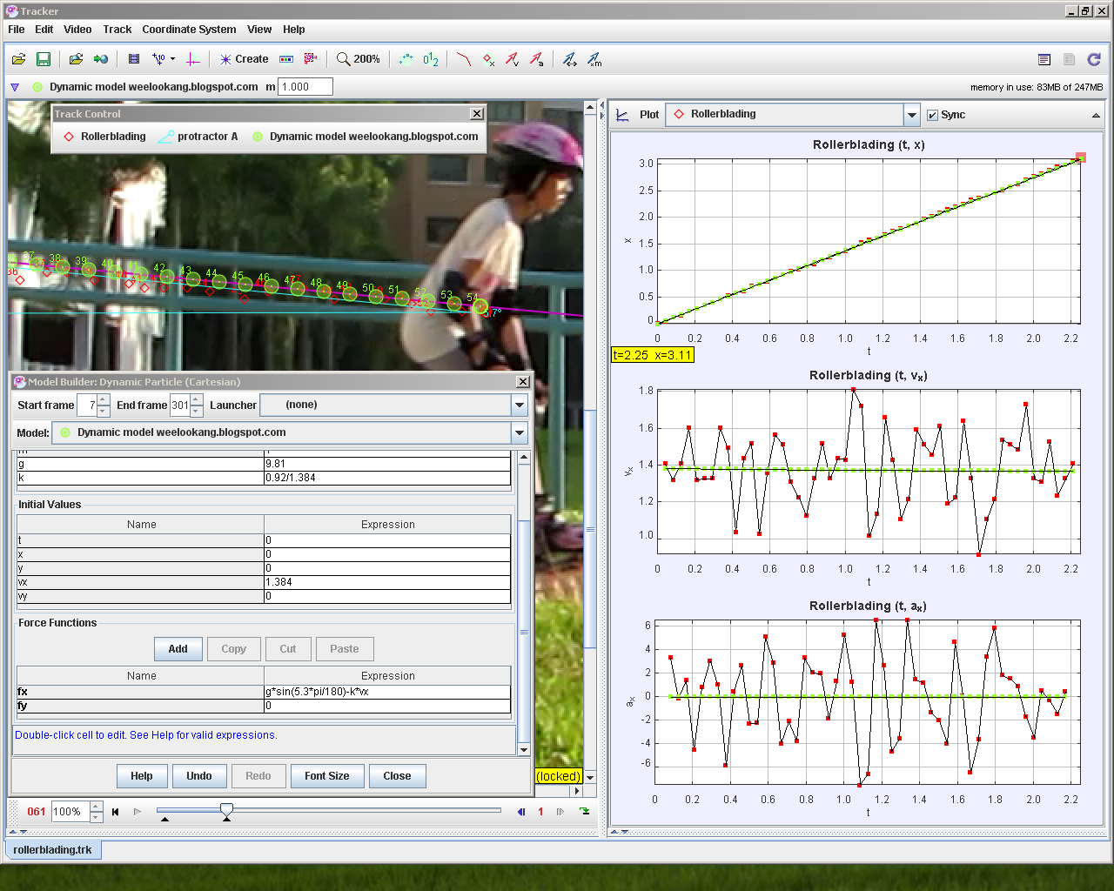
Practice 1: Ask Questions
+Model-able questions
Notes:
Model-able?

Slide 7
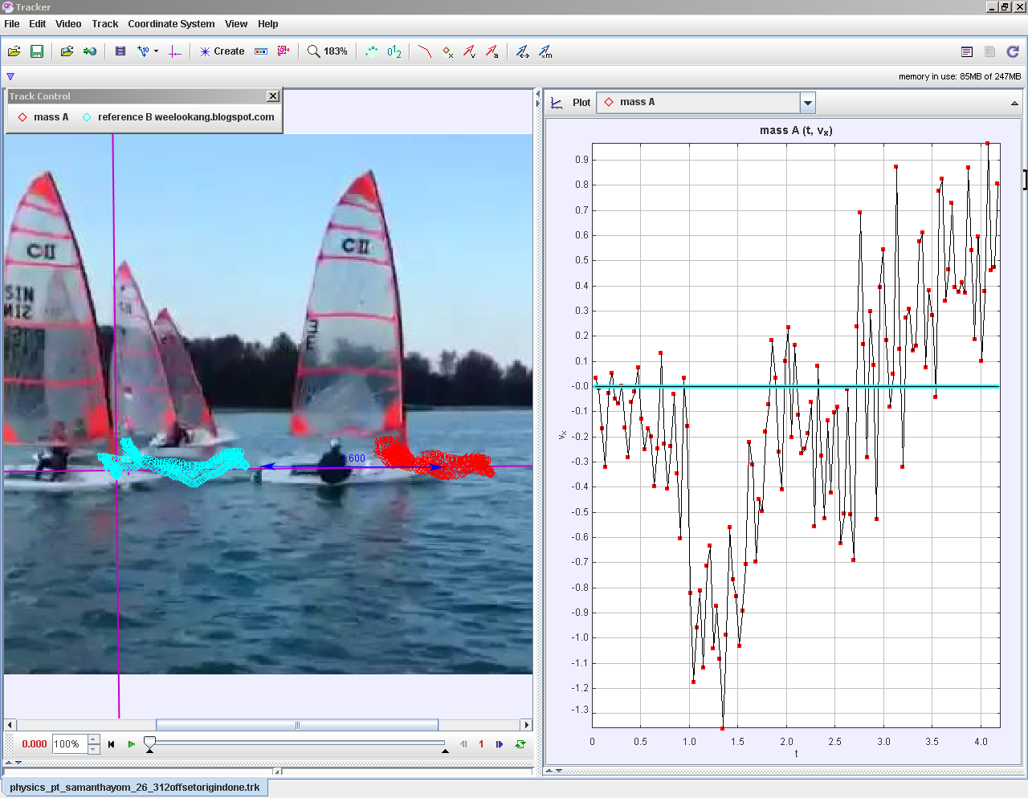
Practice 1: Ask Questions
+ Interesting questions
Notes:
Do you really need more people to determine the value of g=9.81 ?

Slide 8
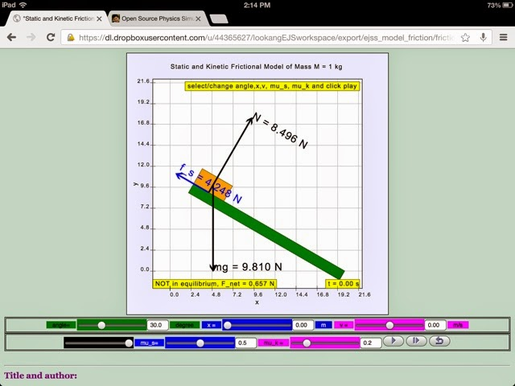
Practice 2: Using Models
+ Easy Java Simulation models are editable by anyone, licensed CC-BY
Notes:
Typically after students discuss their video analysis, teachers like myself would suggest to the students to download relevant models/simulations from my blog or find one on OSP or NTNU Java Forum Good Mentor and Friend Fu-Kwun Hwang.

Slide 9
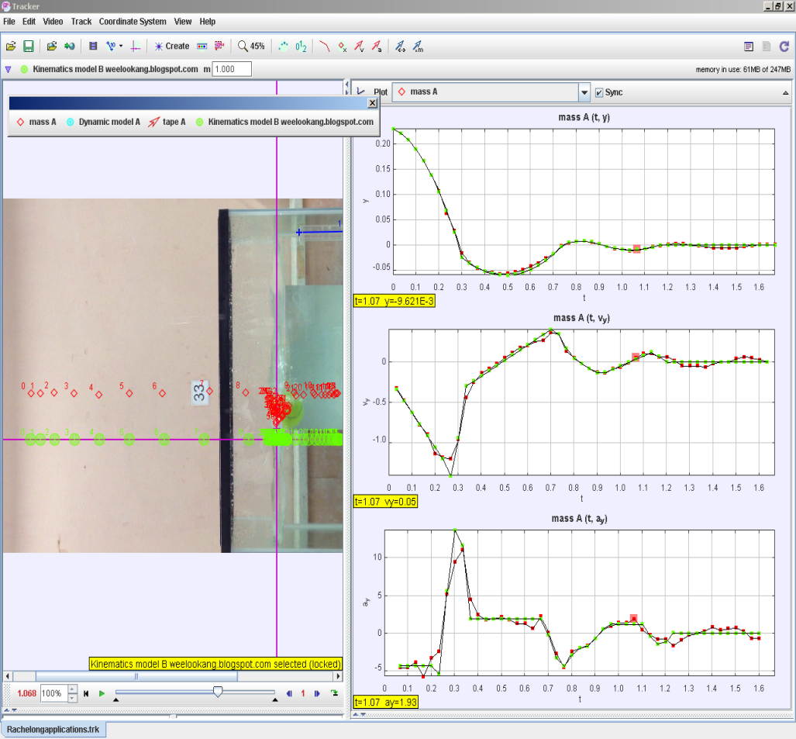
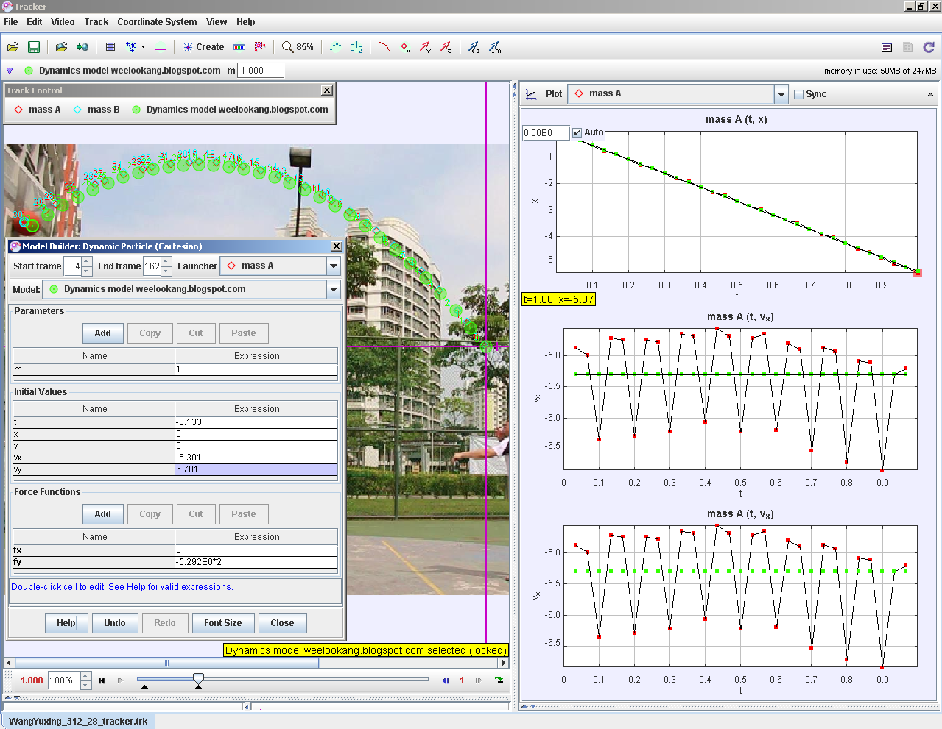
Practice 5: Maths+Computational Thinking
+ Video modeling
Kinematics model & Dynamics model
Notes:
Play video and narrate
I personally like learning from modeling stand a higher chance in preparing students for jobs and challenges yet invented and foreseen (referencing prof lai talk)
In mooc context, it is more personal and deep way to assess learning what student submit their tracker files for the teacher to give feedback in on going fine tuning of the analysis and modeling.

Slide 10
Practice 8: Communications
+ Open access
Video presentation
http://www.youtube.com/
Research shared freely
- One off
https://vimeo.com/
https://arxiv.org/
http://www.scribd.com/
Notes:
One of things about research and education is open access, it is arguably a basic human right in light of today’s technology the internet where it takes only 0.0001 cents to publish digital copies of your work and share it to benefit anyone.

Slide 11
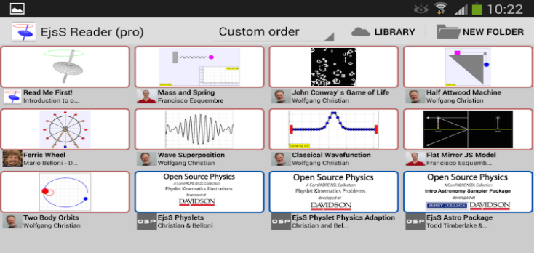
2
Summary:
What – Tracker , Why – Open Education, How – K12 science education framework
more like physicists by 1. ask model-able questions, 2 use EJS models and 5. tracker’s video modeling and 8 open communications.
Digital Library
http://iwant2study.org/lookangejss/
(Android & iOS EJSS reader and EJS itself *.jar)
Singapore Tracker Community http://weelookang.blogspot.sg/p/physics-applets-virtual-lab.html search “tracker” download *.trz files.
Notes:
Advertise the digital library for practice 2 use models

