Slide 1

SORBET
2E 3 24 August 2023

Slide 2
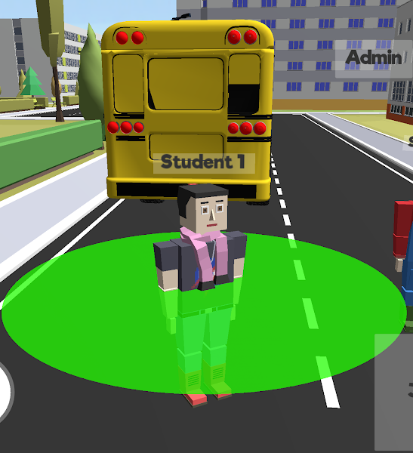
Introduction
The Socially Responsible Behavior Through Embodied Thinking (SORBET) project
SORBET is a two-part activity.
In the first part, students log in to an immersive environment which they can freely explore together.
Think of it as a scavenger hunt, collect as many trash as you can.
Question: What does the simulation model?
https://docs.google.com/document/u/0/d/1z2PD0LUtZz23TYOCfm-vOHKzHnBmGd_fQm__ymPeKmQ/mobilebasic

Slide 3

Join a session
Joining a SORBET session:
Step 1: At the SORBET home screen, please enter a username. This will be your display name in SORBET.
Step 2: Select the Room name 2E3 and password 123.
Step 3: Wait for the simulation to start

Slide 4
Introduction
The Socially Responsible Behavior Through Embodied Thinking (SORBET) project
SORBET is a two-part activity.
In the first part, students log in to an immersive environment which they can freely explore together.
While they are doing so, a disease simulation (set up by their teacher) runs in the background, modeling the spread of the disease. The simulation consists of several cycles (typically five cycles, of about three to five minutes duration each). The first part of the activity concludes when the simulation ends.
Avatars in the SORBET environment. Green rings indicate that the avatars are practicing social distancing.

Slide 5
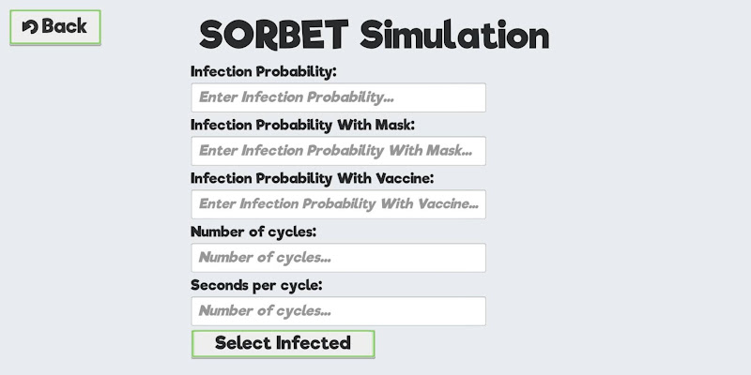

Slide 6
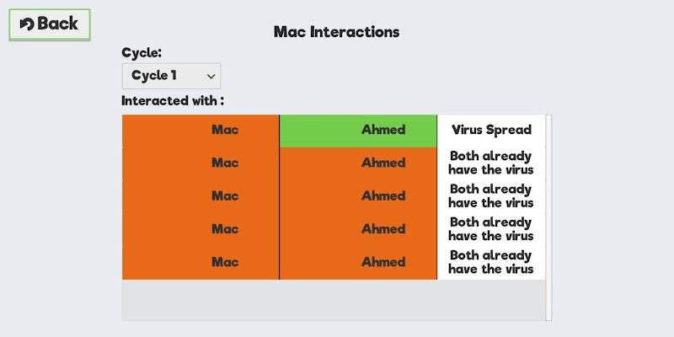
Data Collected
No. of infected students over time in each cycle/stage

Slide 7
Table 3: Possibility Table
 | 1 | 2 | 3 | 4 | 5 | 6
1
2
3
4
5
6

Slide 8
Table 3: Possibility Table
 | 1 | 2 | 3 | 4 | 5 | 6
1 | 2 | 3 | 4 | 5 | 6 | 7
2 | 3 | 4 | 5 | 6 | 7 | 8
3 | 4 | 5 | 6 | 7 | 8 | 9
4 | 5 | 6 | 7 | 8 | 9 | 10
5 | 6 | 7 | 8 | 9 | 10 | 11
6 | 7 | 8 | 9 | 10 | 11 | 12

Slide 9
Table 4: Probability of Getting a Certain Sum
Sum | Probability
2
3
4
5
6
7
8
9
10
11
12

Slide 10
Table 4: Probability of Getting a Certain Sum
Sum | Probability
2 | 1/36
3 | 2/36
4 | 3/36
5 | 4/36
6 | 5/36
7 | 6/36
8 | 5/36
9 | 4/36
10 | 3/36
11 | 2/36
12 | 1/36

Slide 11
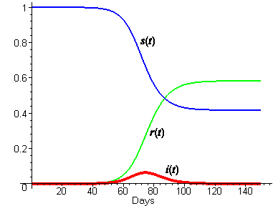
SIR Model for spread of disease

