Slide 1
Nuclear Physics
Binding Energy and Mass Defect

Slide 2
Instruction – part 1
Work individually without discussion on the following MCQs
You have one min for each MCQ

Slide 3
Instruction – part 2
In groups, assign one person to login to LMS https://lms.asknlearn.com/ANDERSON_JC/logon_new.aspx
Go to the Quiz Title Nuclear Physics with a tag (Team Based Learning)
As a group, decide on the correct response and submit your answer
Notes:
Use QR code

Slide 4
Instruction – part 2
If you obtain the correct response on the first attempt, 4 points will be awarded
If it is incorrect, you will given another chance to answer, the points will be halved

Slide 5
Instruction – part 2
No of attempts to obtain the correct answer | Points
1 | 4
2 | 2
3 | 1
4 | 0

Slide 6
Instruction – part 2
You will be given 30 min to complete the online task
Assign a scribe to record the common mistakes and misconception for your group to share with the class
Top scoring group will win a prize

Slide 7
Ready?
Part 1
Think individually without discussion

Slide 8

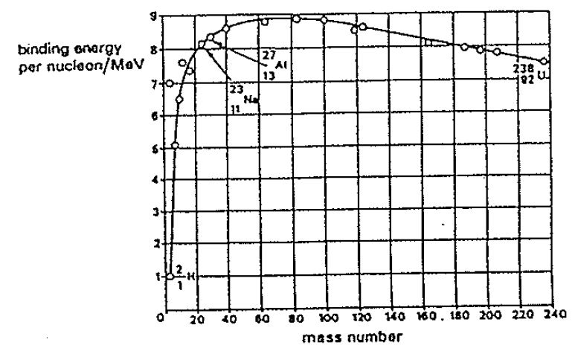
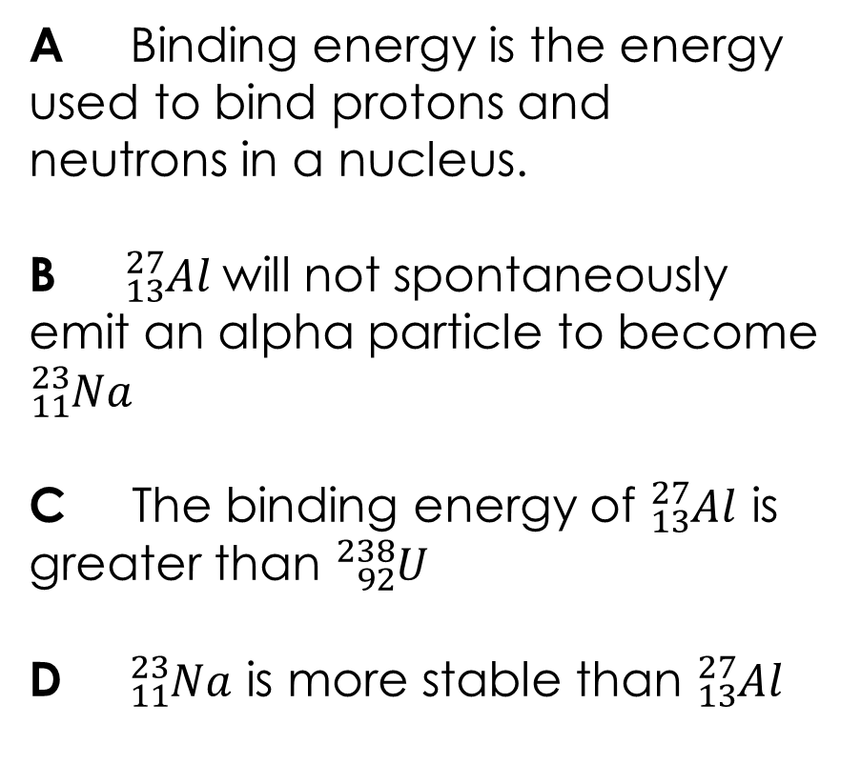
Q1: The figure below shows the graph of the binding energy per nucleon for a number of naturally-occurring nuclides plotted against their mass number. Which of the following statement is a correct deduction from the graph?
End
1
2
3
4
5
6
7
8
9
10
11
12
13
14
15
16
17
18
19
20
21
22
23
24
25
26
27
28
29
30
31
32
33
34
35
36
37
38
39
40
41
42
43
44
45
46
47
48
49
50
51
52
53
54
55
56
57
58
59
60
A Binding energy is the energy used to bind protons and neutrons in a nucleus.
B ${}_{13}^{27}{Al}$will not spontaneously emit an alpha particle to become ${}_{11}^{23}{Na}$
C The binding energy of ${}_{13}^{27}{Al}$ is greater than ${}_{92}^{238}U$
D ${}_{11}^{23}{Na}$ is more stable than ${}_{13}^{27}{Al}$

Slide 9
Q2: Helium nuclei may result from the bombardment of lithium nuclei with protons. The reaction can be represented by the following nuclear equation:
The speed of light is c, and the masses of the particles are:
Lithium m_{L} Helium m_{H} Proton m_{p}
What is the net energy released during such a reaction?
End
1
2
3
4
5
6
7
8
9
10
11
12
13
14
15
16
17
18
19
20
21
22
23
24
25
26
27
28
29
30
31
32
33
34
35
36
37
38
39
40
41
42
43
44
45
46
47
48
49
50
51
52
53
54
55
56
57
58
59
60
A (m_{H} – m_{L} – m_{p}) c ²
B (2m_{H} – m_{L} – m_{p}) c²
C (m_{L} + m_{p} - m_{H}) c²
D (m_{L} + m_{p} - 2m_{H}) c²

Slide 10

Q3: Carbon nuclei may result from the bombardment of Beryllium nuclei with Helium. The reaction can be represented by the following nuclear equation:
The binding energy per nucleon of the particles are:
Beryllium E_{B} Helium E_{H} Carbon E_{C}
What is the net energy released during such a reaction?
End
1
2
3
4
5
6
7
8
9
10
11
12
13
14
15
16
17
18
19
20
21
22
23
24
25
26
27
28
29
30
31
32
33
34
35
36
37
38
39
40
41
42
43
44
45
46
47
48
49
50
51
52
53
54
55
56
57
58
59
60
A (E_{B} + E_{H} – E_{C})
B (9E_{B} + 4E_{H} – 12E_{C})
C (12E_{C} – 9E_{B} – 4E_{H})
D (E_{C} – E_{B} – E_{H})

Slide 11
Q4: A nucleus has a mass number A, atomic number Z and a binding energy B. The mass of the neutron and proton are m_{n} and m_{p} respectively and c is the speed of light.
Which of the following expression correctly represents the mass of the nucleus?
End
1
2
3
4
5
6
7
8
9
10
11
12
13
14
15
16
17
18
19
20
21
22
23
24
25
26
27
28
29
30
31
32
33
34
35
36
37
38
39
40
41
42
43
44
45
46
47
48
49
50
51
52
53
54
55
56
57
58
59
60
A (A – Z)m_{n} + Zm_{p} – B / c ²
B (A - Z)m_{n} + Zm_{p} + B / c ²
C Am_{n} + Zm_{p} – B / c ²
D Am_{n} + Zm_{p} + B / c ²

Slide 12





Q5: A nuclide ${}_{Y}^{X}Z$ has a mass M. The mass of the neutron and proton are m_{n} and m_{p} respectively and c is the speed of light.
What is the binding energy per nucleon of the nuclide?
End
1
2
3
4
5
6
7
8
9
10
11
12
13
14
15
16
17
18
19
20
21
22
23
24
25
26
27
28
29
30
31
32
33
34
35
36
37
38
39
40
41
42
43
44
45
46
47
48
49
50
51
52
53
54
55
56
57
58
59
60
A
B
C
D

Slide 13
Part 2
Discuss in Group and submit your answer on LMS 30 min
https://lms.asknlearn.com/ANDERSON_JC/logon_new.aspx
Assign a scribe to record the common mistakes and misconception for your group

