Slide 1
12cm
10.4cm
6cm
Equilibrium Position
6cm
10.4cm
12cm

Slide 2
Equilibrium Position

Slide 3
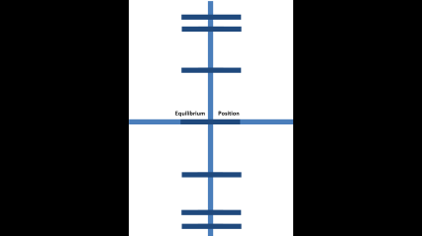
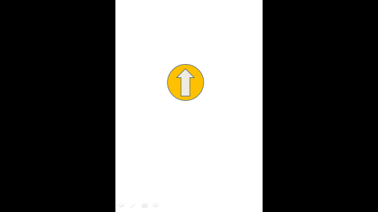
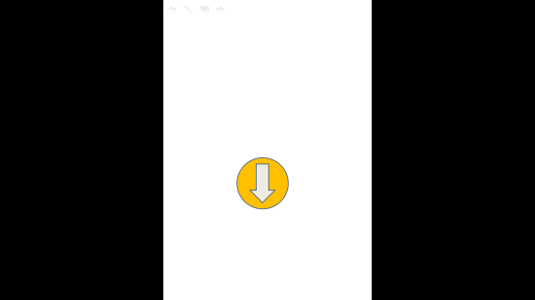

Figure : Shows 13 simulation panel attracted to the white boards to display a complete wave.

