Slide 1
Chapter 12 Light
12.1 Reflection of Light
12.2 Refraction of Light
12.3 Total Internal Reflection
12.4 Refraction by Thin Lenses
12.5 Ray Diagrams for Thin Converging Lenses

Slide 2
12.4 Refraction by Thin Lenses
Learning Outcomes
At the end of this section, you should be able to:
describe how light behaves when it passes through a thin converging or diverging lens;
define the term focal length for a thin converging lens.
draw ray diagrams to illustrate how real and virtual images are formed by a thin converging lens.

Slide 3
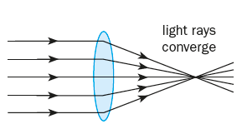
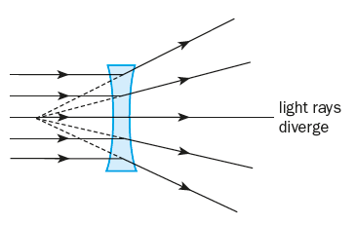
12.4 Refraction by Thin Lenses
Lenses
A lens is a piece of clear plastic or glass with curved surfaces.
Path of Light in Lenses
Through a converging lens
Through a diverging lens
The parallel light rays converge or diverge after passing through the lenses due to the refraction of light.

Slide 4
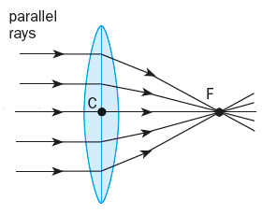
12.4 Refraction by Thin Lenses
Features of a Thin Converging Lens
Principal axis
The horizontal line passing through the optical centre of the lens
The principal axis is perpendicular to the vertical plane of the lens.
Optical centre C
The midpoint between the surfaces of the lens on its principal axis
Rays passing through the optical centre are not refracted.
Notes:
Explain to students the terms used in describing a thin converging lens.

Slide 5
12.4 Refraction by Thin Lenses
Features of a Thin Converging Lens
Focal plane
The plane that passes through the focal point F and is perpendicular to the principal axis
Focal point F
The point at which all rays parallel to the principal axis converge after refraction by the lens
A lens has two focal points, one on each side of the lens.

Slide 6
12.4 Refraction by Thin Lenses
Features of a Thin Converging Lens
focal length
Focal length f is the distance between the
optical centre C and the focal point F.
Notes:
Emphasise to students that it is important they familiarise with these terms as it will help them understand the next section better.

Slide 7
12.4 Ray Diagrams for Thin Converging Lenses
Thin Converging Lens Ray Diagram Simulation

Slide 8
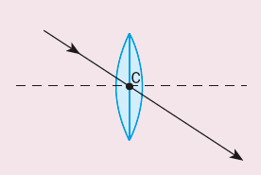
12.4 Ray Diagrams for Thin Converging Lenses
Drawing Ray Diagrams for Thin Converging Lenses
When a ray of light …
passes through the optical centre of the lens,
it passes through without bending.

Slide 9
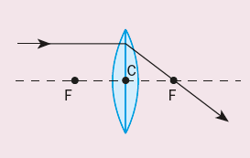
12.4 Ray Diagrams for Thin Converging Lenses
Drawing Ray Diagrams for Thin Converging Lenses
When a ray of light…
passes through the lens parallel to the len’s principal axis,
it is refracted to pass through the focal point F.

Slide 10
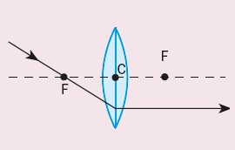
12.4 Ray Diagrams for Thin Converging Lenses
Drawing Ray Diagrams for Thin Converging Lenses
When a ray of light …
passes through the lens by first passing through its focal point,
it is refracted such that it emerges parallel to the principle axis.

Slide 11
12.4 Ray Diagrams for Thin Converging Lenses
ICT Activity (Discuss in Pairs)
In pairs, use the simulation to complete workbook questions with object moving from
Beyond 2F,
At 2F,
Between 2F and F,
At F
Between F and lens.

