Slide 1
A dropping Basket Ball
Understanding Laws of Conservation of Energy
Visualizing Energy Transfer and Energy Transformation using representations

Slide 2
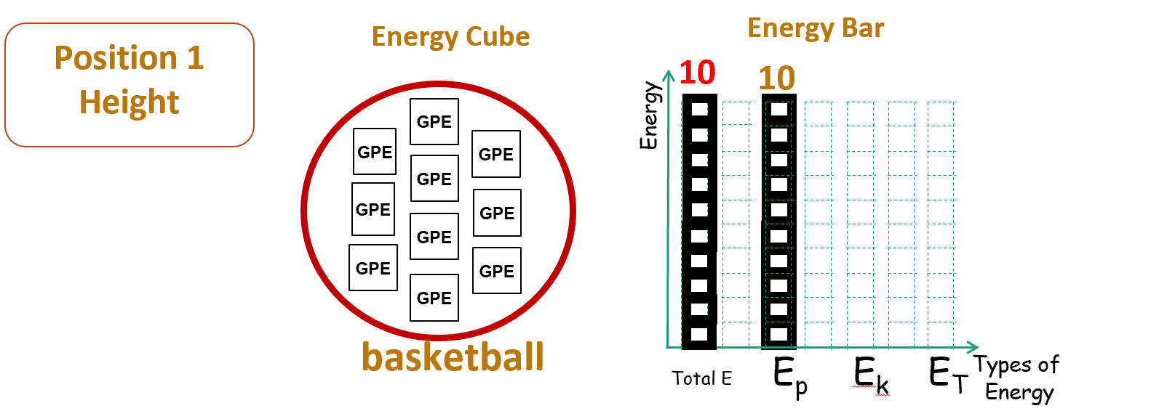
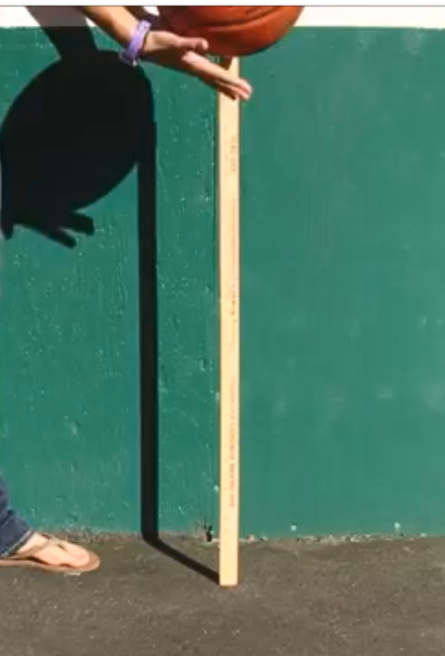
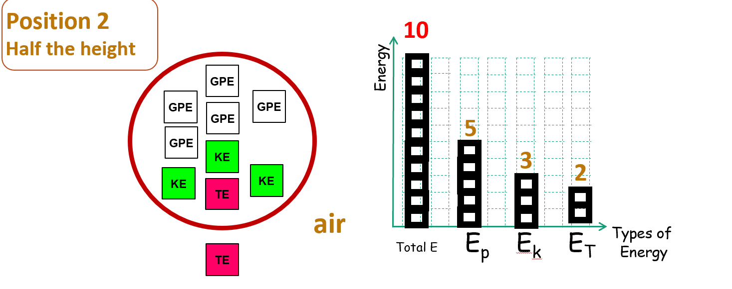
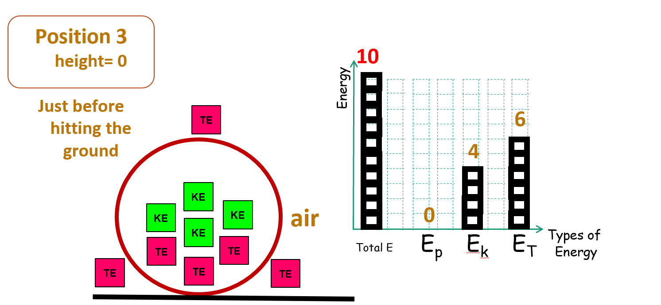
15.2 Energy Changes
Understanding & Visualizing Laws of Conservation of Energy
A dropping basket ball with air resistance
air
Ground (Earth)
Notes:
TIP1: Energy is a measure of how much change (position/motion) in an interaction between bodies
Change in position
Change in motion
Basketball in air interaction
Activity One using Basketball
Show three positions
Each position illustrates Energy cube & Energy bar
What are the forms of energy?
What is the total amount of energy?
What is the change in energy in stage 2 and 3?
What are the forces that are acting on the object? Bring in the Earth and object Acting on their prior knowledge.
What is the distribution of thermal energy Critical thinking on the system
Position A– 10 PE
Position B – 5 PE 3 KE 1TE, 1TE out of body Why do you have 1 TE here? One object moving I the environment, the object will be heated up? Thermal energy generated?
Position C– 5 KE 3 TE, 2 TE out of body

Slide 3
15.2 Energy Changes
Understanding & Visualising Laws of Conservation of Energy
Position 1
Height(max)
Energy Cube
Energy Bar
10
10
GPE
Energy
GPE
GPE
GPE
GPE
GPE
GPE
GPE
GPE
GPE
basketball
Total E E_{p} E_{k} E_{T}
Types of
Energy
air
Ground (Earth)
Notes:
TIP1: Energy is a measure of how much change (position/motion) in an interaction between bodies
Change in position
Change in motion
Basketball in air interaction
Activity One using Basketball
Show three positions
Each position illustrates Energy cube & Energy bar
What are the forms of energy?
What is the total amount of energy?
What is the change in energy in stage 2 and 3?
What are the forces that are acting on the object? Bring in the Earth and object Acting on their prior knowledge.
What is the distribution of thermal energy Critical thinking on the system
Position A– 10 PE
Position B – 5 PE 3 KE 1TE, 1TE out of body Why do you have 1 TE here? One object moving I the environment, the object will be heated up? Thermal energy generated?
Position C– 5 KE 3 TE, 2 TE out of body

Slide 4
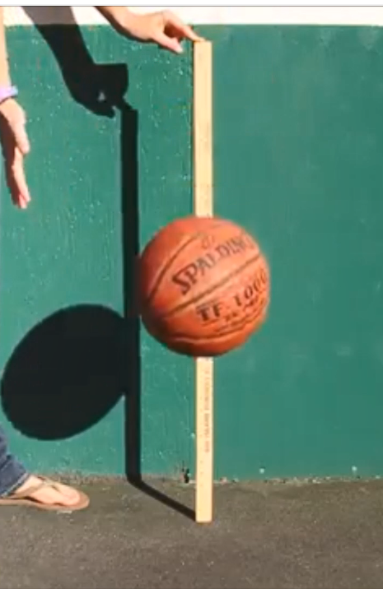
15.2 Energy Changes
Understanding & Visualising Laws of Conservation of Energy
Energy Cube
Energy Bar
Position 2
Half the height
10
GPE
Energy
GPE
GPE
GPE
5
GPE
KE
3
2
KE
KE
TE
air
Total E E_{p} E_{k} E_{T}
Types of
Energy
TE
Ground (Earth)
Notes:
Activity One using Basketball
Show three positions
Each position illustrates Energy cube & Energy bar
What are the forms of energy?
What is the total amount of energy?
What is the change in energy in stage 2 and 3?
What are the forces that are acting on the object? Bring in the Earth and object Acting on their prior knowledge.
What is the distribution of thermal energy Critical thinking on the system
Position A– 10 PE
Position B – 5 PE 3 KE 1TE, 1TE out of body Why do you have 1 TE here? One object moving I the environment, the object will be heated up? Thermal energy generated?
GPE is determined by the height, half the height, half amount of GPE
Move faster, object has higher resistance
Position C– 5 KE 3 TE, 2 TE out of body

Slide 5
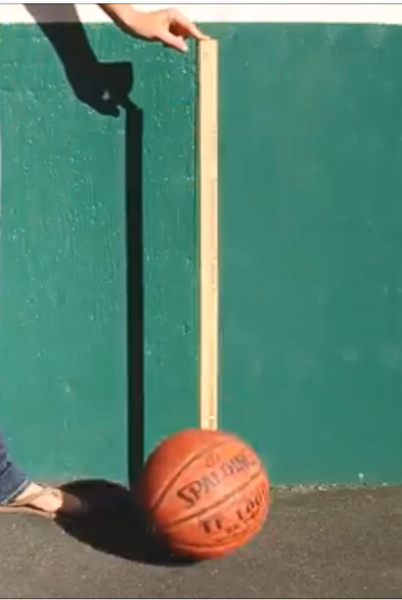
15.2 Energy Changes
Conservation of Energy – Describe Qualitatively
Dropping of Basketball
Energy Cube
Energy Bar
Position 3
height= 0
Just before hitting the ground
10
Energy
TE
6
4
KE
air
0
KE
KE
KE
Types of
Energy
TE
TE
Total E E_{p} E_{k} E_{T}
TE
TE
TE
Ground (Earth)
Notes:
Activity One using Basketball
Show three positions
Real world
Dynamically linked representation
Each position illustrates Energy cube & Energy bar
QUESTION CARD
Q1.What are the forms of energy?
Q2.What is the total amount of energy?
Q3.What is the change in energy in stage 2 and 3? (compare previous and current)
Q4.What are the forces that are acting on the object? Bring in the Earth and object Acting on their prior knowledge. When there is a presence of forces, it results a change and transfer of energy
Frictional force causes transfer of thermal energy.
It must convert GPE to KE before it was converted to TE.
ENTRY PT – students may interpret GPE to TE, position A is there any thermal energy, object must move faster, it increases the air resistance.
Frictional force slows down the object.
GPE is dependent on the height. (what happens to KE?)
Q5. What is the distribution of thermal energy? Two bodies get heated;
Air is poor thermal conductor (less TE in air); Assume similar thermal conductivity. IF metal than air, higher thermal conductivity. Basketball and air (two bodies)
Critical thinking on the system
Position A– 10 PE
Position B – 5 PE 3 KE 1TE, 1TE out of body Why do you have 1 TE here? One object moving I the environment, the object will be heated up? Thermal energy generated?
Position C– 4 KE 3 TE, 2 TE out of body
1 TE in the position B
3 TE stays inside the ball
2 TE outside the ball
4 KE indicates speed is maximum and therefore there are more TE due to higher resistance

