Slide 1
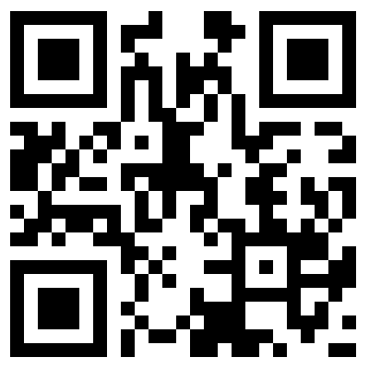
Kinematics
pingo.upb.de → 682293

Slide 2

ConcepTest 1: Driving-car applet
A train car moves along a long straight track. The graph shows the position as a function of time for this train. The graph shows that the train:
1. speeds up all the time.
2. slows down all the time.
3. speeds up part of the time and slows
down part of the time.
4. moves at a constant velocity.
Notes:
Answer: 2.The slope of the curve diminishes as time increases.

Slide 3
ConcepTest 2: Driving-car applet (with store data)
The graph shows position as a function of time for two trains running on parallel tracks. Which is true?
1. At time t_{B}, both trains have the same velocity.
2. Both trains speed up all the time.
3. Both trains have the same velocity at some time
before t_{B}.
4. Somewhere on the graph, both trains have the same
acceleration.
Notes:
Answer: 3.The slope of curve B is parallel to line A at some point t < t_{B}.

Slide 4
ConcepTest 3: Falling-ball applet
A person standing at the edge of a cliff throws one ball straight up and another ball straight down at the same initial speed. Neglecting air resistance, the ball to hit the ground below the cliff with the greater speed is the one initially thrown
1. upward.
2. downward.
3. neither—they both hit at the same speed.
Notes:
Answer: 3. Upon its descent, the velocity of an object thrown straight up
with an initial velocity v is exactly –v when it passes the point at which it
was first released.

Slide 5
ConcepTest 4: Falling-ball applet
You are throwing a ball straight up in the air.
At the highest point, the ball’s
1. velocity and acceleration are zero.
2. velocity is nonzero but its acceleration is zero.
3. acceleration is nonzero, but its velocity is zero.
4. velocity and acceleration are both nonzero.
Notes:
Answer: 3.The ball reaches its highest point when its velocity is zero; the
acceleration of gravity is never zero.

Slide 6
ConcepTest 5: Extension (2D applet)
Consider the situation depicted here. A gun is aimed directly at a dangerous criminal hanging from the gutter of a building. The target is well within the gun’s range, but the instant the gun is fired and the bullet moves with a speed v_{o}, the criminal lets go and drops to the ground. What happens? The bullet
1. hits the criminal regardless of the value of v_{o}.
2. hits the criminal only if v_{o} is large enough.
3. misses the criminal.
Notes:
Model Answer: 1. Downward acceleration of bullet and criminal are identical, so the bullet will hit its target—they both “fall” the same distance.

Slide 7
ConcepTest 6: Extension (2D applet)
A battleship simultaneously fires two shells at enemy ships. If the shells follow the parabolic trajectories shown, which ship gets hit first?
1. A
2. both at the same time
3. B
4. need more information
Notes:
Answer: 3. The time a projectile spends in the air is equal to twice the
time it takes to fall from its maximum height. Because the shell fired at ship
A reaches a higher altitude than the one aimed at B, the former takes
longer to return to sea level.

