Slide 1
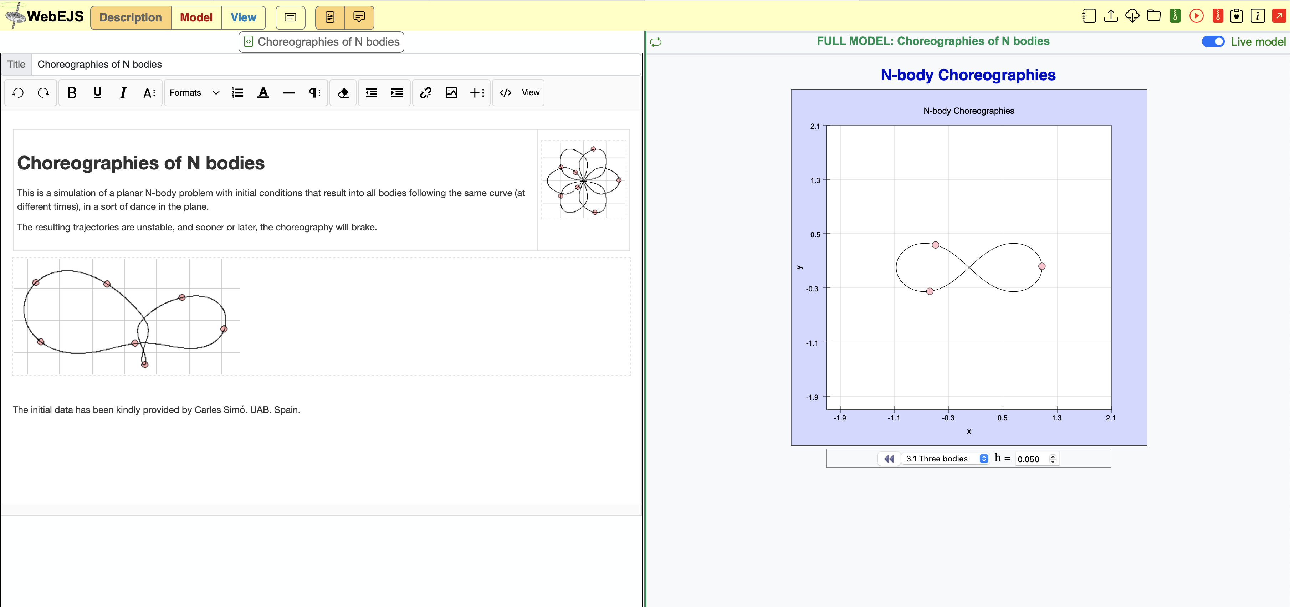
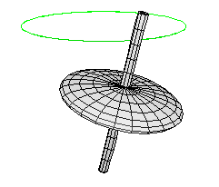

EJS Models in more detail
Francisco Esquembre
Creation of Interactive Resources Using the WebEJS Authoring Toolkit
Powered by WebEJS

Slide 2
EJS Models in more detail
Contents
A crash course on Modelization
How EjsS model tabs work together
Main tabs
Auxiliary tabs
Other topics:
JavaScript variable “types” in EjsS
The ODE editor and its sub panels
[Binding variables and properties]
[Using view functions]
Creation of Interactive Resources Using the WebEJS Authoring Toolkit
Powered by WebEJS

Slide 3

EJS Models in more detail
Modelling steps
Analise the problem (Mental model)
Obtain and study data from the system to identify its behaviour
Extract the core of the problem (simplify)
Decompose in subproblems (sub-models)
Formulate the mathematical problem
Determine variables and their units
Input: parameters, independent variables and inputs
State: dependent variables, auxiliary variables
Output: display or output variables
Establish relations among variables
Equations
Functions
Algorithms
Solve the model
Analytically
Numerically (Simulation)
Simplify
Validate and interpret
Predict
Understand
Report (document) the process
Maintain the model
Improve it
Creation of Interactive Resources Using the WebEJS Authoring Toolkit
Powered by WebEJS

Slide 4
EJS Models in more detail
Model classification
Deterministic versus Probabilistic (or Stochastic)
Same input -> Same output ?
Deterministic: most mechanics models: SHO, pendulum…
Stochastic: MonteCarlo models
Dynamic versus Static
Is time one of the input variables?
Dynamic: problems of dynamics, population models
Static: geometrical optics
Discrete versus Continuous
Output only in a discrete (countable) or uncountable set of instants in time?
Discrete: time series
Static: differential equations
In the end, all computer models are discrete!
Creation of Interactive Resources Using the WebEJS Authoring Toolkit
Powered by WebEJS

Slide 5
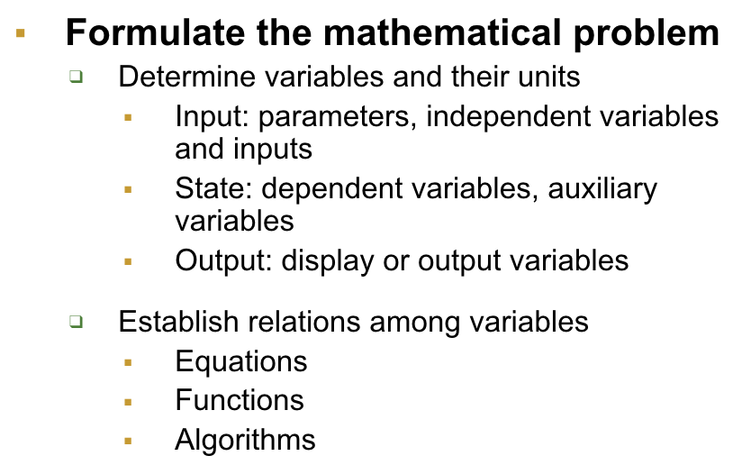
EJS Models in more detail
Model formulation
“Active” formulation of models in EJS
Identify variables
Initialize model
Response to changes
Evolution
User interaction
Output & Interaction
The view
Creation of Interactive Resources Using the WebEJS Authoring Toolkit
Powered by WebEJS

Slide 6
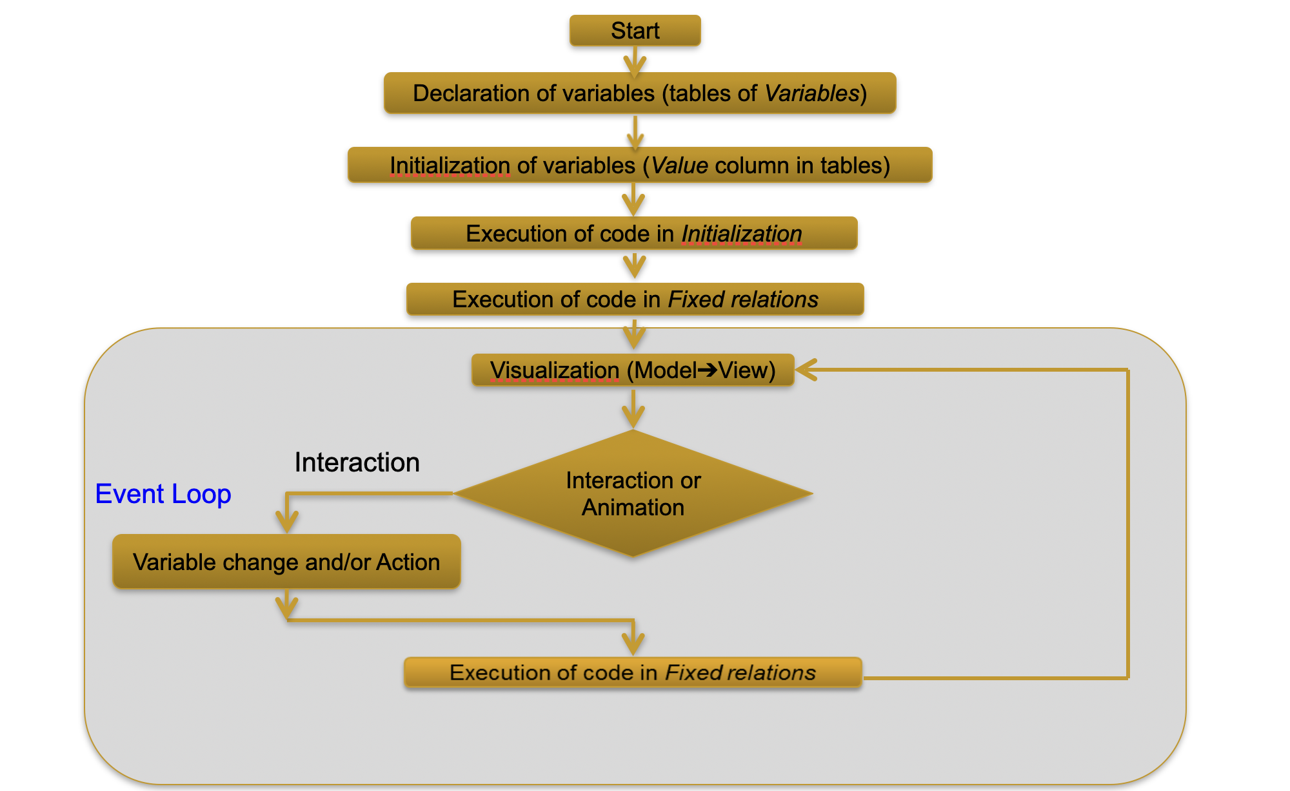
EJS Models in more detail
How EJS model tabs work together
in a model with no evolution
Creation of Interactive Resources Using the WebEJS Authoring Toolkit
Powered by WebEJS

Slide 7
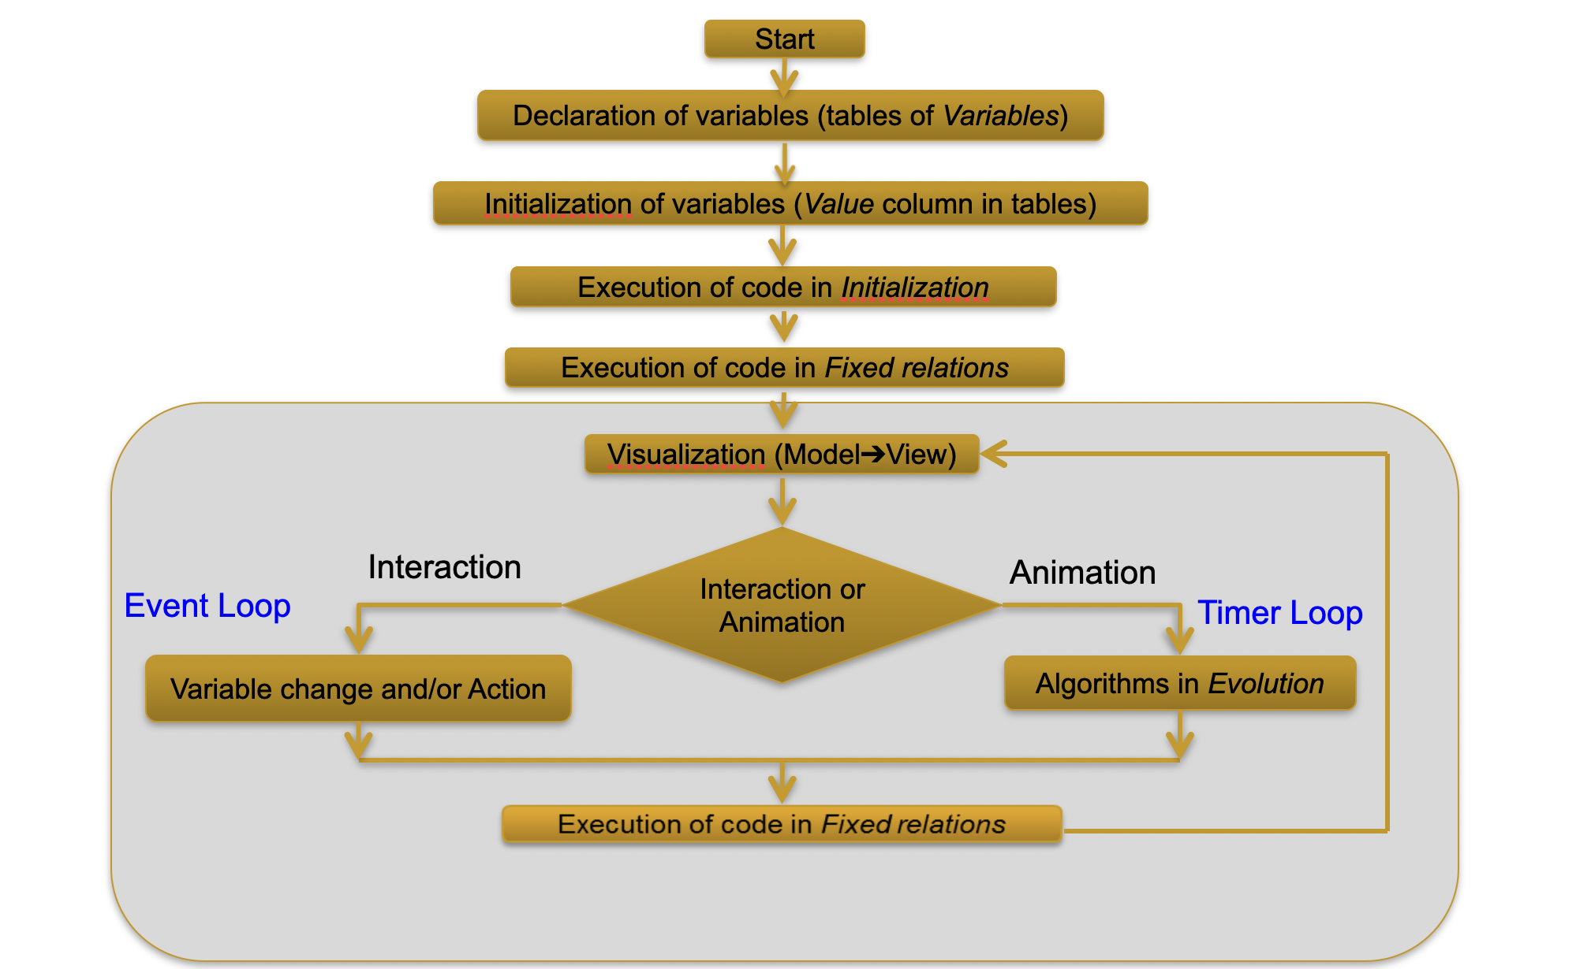
EJS Models in more detail
How EJS model tabs work together
in a model with evolution
Creation of Interactive Resources Using the WebEJS Authoring Toolkit
Powered by WebEJS

Slide 8
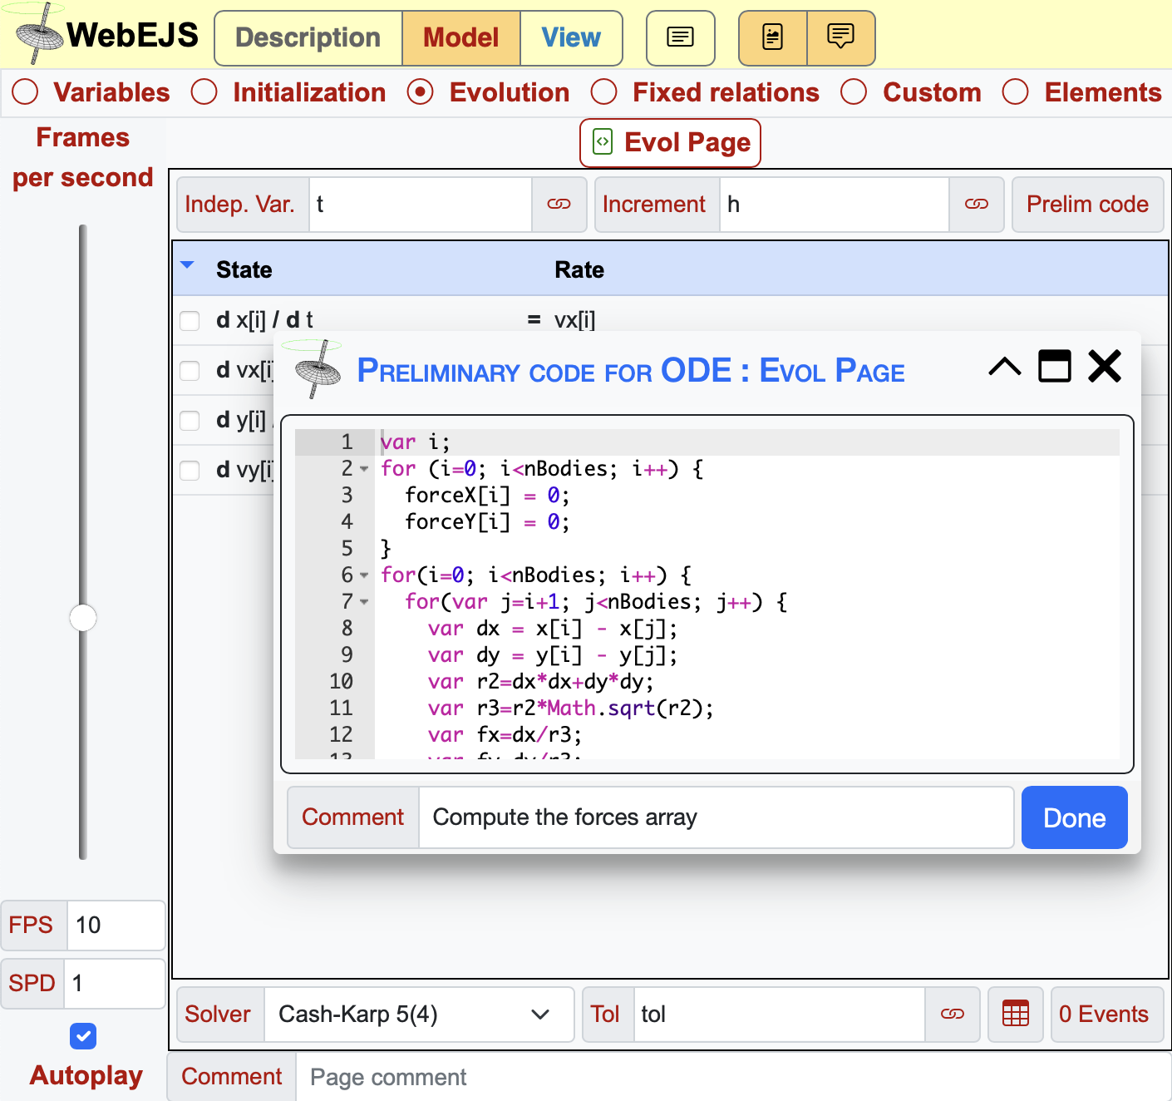
EJS Models in more detail
The ODE editor and its sub panels
The ODE editor basic panel
Equations
Solver
Tolerance
Preliminary code
Advanced panel
Events
_resetSolvers()
Creation of Interactive Resources Using the WebEJS Authoring Toolkit
Powered by WebEJS

Slide 9
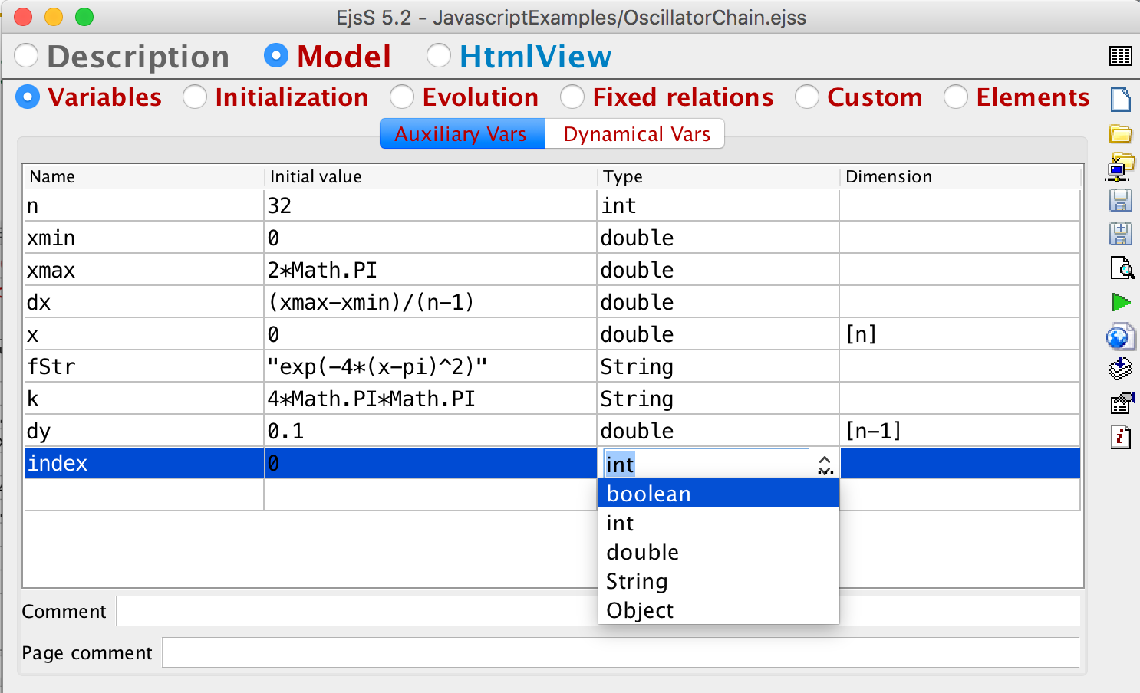
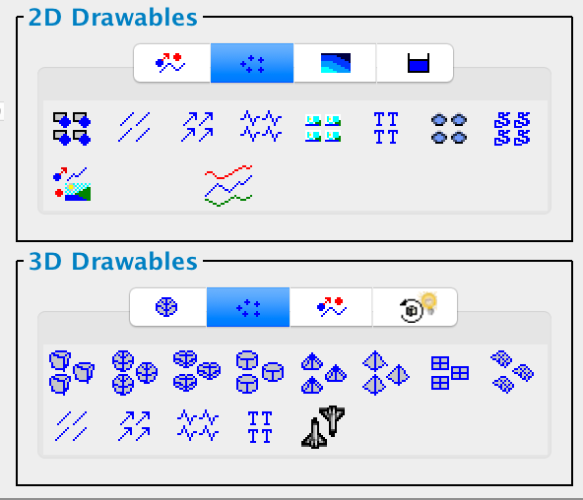
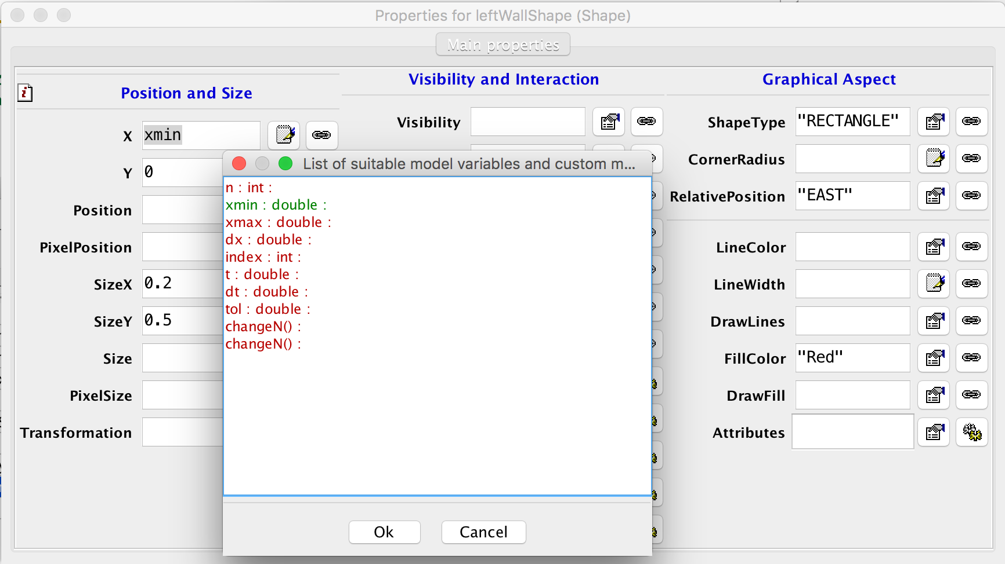
EJS Models in more detail
JavaScript variable “types” in EJS
var versus booleans, int, double, String, Object?
Arrays
Creation of Interactive Resources Using the WebEJS Authoring Toolkit
Powered by WebEJS

Slide 10
EJS Models in more detail
JavaScript 101: Variables in JavaScript
Variables do NOT need to be declared before being used. (Potential caveat!)
All variables (when declared) are declared as var
var isGood = true;
var i = 0;
var x = 0.1;
var text = ’Hello’;
var array = [ 1.0, 2.0, 3.0 ];
var myObject = { x : 0.1, y : 0.2 };
console.log (“array[0] = “+array[0]);
console.log (“myObject x = “+myObject.x);
But there are actually 5 types:
string, number, boolean, object, function
Conversion is automatic: text = 0.1;
Or through special functions: String (x), Number(“0.1”)
(http://www.w3schools.com/js/js_type_conversion.asp)
Creation of Interactive Resources Using the WebEJS Authoring Toolkit
Powered by WebEJS

Slide 11
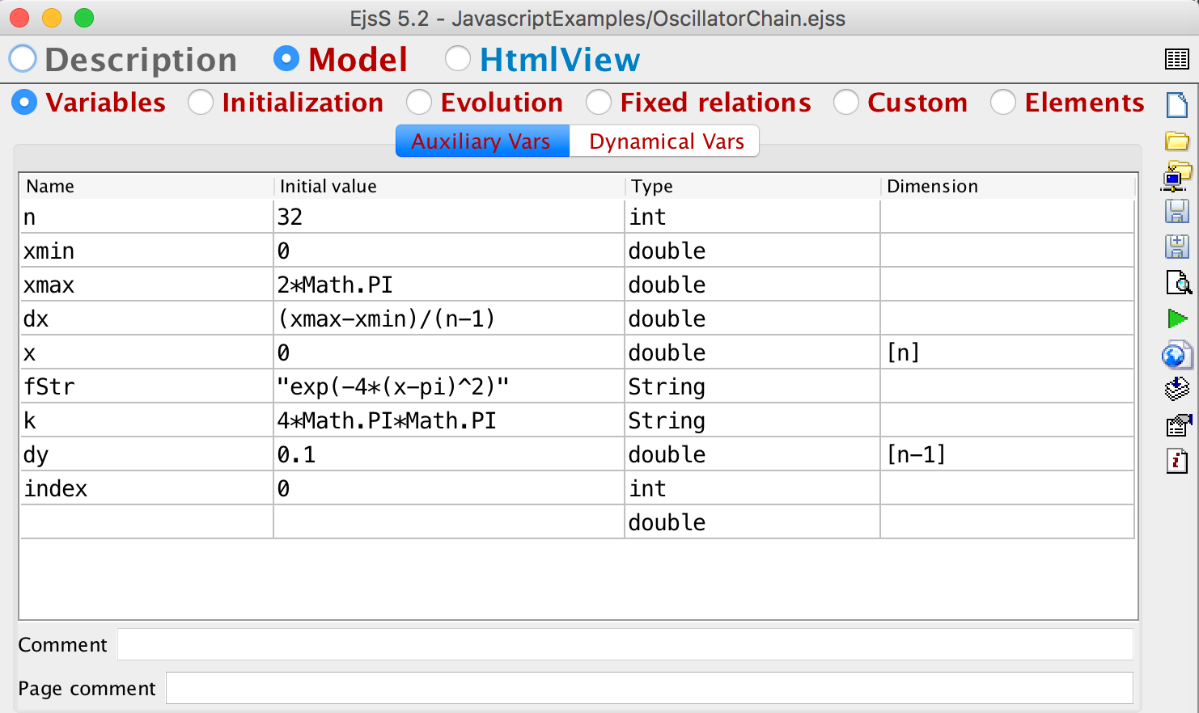
EJS Models in more detail
JavaScript 101: Variables in EJS
Global variables are declared in the Variables tab and commented (recommended)
We specify the type of variables when declaring in Variables (as a hint for the view)
Variables are initialised if a value is given (recommended)
Vars declared in code tabs are local to this tab (except…)
Vars declared in Custom, outside of a function, are also global.
Creation of Interactive Resources Using the WebEJS Authoring Toolkit
Powered by WebEJS

Slide 12
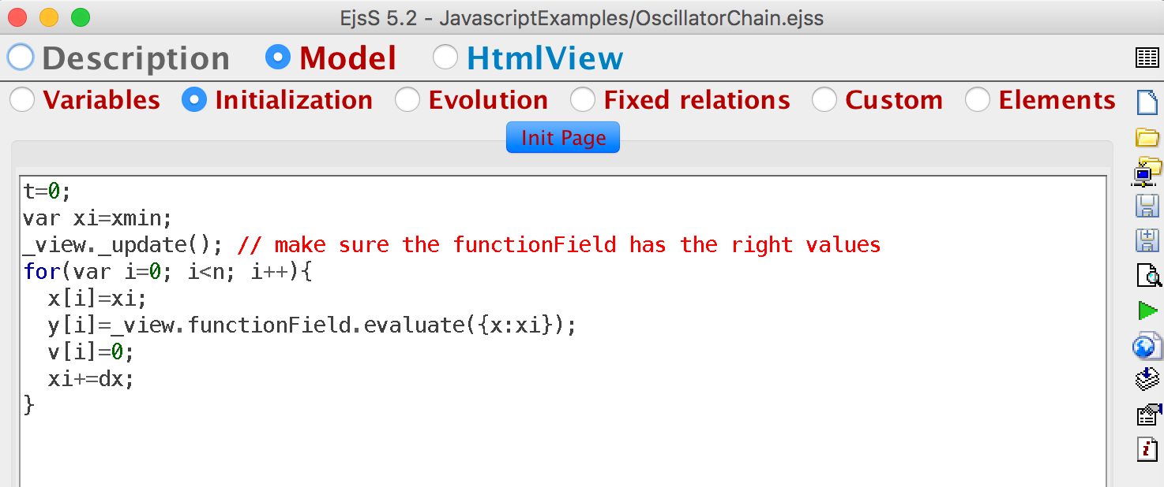
EJS Models in more detail
JavaScript 101: Variables in EJS
Arrays are declared with an indication of its dimension
Or as x = new Array(n);
Or as x = [ ];
Though the length can be changed in run time
Elements are addressed as x[i] with i an integer.
Objects are rare in EjsS.
declared as obj = { };
Fields aded as
obj[“name”] = “Paco”;
obj.name = “Paco”;
There are two predefined objects: _model and _view. _view is used sometimes.
Creation of Interactive Resources Using the WebEJS Authoring Toolkit
Powered by WebEJS

Slide 13
EJS Models in more detail
JavaScript 101: JavaScript syntax tips
Operators: + - * / % = ! == != === !== ?:
Sentences and expressions
Bifurcations
if, if - else
switch - case
Loops
for (var i=0; i<n; i++) { }
while ( ) { }
do { } while ( );
Creation of Interactive Resources Using the WebEJS Authoring Toolkit
Powered by WebEJS

Slide 14
EJS Models in more detail
JavaScript 101: Functions and libraries
Functions
function myFunction (param1, param2) { };
No return declaration, no parameter declaration.
List of parameters does not need to be respected!
functions can be treated as variables
var myFunction = function(param1, param2) { };
and parameters for other functions:
integrate (myFunction);
Libraries (Math in particular):
www.w3schools.com/jsref/jsref_obj_math.asp
of Google for “javascript math functions”
Math.sin(x) …
Creation of Interactive Resources Using the WebEJS Authoring Toolkit
Powered by WebEJS

Slide 15
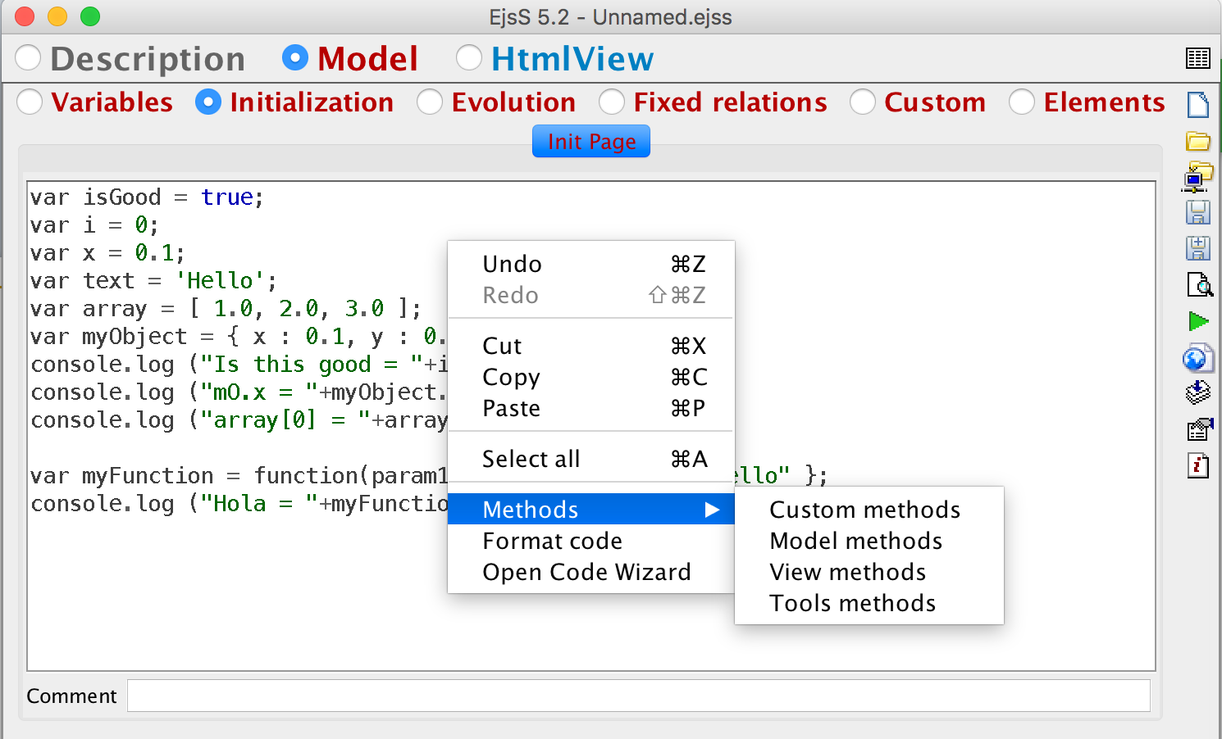
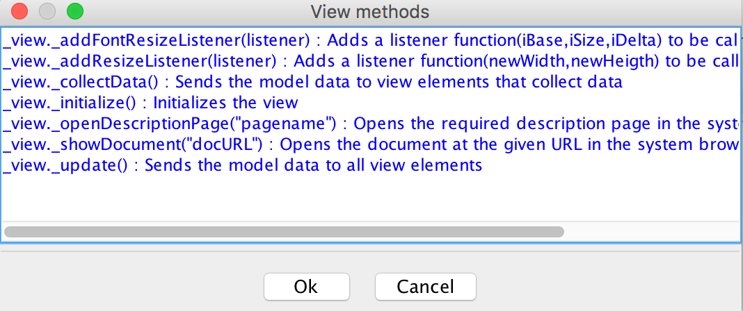
EJS Models in more detail
JavaScript 101: Objects in EjsS
_model
Functions
_model.play()
_model.pause()
_view
Elements
_view.myTrail
.setProperty ( “name”, value);
special functions, such as, _view.myTrail.addPoint(t,x); See documentation for element.
Functions
_view._update();
The popup menu provides help (see image)
Creation of Interactive Resources Using the WebEJS Authoring Toolkit
Powered by WebEJS

Slide 16
EJS Views in more detail
Francisco Esquembre
Creation of Interactive Resources Using the WebEJS Authoring Toolkit
Powered by WebEJS

Slide 17
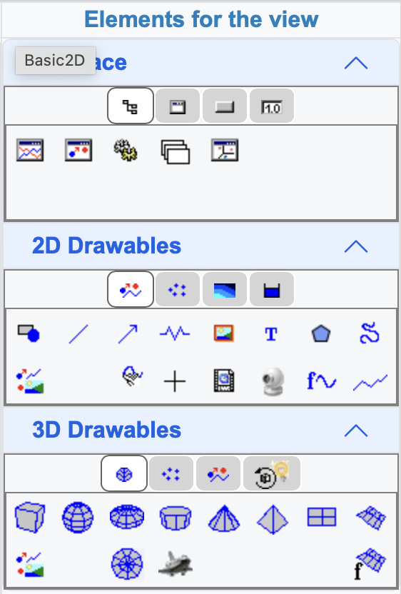
EJS Views in more detail
Review
The basics:
Elements and properties
Parents and children
Interface elements
Containers: panels and drawing panels
Decoration and Input/Ouput
Drawables
Drawables 2D
Drawables 3D
Sets and arrays
Compound elements and Templates
Creation of Interactive Resources Using the WebEJS Authoring Toolkit
Powered by WebEJS

