Slide 1
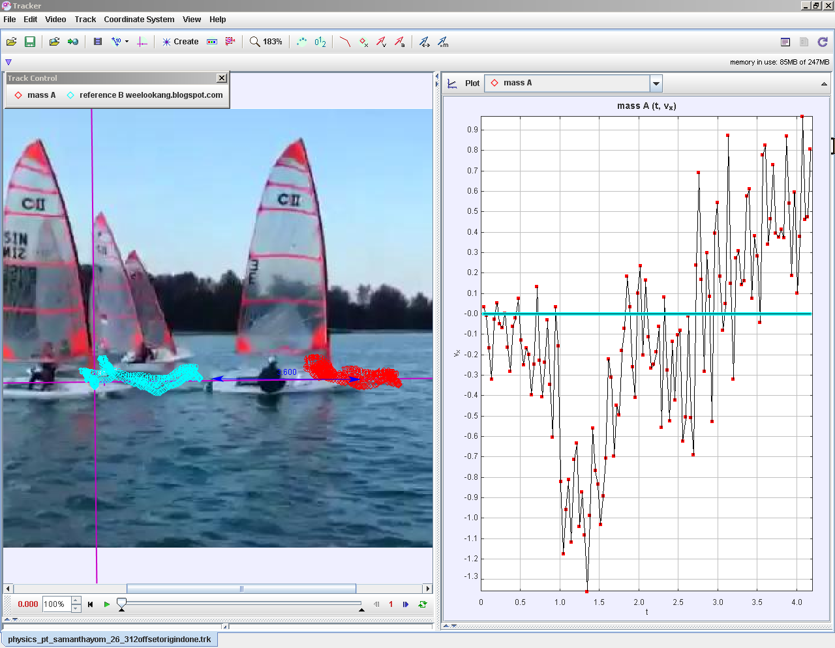

Becoming scientists through Video Analysis
TzeKwang.LEONG@rgs.edu.sg
Ning_Hwee_Tiang@moe.edu.sg
Tan_Kim_Kia@moe.edu.sg
Lawrence_WEE@moe.gov.sg
LEE_Tat_Leong@moe.gov.sg
Date: 04 Feb 2015
Venue: edulab@AST, 2 Malan Road Blk J, Level 4
Time: 1500-1730
https://sites.google.com/a/moe.edu.sg/becoming-scientists-through-video-analysis/
Notes:
Our project seeks to allow students to be like scientists (obtain real data from physical phenomena, engage in making inference and deducing how the physical world work).
This is accomplished by using the k 12 8 practice approach supported by video analysis with Tracker.
At this point of sharing, project is ongoing..

Slide 2
Program
Trainer | Time (mins) | Activity
Tze Kwang, Ning, Kim Kia | 20 | introduce the 8 Practices of Science Education adapted from the Science Framework for K-12 Science Education
Lawrence | 10 | design principles behind this ICT-enabled practice
Tze Kwang, Ning, Kim Kia | 60 | Hands-on demonstrate the effective use of Tracker, a video analysis tool, for analysis and interpretation of phenomena
everyone | 20 | networking
Tat Leong and Tze Kwang | 30 | in-depth model building. oriented to the Tracker Shared Library where available models for physics concepts such as push and deceleration model
Lawrence | 10 | Reflect and Feedback

Slide 3

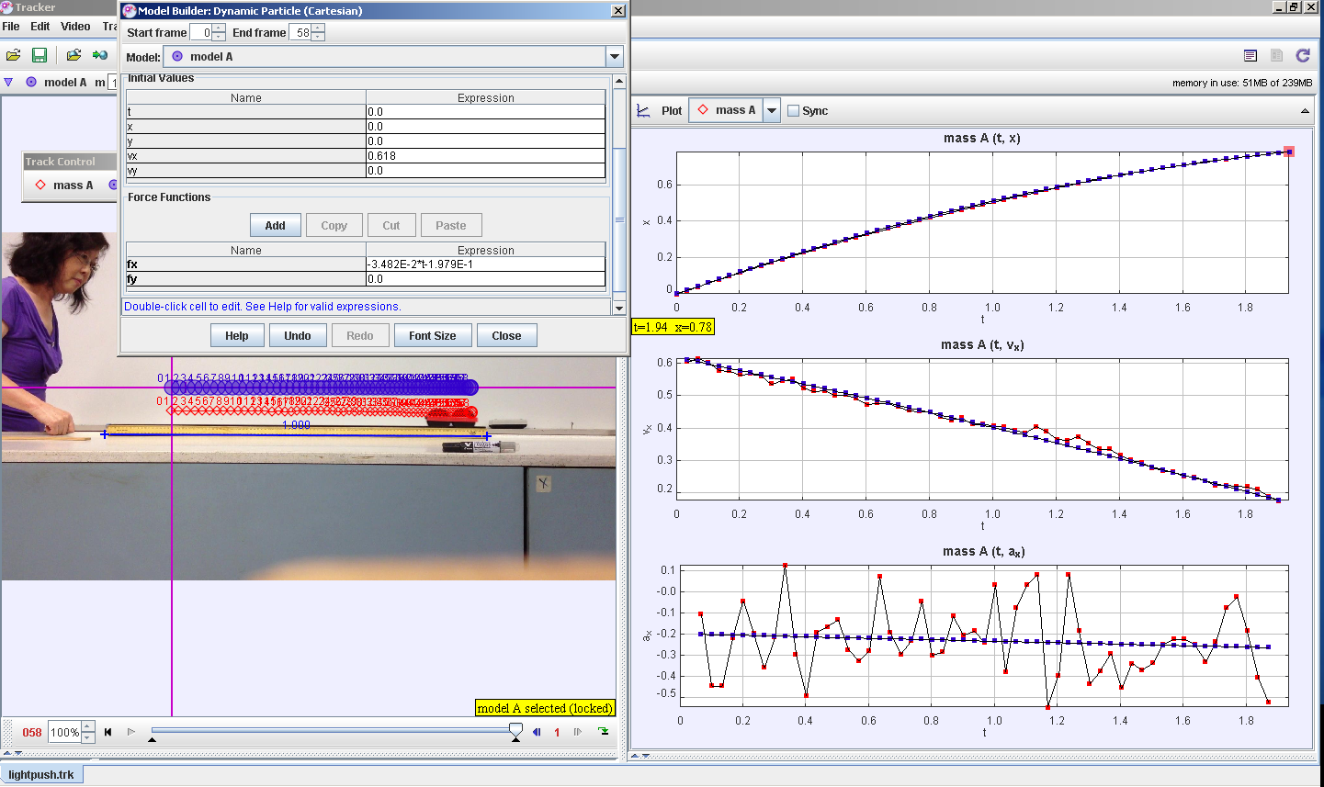
What?
What is tracker? https://www.cabrillo.edu/~dbrown/tracker/A software able to capture data from the video and be used for graphical analysis
http://weelookang.blogspot.it/2014/02/tracker-light-push.html

Slide 4
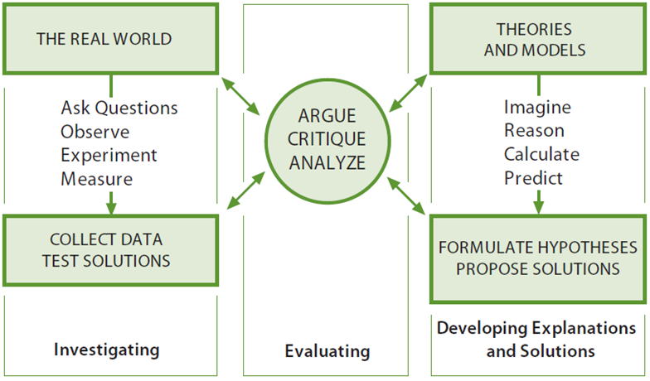
What?: K12 eight practices of science by National Academy of Sciences
2.
1.
7.
4.
8. communicate
4.
6.
3.
Notes:
Have you ever wondered how a student learn how to play basketball? She practice the game, often with other player. She doesn't just sit there and memorise all the laws of basketball.
How does a student learn how to be a scientist?
Does she ask question, develop models ...
1. Ask questions
2. Develop models
3. Plan and carry out investigations
4. Analyze and interpret data
5. Use mathematics thinking
6. Construct explanations
7. Engage in argument from evidence
8. Obtain, evaluate and communicate information

Slide 5
What?: K12 eight practices of science by National Academy of Sciences
8 practices of scientists
(1) Asking Questions☺
(2) Using Models²
(3) Plan & Carry Out Investigations☺
(4) Analysing Data☺
(5) Mathematical & Computational² Thinking
(6) Explaining based on evidence☺
(7) Argumentation
(8) Communication☺
2 Wee, Loo Kang, Chew, Charles, Goh, Giam Hwee, Tan, Samuel, & Lee, Tat Leong. (2012). Using Tracker as a pedagogical tool for understanding projectile motion. Physics Education, 47(4), 448.
Notes:
The National Science Education Standards (NSES p. 23) defines scientific inquiry as
“the diverse ways in which scientists study the natural world and propose explanations
based on the evidence derived from their work.
Scientific inquiry also refers to the activities through which students develop knowledge and understanding of scientific ideas, as well as an understanding of how scientists study the natural world.”

Slide 6
Why?
Science students should behave like scientists.
Traditional Lessons | Scientist Research
Topics taught in isolation | Knowledge from various topics are required
Simplified theoretical scenario with many assumptions | Authentic collected data which often include anomaly
Knowledge apply to assessment questions | Knowledge apply to real world situations
Teacher directed; Teacher decide on question | Student directed; Ownership of research question
No differentiation; One size fits all | Research is individualized
Notes:
Or does she learn the topics in isolation and solve simplified questions with many assumptions only for the purpose of examination?
Does she just do what the teacher tell her to do and do exactly the same thing from her classmates who have different interest and different abilities?
There's obviously a gap between how we teach & what need to be taught & that's why we need to redesign our curriculum to better train our students as scientist and also to better motivate them in learning

Slide 7
Why?
Tracker empower students to investigate motions they observe in real world
Tracker | Data logger / traditional experiment
2-D motion; Non-rigid body | 1-D motion (2-D motion are extremely difficult to setup)
Shorter setup time | Longer setup time
Same software & video can be used for several topics | Every experiment is designed for a single learning objective
Differentiation is easy | Differentiation is difficult
high speed camera allow very short duration motion | Motion has to be long enough for negligible human reaction time
Free; students can conduct individual research even beyond the classroom | Data logger are expensive and students have to share the sensors within classroom
Notes:
Why do we use tracker instead of data logger or other ways of experimentation.
Tracker empowered to investigate almost any motions they observe in real world in a very short time. Examples include 2d, non rigid body, short duration motion & multiple objects.
Because of the ease of setting up & not requiring any complicated setup, students can perform different task, anytime, anywhere.
Also the same video can be used for several topics which help the students establish connection between topics.

Slide 8
Using Tracker as a Pedagogical Tool for Understanding Toss Up-Free Fall Motion
Research paper at Cornell University Library http://arxiv.org/abs/1501.02858
An Evergreen Sec Physics PLT research project in collaboration with eduLab
Sec 3 Pure Physics Kinematics of Free Fall
Google Site to facilitate instructions
Lesson at Computer Lab
Use of Pre- and Post test multiple-choice question and assessment tool
Post lesson Students Focus Group Discussion

Slide 9

The Learning Task
Video – ball tosses up
Graph – displacement-time, velocity-time, acceleration-time
Google site https://sites.google.com/a/moe.edu.sg/2014-sec-3-physics-performance-task/

Slide 10
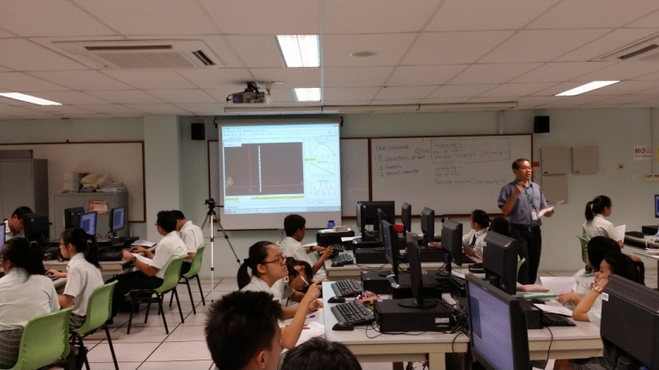
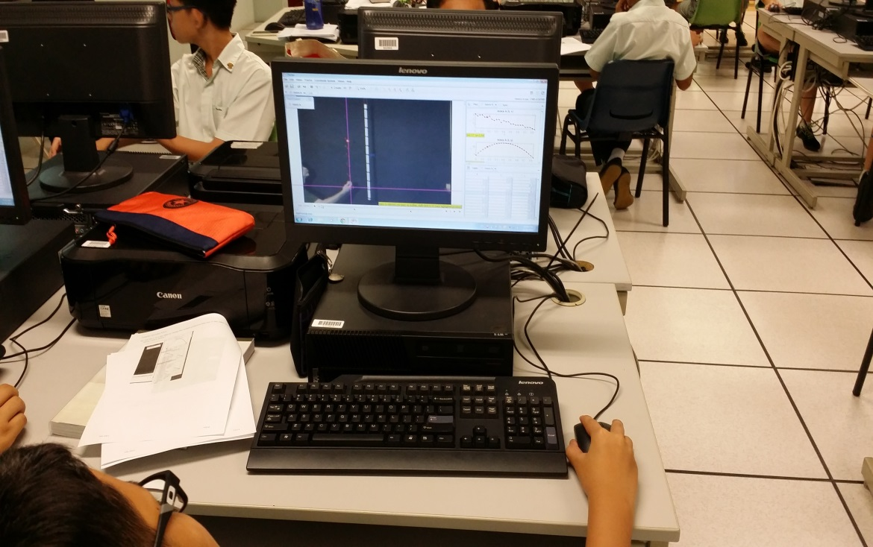

Slide 11
Test Scores
Post test positive gain
Cohen’s d effect
size = 0.79
(practically significant)

Slide 12
Students’ FGD
“We are able to see the connections between the real life [video] and the [scientific] graph[s]. Tracker helps me to confirm the theory [in kinematics] I have learned.”
“The video analysis [Tracker] gives me the opportunity to check the data collected. I realized that in real life data collection, there are random errors, which was shown from the graph plotted.”
- AMIRUL SUFYAN, 3 commitment
- LEE CHAEYUN, 3 Respect

Slide 13
Students’ FGD
“Compared to teachers’ explanation on the board, the video analysis gives us more opportunity to have the real learning experience; rather that spoon feed us with content. By allowing us to use the video analysis [tool, Tracker], we are able to see more precisely between the ball and the graph plotted.”
- KOO CHUN AUN, 3 Respect

Slide 14
Students’ FGD
“Perhaps we can have a practical lesson [a performance task] in the curriculum. We would be interested in trying it out ourselves to do the experiment and record the videos ourselves”.
“I don’t have the experience to load the video and track the video. I would like teachers to use the video Tracker to show us the scenarios in learning, so that we can strike a balance between learning effectively and not to spend too much time in setting up the video [tool] Tracker”.
- LIN RUI XIANG, 3 Commitment
- YIP SHI MIN, 3 Integrity

Slide 15
Teachers’ Reflections
Start the year with an easier horizontal kinematics task like investigating a constant speed object moving on a frictionless track. This serves to address the cognitive overload (Roth, 1999) problem encountered when using the software Tracker and the relatively complex concept of toss up and free fall for fresh Sec 3 students.

Slide 16
Teachers’ Reflections
We also recognize for sustained learning gains that Tracker use be integrated for topics like kinematics, dynamics and work, energy which tracker’s analysis affords for seamlessly.
We will use Tracker as tool to model and analyse difficult exam questions to help students visualise abstract and invisible Physics concepts.

Slide 17
REFINING DESIGN PRINCIPLES
After every lesson observation
surface strengths and areas for improvement
organise the input according to the design principles
New version of DP doc
Notes:
Level wide for all schools

Slide 18
REFINING DESIGN PRINCIPLES
ACTIVITY | PARTICIPATION STRUCTURE | SOCIAL SURROUND
Formulate empirically model-able testable questions that arise from careful observation of phenomena (Practice 1) | Create opportunities for students to share argue, and explain suitable equation-models (Practice 6.8) | Create high-challenge, low threat environments that allows time for reflection and feedback
Notes:
Level wide for all schools

Slide 19
REFINING DESIGN PRINCIPLES
ACTIVITY | PARTICIPATION STRUCTURE | SOCIAL SURROUND
Interpret data by identifying significant features and patterns, use mathematics to represent relationships between variables, and take into account sources of error. (Practice 4, 5) | Create opportunities for students to evaluate and refine models through an iterative cycle of comparing their predictions with the real world and then adjusting them to gain insights into the phenomenon being modeled (Practice 2,3) | Reasoning and argument based on evidence are essential in identifying the best explanation for a natural phenomenon (Practice 7)
Notes:
Level wide for all schools

Slide 20
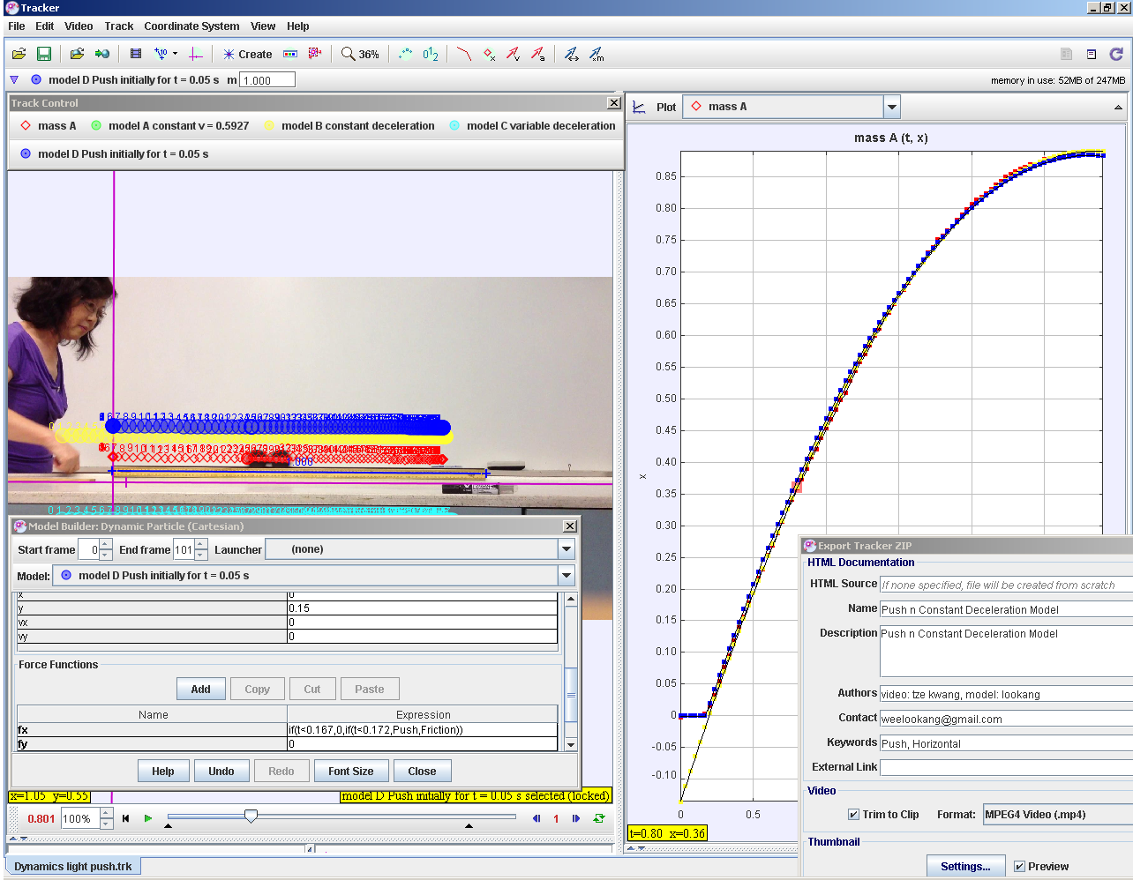
Tracker Push n Constant Deceleration Model
Model A constant v = 0.5927
Model C Fdrag = k*vx
Model B F = μ *R
Model D = fx = if(t<0.167,0,if(t<0.172,Push,Friction)) , Push = 134, Friction = -1.268E-1*2
Notes:
http://weelookang.blogspot.sg/2015/01/tracker-push-n-constant-deceleration.html

Slide 21
How?
1. Flip videos provided prior to lesson for students to watch before lesson.
a. How to install tracker
b. how to generate the s-t, v-t and a-t graphs of a cart with hard push is given (approximately constant speed).
c. how to analyse the graphs by finding gradient and area
https://www.youtube.com/watch?v=H_zrkl16BNs
https://www.youtube.com/watch?v=7_TgOSMqRQs
Prior knowledge: The displacement-time, velocity-time and acceleration-time graph was already explained in prior lesson.
Notes:
Unlike traditional course, our focus is graphical representation. After defining displacement, velocity and acceleration, we ask the students to download and watch some flip video to know how to track and analyse the graphs.
Throughout the course we have several flip instructions to make way for more activity time in class.

Slide 22
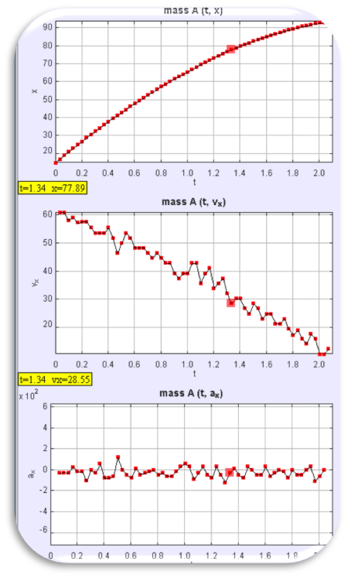
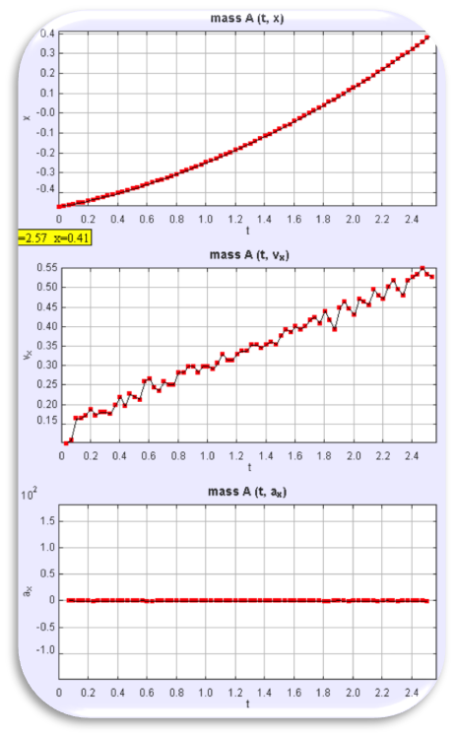
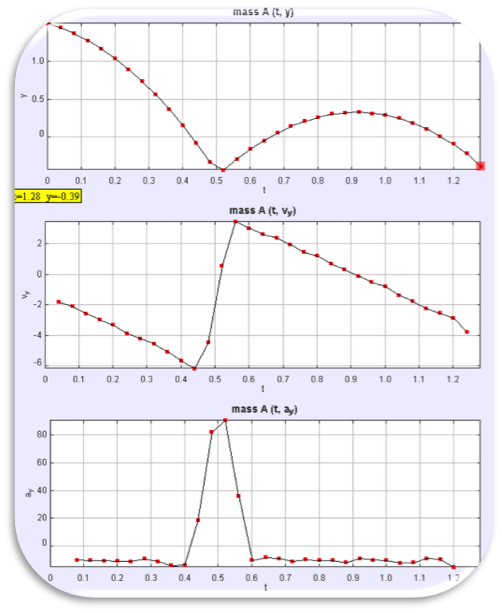
How?
2. The students were then given a set of video to analyse in groups. They will discuss and each group will present and critic on the other group presentations.
Cart with gentle push (Slowing down at constant acceleration)
Cart on slope (Speeding up at constant acceleration)
Bouncing Ball
(Motion divided into phase)
Notes:
In class, the students were then given...
All I needed to do was facilitate and summarise the discussion and highlight good presentation and misconceptions.
Every video are given with increasing difficulty and a certain thing to teach in mind.
For the projectile motion, the objective was to show students that motion occurs in phases and each phase are acted by different forces.

Slide 23
How?
4. Students given 1 track and several marbles and balls and were told to
a. Define a problem
b. Plan out an investigation
c. Analyse and interpret the data
d. Construct explanations
Some investigations include:
• Marble rolling up and down a ramp
• Bouncing Marble (even bouncing down the stairs or on a slope)
• Flying Marble colliding with wall
• Colliding Marble
Notes:
Once the students are familiar with the software and graph analysis, we gave them opportunity to practice as a scientist by providing them with a track and several marbles and balls.

Slide 24
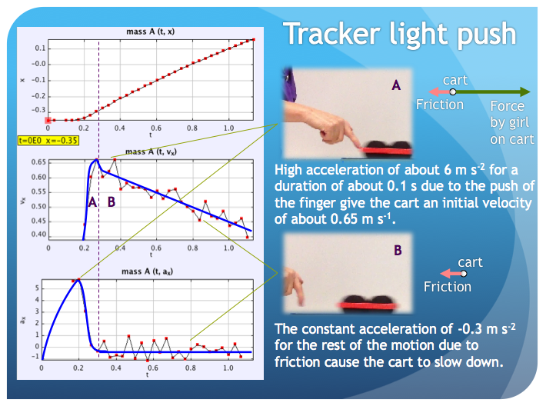
How?
5. Students were asked to suggest what causes the motion. All previous videos are revisited to discuss the dynamics.
Notes:
After they are familiar with kinematics, we revisited all the previous videos and ask them what causes the motion.
The students were able to verbalise that the force by the hand causes the motion and the force of the hand was no longer acting on the cart once it is no longer in contact. This used to be a very common misconception in the past and tracker.was able to address it.
Also the students understood that friction by the track was responsible for slowing down the cart.

Slide 25
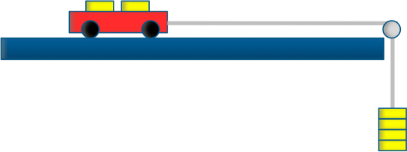
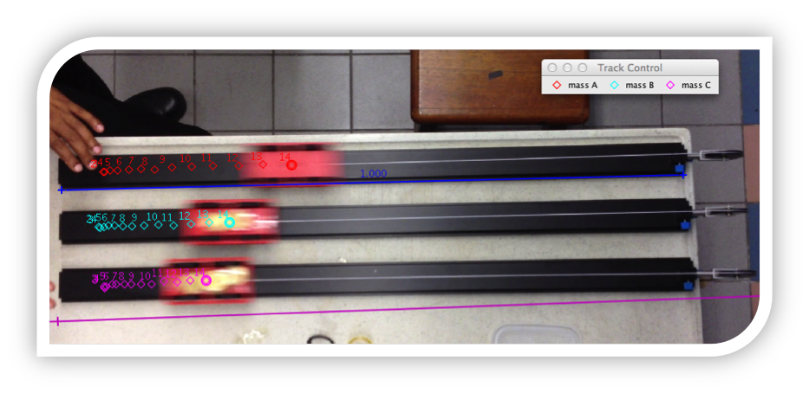
How?
6. 3 carts with different mass are pulled with pulley of equal mass. Students conclude that F = m a
Notes:
In order to teach newtons second law, I use 3 cart of different mass each attached to a pulley weighted by identical masses. The students were able to deduce that F = ma based on actual data

Slide 26
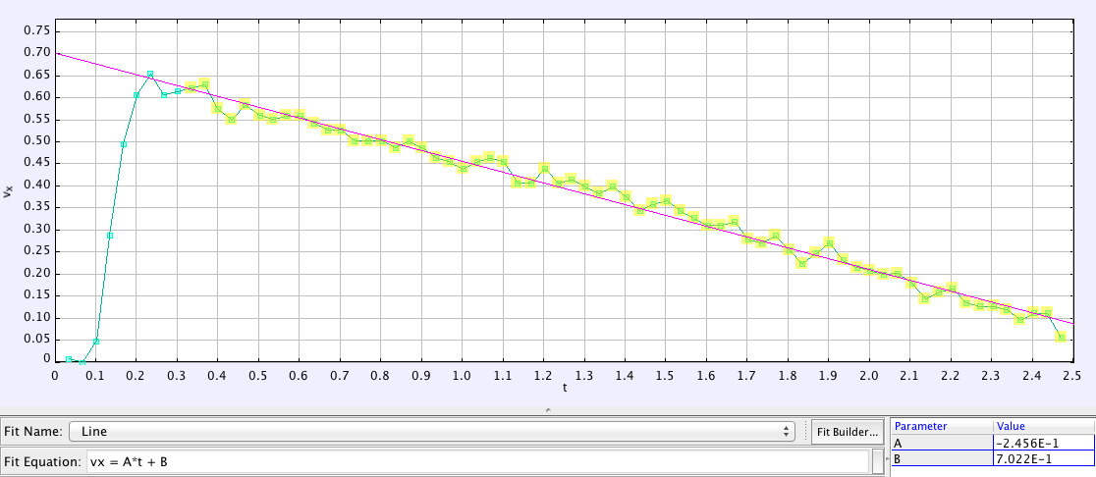
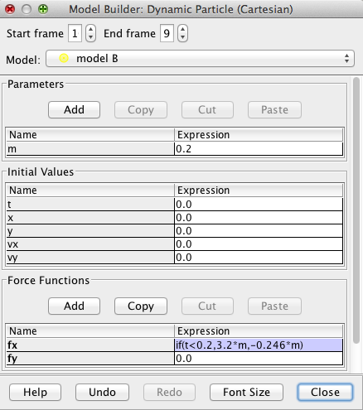
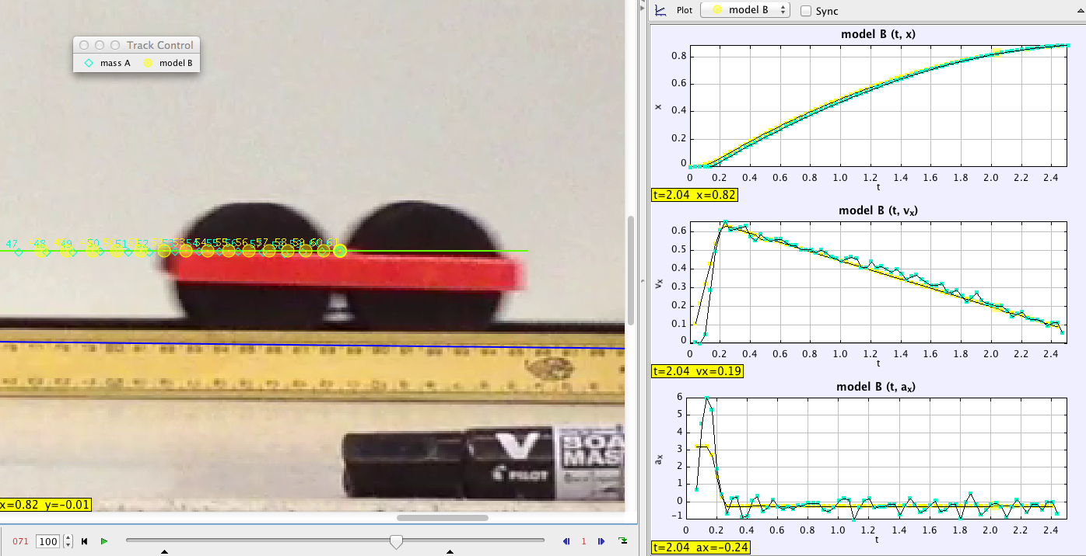
How?
7. Using the model builder, the students could determine aĺl the forces that causes the motion (such as the friction, weight, normal contact force by the track).
Notes:
Next we introduce the dynamic model builder to the students. From the best fit gradient of the graph the students can determine the deceleration of the cart to be 0.246 ms-2.
She can then key in the friction into the model. However, there is a push at the start so a if statement need to be used to include the force of the push.
By using the same technique the student can determine the average force of the push.

Slide 27
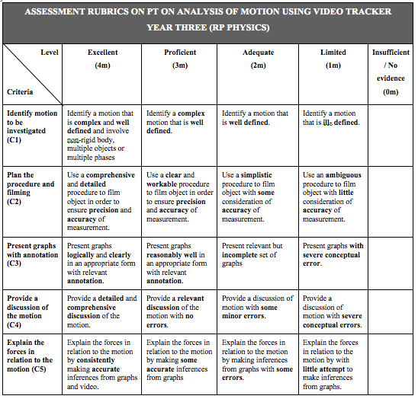
How?
8. Project task
(20% assessment)
You are a scientist who is tasked by A*Star to explain a complex motion and the cause of the motion. You are to record a video of a moving object and to analyze the kinematics and dynamics involved in the motion with the aid of Tracker software. Your report will help the scientific community better understand the complex motion.
Notes:
Once the students are competent in their kinematics and dynamics, it's time to up the challenge. We assigned them this project task which count towards 20% of their end of year result.
Even though the students are generally motivated, we have to assign a significant percentage if we want them to take it seriously.
The first strand allows some differentiation. Better students can stretch themselves while weaker or less motivated students can do simple task without being too heavily penalised and also show their understanding of the topics.

Slide 28
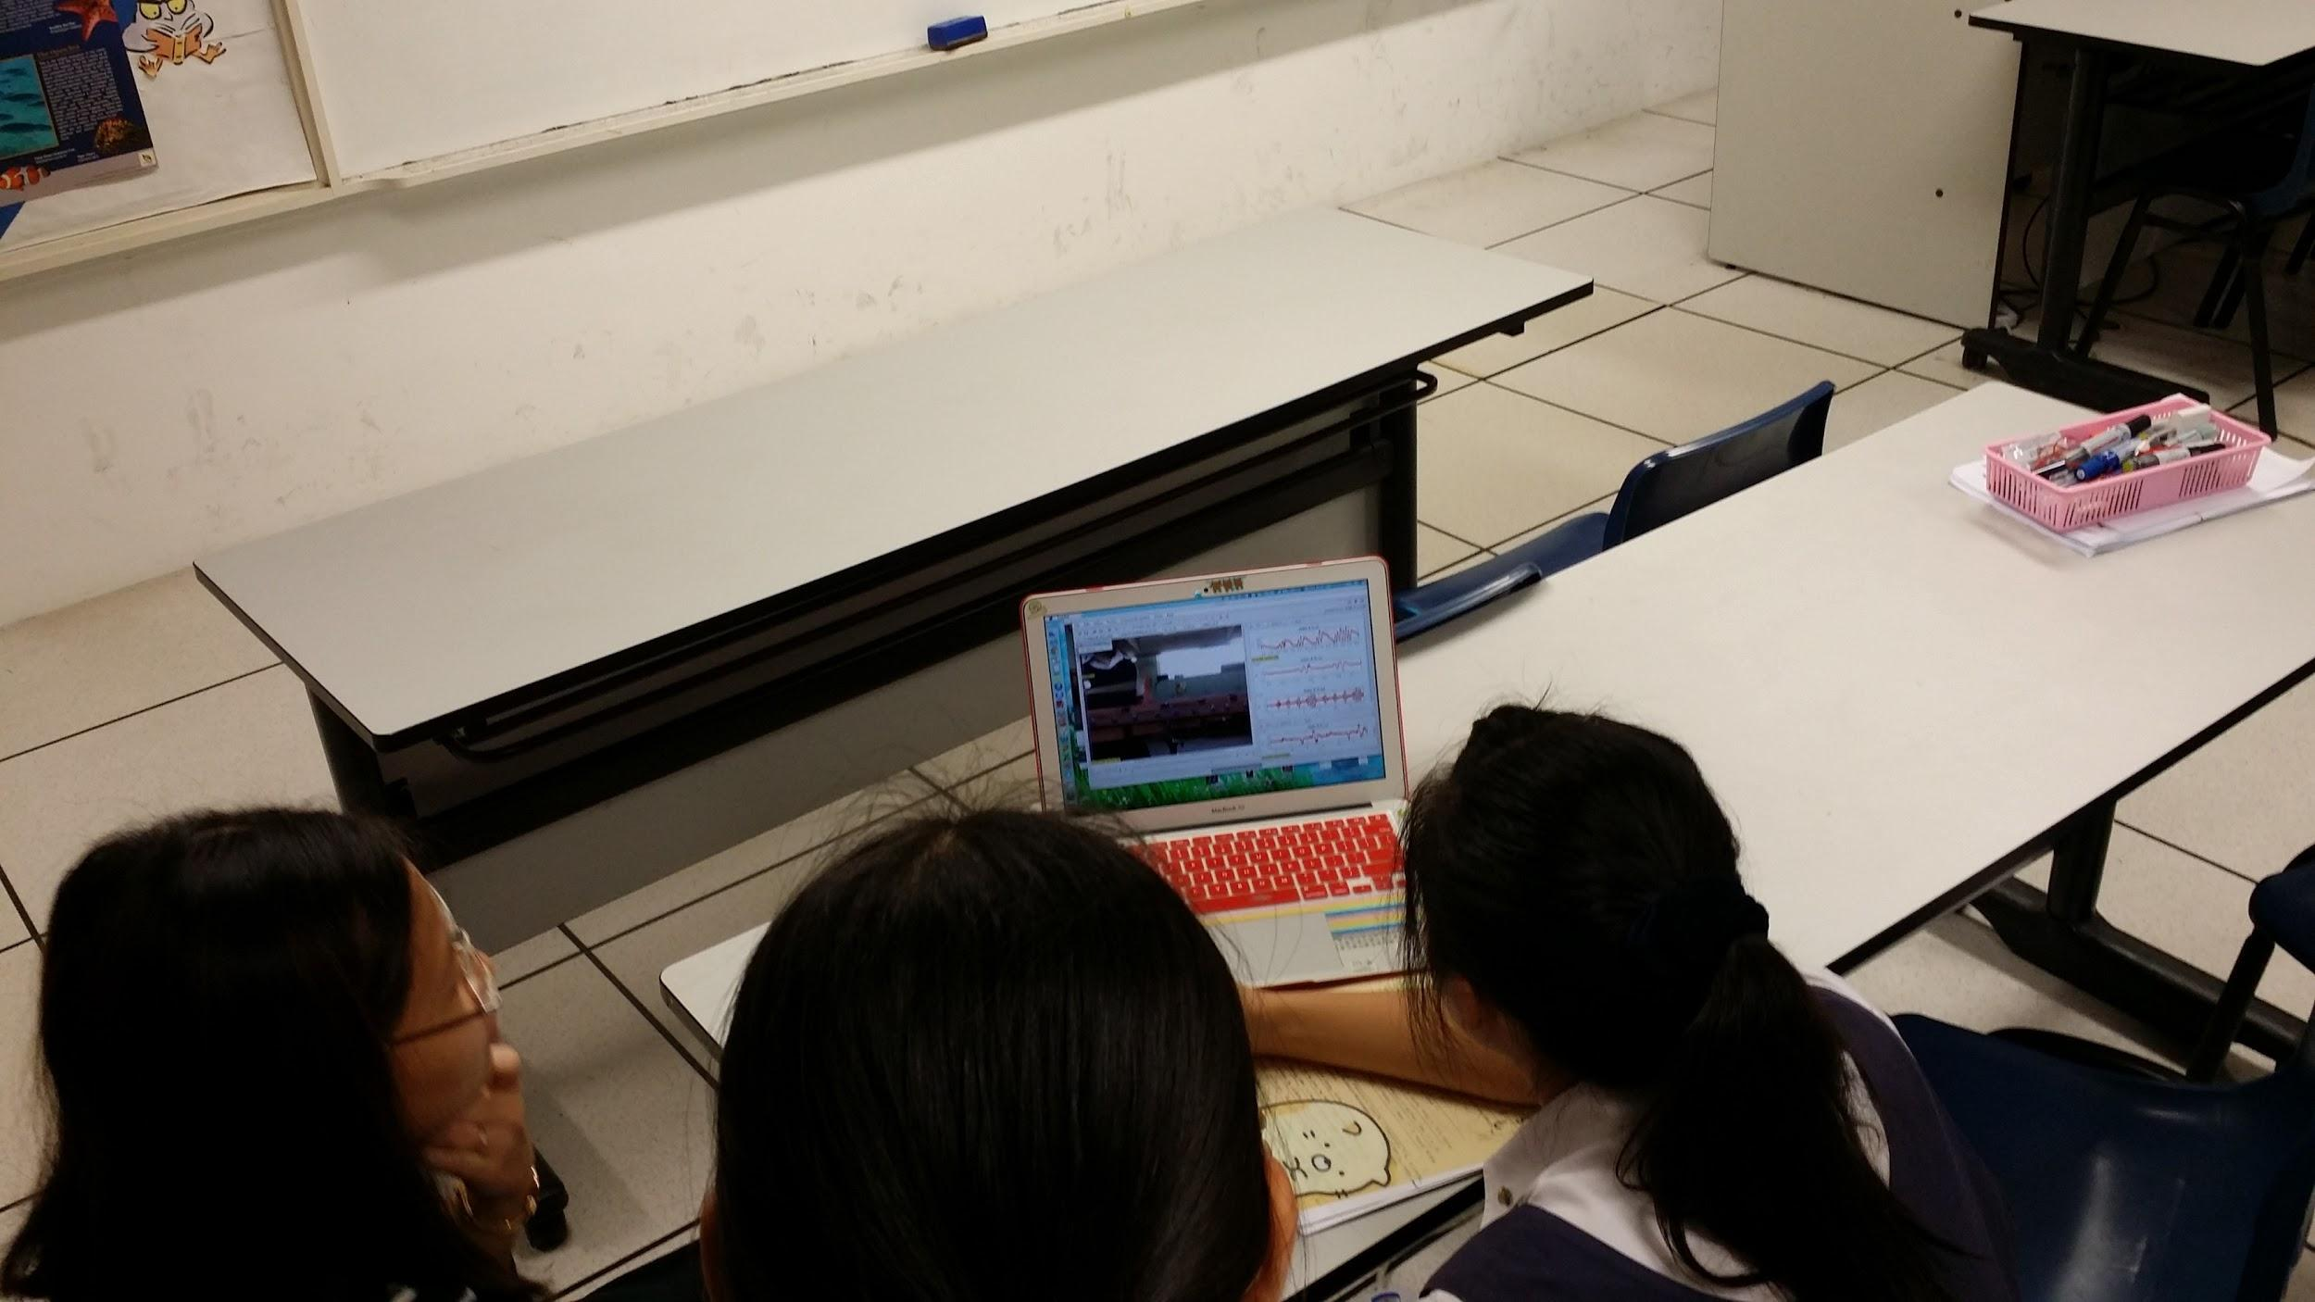
How?
9. Students are given opportunities to discuss their analysis with the teachers both in class and outside class. Suggestions were made by teachers to refine their video, given direction for further readings or suggestion on analysis.
Notes:
Consultations are very important because of the complexity of the task. Students are given opportunities to discuss their analysis with the teachers both in class and outside class. Suggestions were made by teachers to refine their video, given direction for further readings or suggestion on analysis.

Slide 29
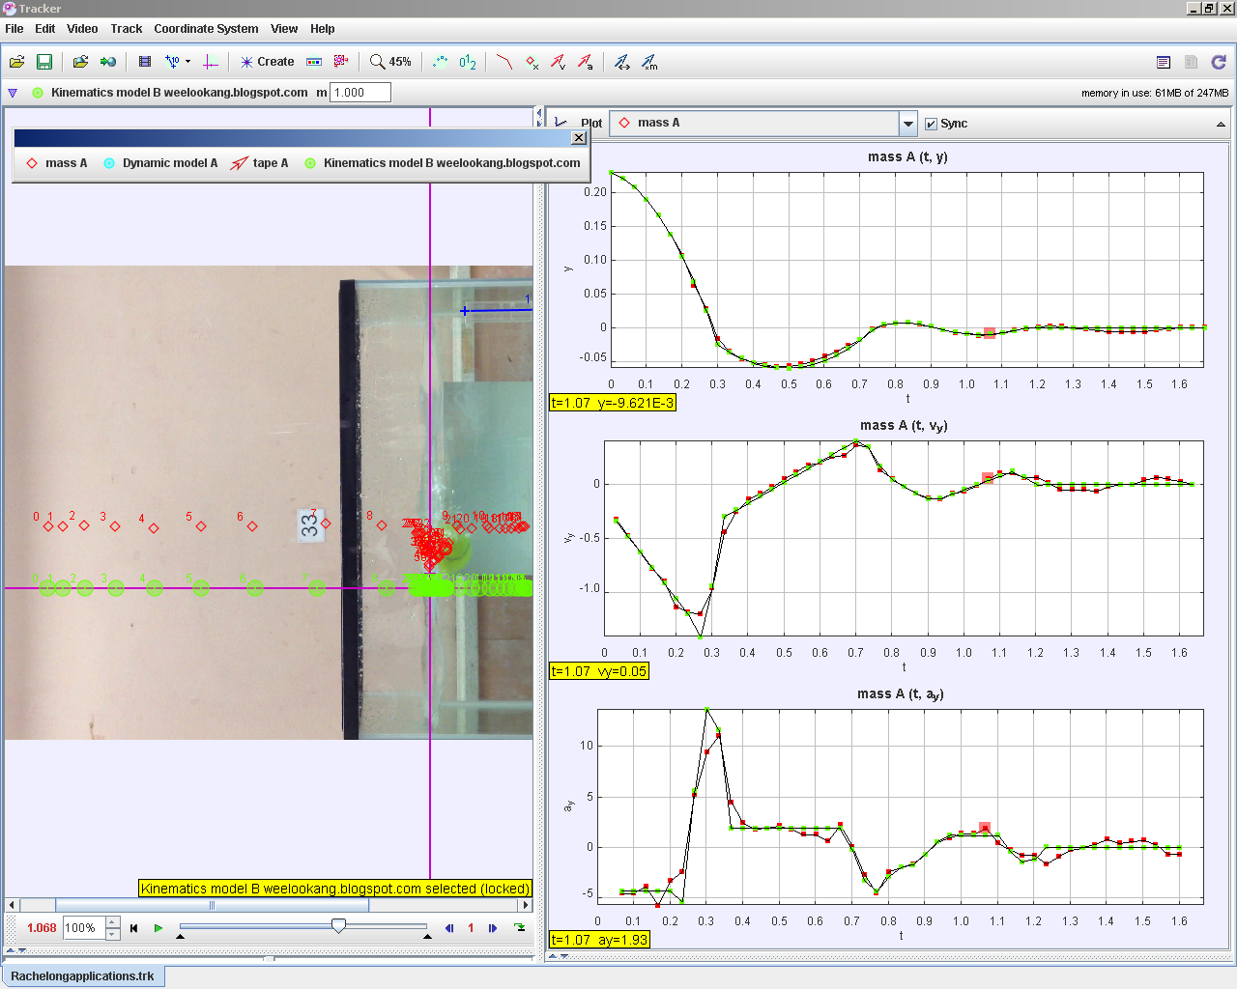
How?
10. Modelling included in students’ report (Not done due to time constraint. Will be implemented in future batches.)
http://weelookang.blogspot.sg/2014/05/tracker-rachelong-student-video-tennis.html
Notes:
Initially we wanted to ask the students to include modelling in their report but due to time constraints, we couldn't give them enough practice to have a fair assessments.
To see the power of modelling in tracker, we have a sample here. The students recorded a tennis ball dropped into water and bouncing off the water. The force include weight, up thrust and drag force. Through a nested if statement, you can see how close them model matches the original video. If the students could do this, their understanding of the motion will be very deep.

Slide 30
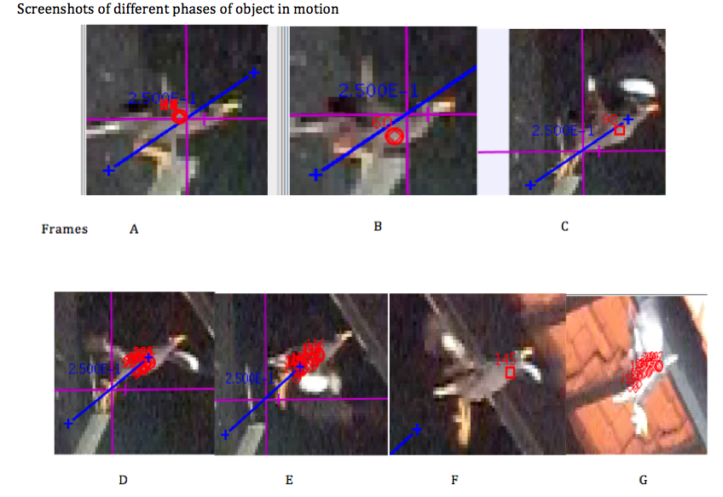
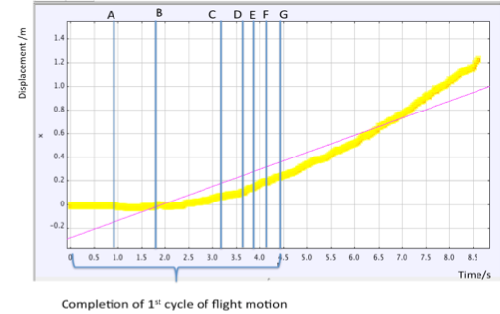
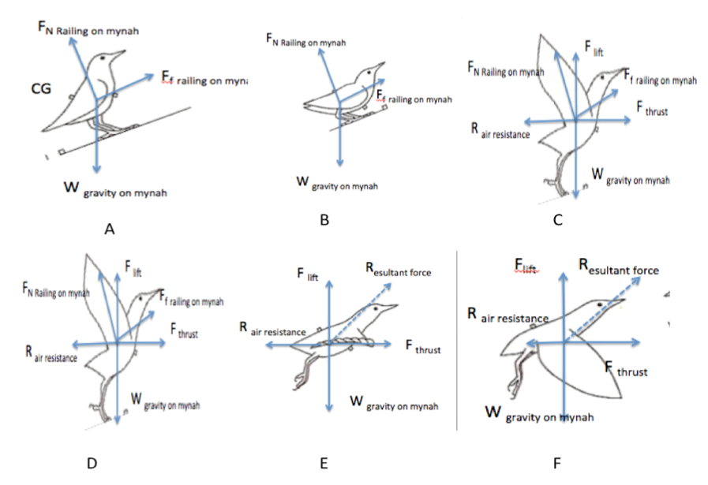
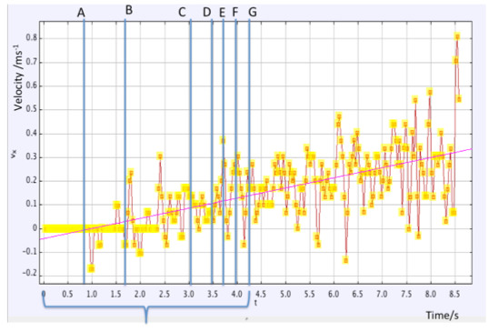
Sample Student Report
Zhao Yi Yan, “We are allowed to use physics to understand the movement around us, therefore it was very relatable. Apart from what we were taught, I did a lot of reading on the movement relating to the movement.”
Downward stroke exert more force, because the wings extend to the fullest and have the largest surface area in contact with the air. The up-stroke exert much less force and also takes less time. During up-stroke, the wings folds partially to have a smaller surface area, so less resistance against myna’s body.
Myna’s body is tilted upwards, and the head is always lifted during the down-stroke and falls a bit during the up-stroke, to reduce the air resistance coming against the myna.
When myna reaches a certain height, the beating of wing motion will be less frequent as it no longer need the extra force to gain positive vertical displacement and accelerate forward.
Notes:
The is a sample report by a student of course not the full report in order to squeeze into 1 slide.
"We were..."
Students are willing to invest their personal time to learn more about the motion because there is ownership in the research.
Look at the depth of the report. It's way beyond what I taught me or any k9 text books can teach.

Slide 31
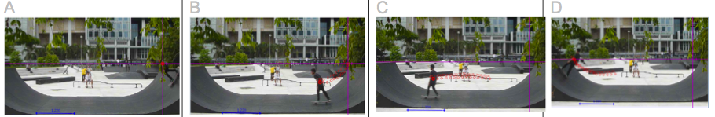
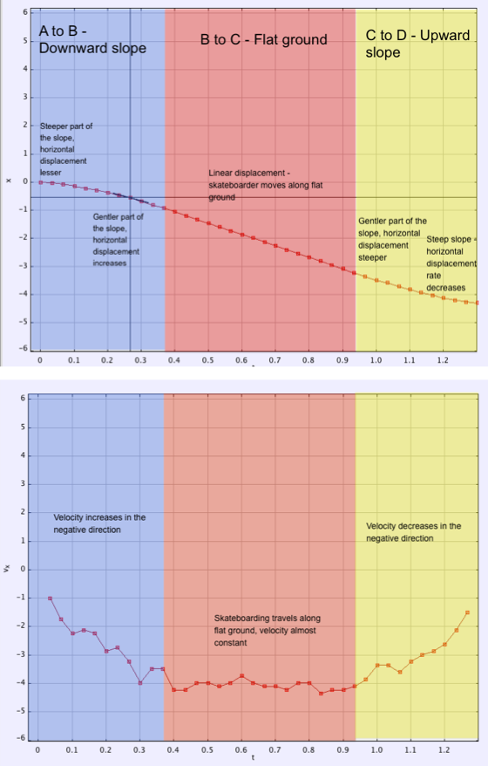
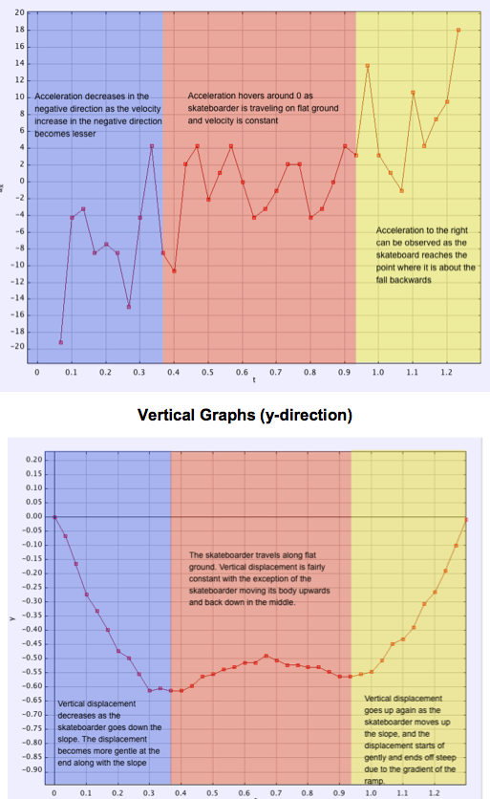
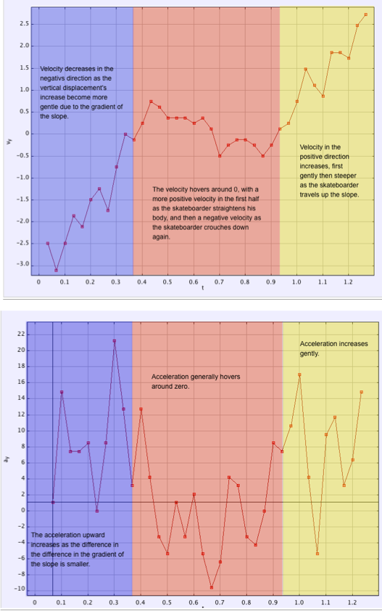
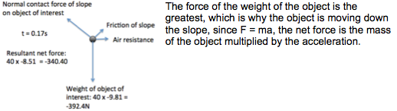
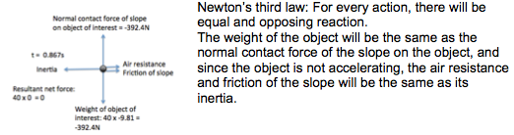
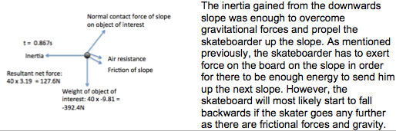
Sample Student Report

Slide 32
Perception Survey Results
Notes:
We did a pre and post survey after the students completed their performance task.
It's very heartening to see the students enjoy the physics lessons so much. I have to remind everyone that I'm teaching in a girls school. In the past, the girls were not very keen in studying physics so this change is perception means a lot.
All perceptions improve for the best class perception after the lesson.
The rest of the cohort only improve in perception score for the first 2 questions.
Although all students enjoyed the hands on process, only the best class truly behave like a scientist.
The preliminary results seems to suggest that this programme is more beneficial for better classes.
Further verbal interview and extensive research need to be conducted to draw better conclusions.

Slide 33
Approach:
Strategy: Predict-Explain-Observe-Explain (PEOE).
Students are given a description (motion), to predict the motion graphs, & explain amongst pair/group how and why their graphs (prediction)
Subsequently, each group reached a mutual solution (prediction), white-board sharing with class, their ideas (predicted graphs)
Next, students paired up & perform data collection, using video-capture of the motion and video analysis (Tracker), and recorded individually their observations and result (graphs).
Meanwhile, the teacher guided the students to make observations that are relevant to target concepts.
Groups made explanations in their presentations via white-boarding session. Discrepancies between observations and predictions, and groups’ observations were discussed and resolved.
http://weelookang.blogspot.sg/2014/02/tracker-workshop-at-national-jc.html
Notes:
wm_falling ball worksheet tracker 4.84 (model building – F=ma)
Various practices are introduced to the students via guided inquiry approach.
Creates collaboration learning
ETD officer demonstrated how to use VA to find more about motion – students are working with expert in the field; additional showcase of how scientists work & think.
The teachers learnt from the ETD officer about Tracker & its capability (model building).

Slide 34
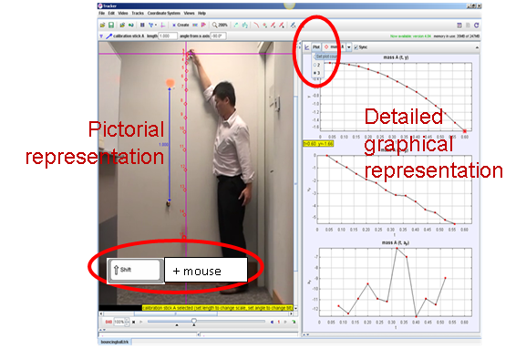
Meaning making through Multiple representations
Notes:
P2-develop model, P4-analyse & interpret data, P5-use mathematics thinking
Visual agreement may validate models more convincingly than numerical or graphical comparisons for beginning students. Visual comparison is rapid, easy to discern fine difference
sense-making, math & physics,
Age appropriate – mathematically ready
Connection making – math learnt & application

Slide 35
Pedagogical tool
Multiple representations – part of being a scientist & a language of science.
Meaning making – give them a context and discuss, different representations of the same motion
VA experiences utilize multiple representations that provide excellent opportunities for students not only to develop the conceptual understanding, but also to develop scientific investigation and inquiry skills at the same time. Students are provided an excellent opportunity to become involved in the "active process" of learning science while doing science.
Provide activities involving modeling offer students “an idea of how a real physicist works in determining equations that fit the study being made” (Rios & Madhavan, 2000, p. 95)
encourages self-directed learning and use it for independent projects
Notes:
The idea here is not abt getting them proficient with the software, ability to understand, construct various representations, lastly apply it to new situation.

Slide 36
Continuing, the students were asked “What if a ball is tossed into the air? How do you think the motion would differ, or similar?’ “How can you find out?”
The students were asked to make predictions first, and went on to design their investigation.
Each group was allowed to make their own video and perform the Tracker analysis, although alternative was provided – pre-loaded videos.
The lesson culminated with individual group presentation in a white-boarding session, the students were asked to analyze, compare, contrast and criticize the groups’ observations.
http://www.cabrillo.edu/~dbrown/tracker/ - video ‘ball tossup’
Notes:
The students initiate their own investigation after question was raised and prediction made.
wm_Free fall - investigate using tracker-student 2 (extension – moon’s a cf g=10), which is quite challenging as the kids are not familiar with the connection between force & motion yet.
That’s why the curriculum has to be spiraled.

Slide 37
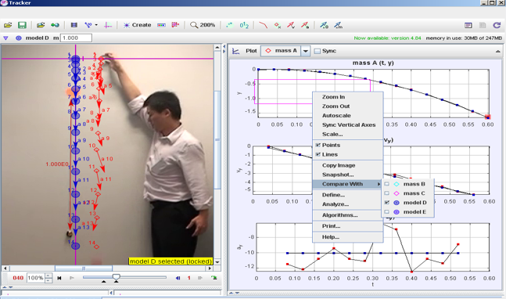
Other practices ..
While doing students encountered experimental error (messiness of real world study) – makes it more realistic as a scientific process
error incorporated in the “marking” process, marking the exact same location on the moving object(s) in each frame
The quality of the video – marking error ito timing
Calibration error
Exposure students to this real world (data collection & analysis) issues, helps them to manage sources of error and better experimental designs.
EXTEND LEARNING – Model Building.
By overlaying simple dynamic particle model on the video, allows a comparison the Model created and the activated motion map.
As such differentiation of instruction and learning for the students occur.

Slide 38
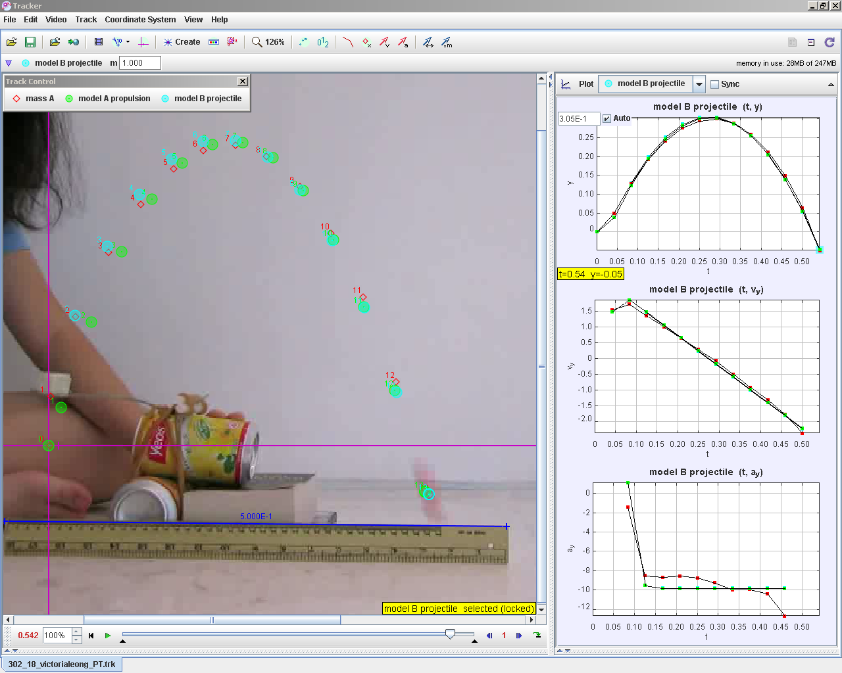
What’s Next?
As the curriculum progresses, students are challenged to apply their knowledge of VA onto topics (terminal velocity, force, energy conservation) and extend their learning with modeling.
This practice will continue to deepen their conceptual understanding as they move onto grades 11 & 12, and are ready and more apt to learn with modelling building and simulations (multiple representations).
http://weelookang.blogspot.sg/2014/08/tracker-propulsion-and-projectile-model.html g = 9.81 , Fy = 54, Fx = 14.5, t1 = 0.05 (arbitrarily assumed) fx = if(t<t1,Fx,0) fy = if(t<t1,Fy-m*g,-m*g)
Notes:
(longitudinal study / follow up on sts’ progress as they move onto SH).
Concepts must not just be presented to students from time to time but must be offered to them periodically in different contexts and at increasing levels of sophistication. (ch13, AAAS, 1990)
CoP - using this technology, students not only generate actual data supporting claims
of energy conservation in these situations, they may also investigate the loss of mechanical energy due to friction.

Slide 39
Teachers’ Professional Learning
Planning to teach unit on Kinematics, 4 teachers formed professional learning team (Jolly, 2008; Vescio et al., 2008) whereby effective student learning is the goal and we work collaboratively to achieve this goal.
We adopted Instructional Rounds (Marzano, 2011) in classroom observation, our team engaged in active discussion in how to improve quality of our instruction/teaching, and subsequently, in self-reflection.
We are glad and honored to be able to make contribution to fraternity via platforms for sharing with fellow physics teachers via consolidation of lesson packages in the online repository and conducting workshop.
Improve in SMK, PCK, quality of lesson plans
More skilled in making observation
Increase motivation and self-efficacy
Develop stronger collegial networks

Slide 40
工欲善其事，必先利其器 - 孔子
‘An artisan must first sharpen his tools if he is to do his work well.’ ~ Confucius
Scientists need to have tools that support their investigations and create new knowledge.
Similarly, video analysis (Tracker) is
A tool that facilitates students working & thinking like scientists do,
A pedagogical tool for the teacher’s use in develop effective teaching and learning of Physics
Notes:
VA experiences utilize multiple representations that provide excellent opportunities for students not only to develop the conceptual understanding, but also to develop scientific investigation and inquiry skills at the same time. Students are provided an excellent opportunity to become involved in the "active process" of learning science while doing science.

Slide 41
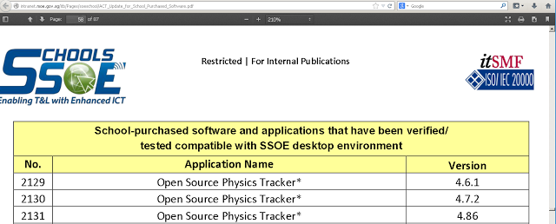
Tracker 4.87 is SSOE white listed
updated 13 Nov 2014. do a CONTROL-FIND (F) and look for "open source"
http://intranet.moe.gov.sg/itb/Pages/soeschool/ACT_Update_for_School_Purchased_Software.pdf
Notes:
http://weelookang.blogspot.sg/2014/08/ssoe.html

Slide 42
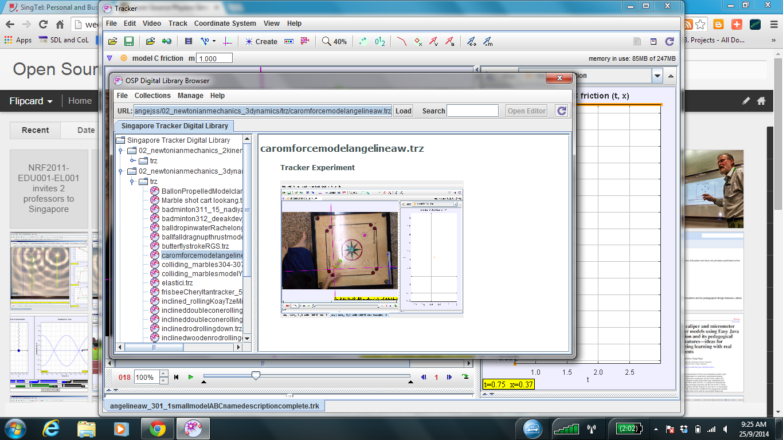
Singapore Teachers Shared Library in Tracker: http://iwant2study.org/lookangejss/

Slide 43
Reflect and Feedback
- Describe in detail at least one of the 8 practices of K12 science education framework
- Download, install and use tracker basic analysis
- Create at least one model in tracker for Practice 5 (mathematical and computational thinking)

Slide 44

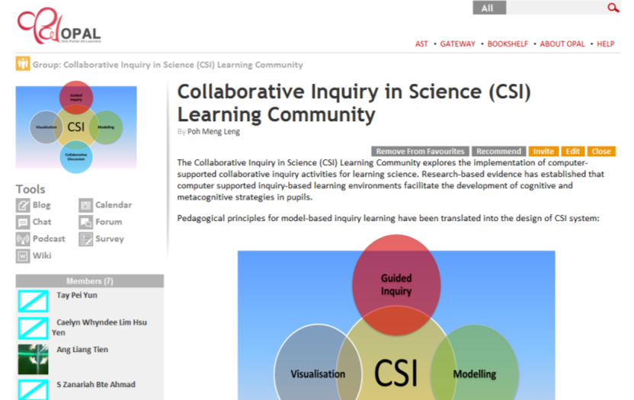


CSI LC – Join Us
Technologies for Learning
http://tinyurl.com/csiLearningCommunity
Join us!
Notes:
Pedagogical principles for model-based inquiry learning have been translated into the design of CSI system.

Slide 45

Workshop Title | TRAISI | Venue | Dates
Model-based Collaborative Science Inquiry: Making Thinking Visible | 41136 | eduLab@AST (2 Malan Road) | Term 1 Week 6 11 Feb 2015 Wed
Model-based Collaborative Science Inquiry: 1:1 Computing | 41134 | eduLab@AST (2 Malan Road) | Term 2 Week 1 25 Mar 2015 Wed
Model-based Collaborative Science Inquiry: Assessment for Learning | 41135 | eduLab@AST (2 Malan Road) | Term 2 Week 10 27 May 2015 Wed
Becoming Scientists Through Video Analysis edulab017 | 41133 | eduLab@AST (2 Malan Road) | 04 Feb 2015 Wed
Computer Modeling Pedagogy using Tracker edulab017 | 7th Physics IPSG Sharing | Nanyang Junior College Computer Lab | 21 Jan 2015 (Wed) 1500-1730

