Slide 1
Using Tracker as a Pedagogical Tool for Understanding Toss Up-Free Fall Motion
Research paper at Cornell University Library http://arxiv.org/abs/1501.02858
An Evergreen Sec Physics PLT research project in collaboration with eduLab
Sec 3 Pure Physics Kinematics of Free Fall
Google Site to facilitate instructions
Lesson at Computer Lab
Use of Pre- and Post test multiple-choice question and assessment tool
Post lesson Students Focus Group Discussion

Slide 2

The Learning Task
Video – ball tosses up
Graph – displacement-time, velocity-time, acceleration-time
Google site https://sites.google.com/a/moe.edu.sg/2014-sec-3-physics-performance-task/

Slide 3
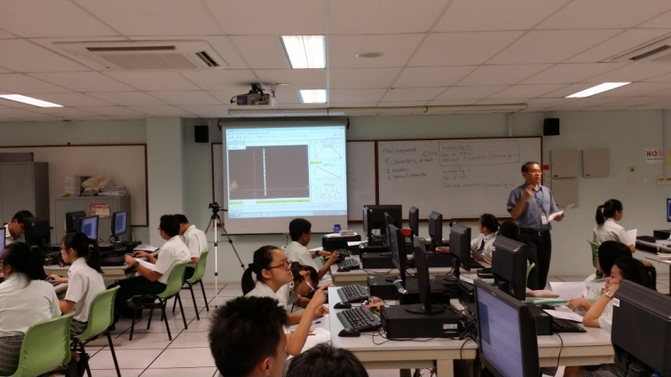
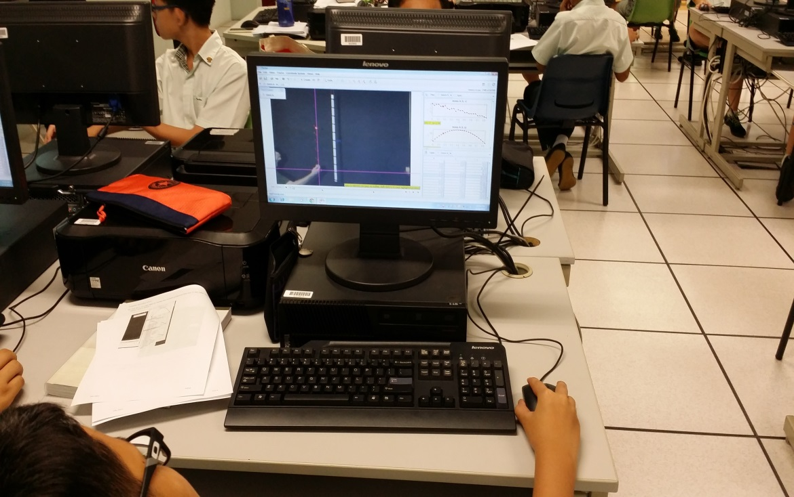

Slide 4
Results
Test Scores
Post test positive gain
Cohen’s d effect
size = 0.79
(practically significant)

Slide 5
Students’ FGD
“We are able to see the connections between the real life [video] and the [scientific] graph[s]. Tracker helps me to confirm the theory [in kinematics] I have learned.”
“The video analysis [Tracker] gives me the opportunity to check the data collected. I realized that in real life data collection, there are random errors, which was shown from the graph plotted.”
- AMIRUL SUFYAN, 3 commitment
- LEE CHAEYUN, 3 Respect

Slide 6
Students’ FGD
“Compared to teachers’ explanation on the board, the video analysis gives us more opportunity to have the real learning experience; rather that spoon feed us with content. By allowing us to use the video analysis [tool, Tracker], we are able to see more precisely between the ball and the graph plotted.”
- KOO CHUN AUN, 3 Respect

Slide 7
Students’ FGD
“Perhaps we can have a practical lesson [a performance task] in the curriculum. We would be interested in trying it out ourselves to do the experiment and record the videos ourselves”.
“I don’t have the experience to load the video and track the video. I would like teachers to use the video Tracker to show us the scenarios in learning, so that we can strike a balance between learning effectively and not to spend too much time in setting up the video [tool] Tracker”.
- LIN RUI XIANG, 3 Commitment
- YIP SHI MIN, 3 Integrity

Slide 8
Teachers’ Reflections
Start the year with an easier horizontal kinematics task like investigating a constant speed object moving on a frictionless track. This serves to address the cognitive overload (Roth, 1999) problem encountered when using the software Tracker and the relatively complex concept of toss up and free fall for fresh Sec 3 students.

Slide 9
Teachers’ Reflections
We also recognize for sustained learning gains that Tracker use be integrated for topics like kinematics, dynamics and work, energy which tracker’s analysis affords for seamlessly.
We will use Tracker as tool to model and analyse difficult exam questions to help students visualise abstract and invisible Physics concepts.

