Slide 1
Performance Task using Video Analysis and Modelling to promote K12 eight practices of science
Notes:
Our project seeks to allow students to be like scientists (obtain real data from physical phenomena, engage in making inference and deducing how the physical world work).
This is accomplished by using the k 12 8 practice approach supported by video analysis with Tracker.

Slide 2



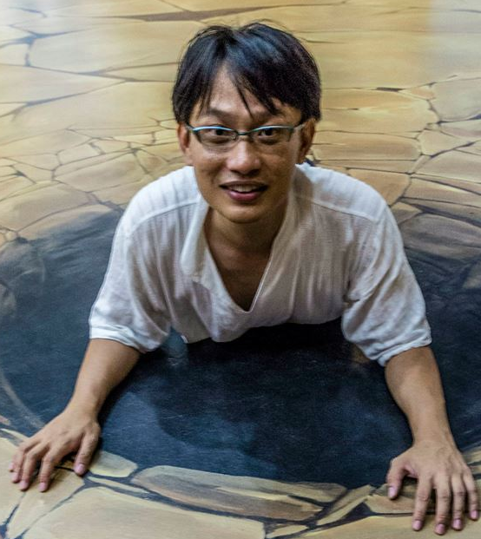

Who, Where?
Raffles Girls' School
K-9 Students
Ministry of Education
(Education Technology Division)
National Institute of Education
Leong Tze Kwang
Thio Cher Kuan
Sharon Siow
Wee Loo Kang
Notes:
We are from Singapore &
I'm leong the kwang from Raffles girls school.
Together in my team are Mr thio & ms siow who are are not with us today. Also Mr wee from the ministry of education is supporting our team.

Slide 3

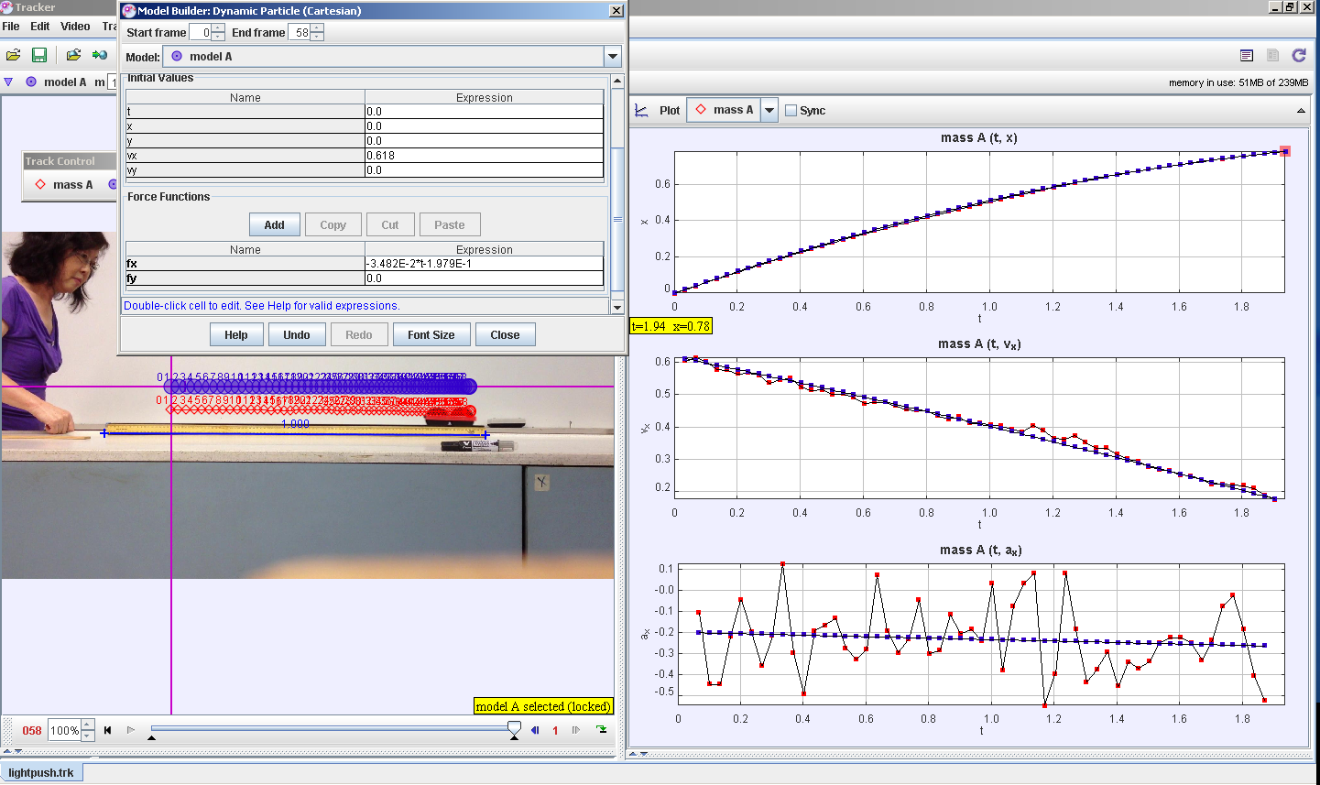
What?
What is tracker?
https://www.cabrillo.edu/~dbrown/tracker/
A software able to capture data from the video and be used for graphical analysis
http://weelookang.blogspot.it/2014/02/tracker-light-push.html

Slide 4
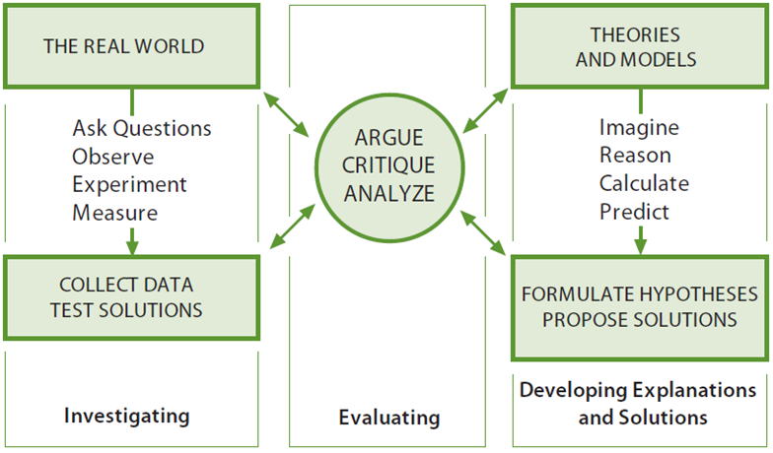
What?
K12 eight practices of science by
National Academy of Sciences
2.
1.
7.
4.
8. communicate
4.
6.
3.
Notes:
Have you ever wondered how a student learn how to play basketball? She practice the game, often with other player. She doesn't just sit there and memorise all the laws of basketball.
How does a student learn how to be a scientist?
Does she ask question, develop models ...
1. Ask questions
2. Develop models
3. Plan and carry out investigations
4. Analyze and interpret data
5. Use mathematics thinking
6. Construct explanations
7. Engage in argument from evidence
8. Obtain, evaluate and communicate information

Slide 5
Why?
Science students should behave like scientists.
Traditional Lessons | Scientist Research
Topics taught in isolation | Knowledge from various topics are required
Simplified theoretical scenario with many assumptions | Authentic collected data which often include anomaly
Knowledge apply to assessment questions | Knowledge apply to real world situations
Teacher directed; Teacher decide on question | Student directed; Ownership of research question
No differentiation; One size fits all | Research is individualized
Notes:
Or does she learn the topics in isolation and solve simplified questions with many assumptions only for the purpose of examination?
Does she just do what the teacher tell her to do and do exactly the same thing from her classmates who have different interest and different abilities?
There's obviously a gap between how we teach & what need to be taught & that's why we need to redesign our curriculum to better train our students as scientist and also to better motivate them in learning

Slide 6
Why?
Tracker empower students to investigate motions they observe in real world
Tracker | Data logger / traditional experiment
2-D motion; Non-rigid body | 1-D motion (2-D motion are extremely difficult to setup)
Shorter setup time | Longer setup time
Same software & video can be used for several topics | Every experiment is designed for a single learning objective
Differentiation is easy | Differentiation is difficult
high speed camera allow very short duration motion | Motion has to be long enough for negligible human reaction time
Free; students can conduct individual research even beyond the classroom | Data logger are expensive and students have to share the sensors within classroom
Notes:
Why do we use tracker instead of data logger or other ways of experimentation.
Tracker empowered to investigate almost any motions they observe in real world in a very short time. Examples include 2d, non rigid body, short duration motion & multiple objects.
Because of the ease of setting up & not requiring any complicated setup, students can perform different task, anytime, anywhere.
Also the same video can be used for several topics which help the students establish connection between topics.

Slide 7
How?
1. Flip videos provided prior to lesson for students to watch before lesson.
a. How to install tracker
b. how to generate the s-t, v-t and a-t graphs of a cart with hard push is given (approximately constant speed).
c. how to analyse the graphs by finding gradient and area
https://www.youtube.com/watch?v=H_zrkl16BNs
https://www.youtube.com/watch?v=7_TgOSMqRQs
Prior knowledge: The displacement-time, velocity-time and acceleration-time graph was already explained in prior lesson.
Notes:
Unlike traditional course, our focus is graphical representation. After defining displacement, velocity and acceleration, we ask the students to download and watch some flip video to know how to track and analyse the graphs.
Throughout the course we have several flip instructions to make way for more activity time in class.

Slide 8
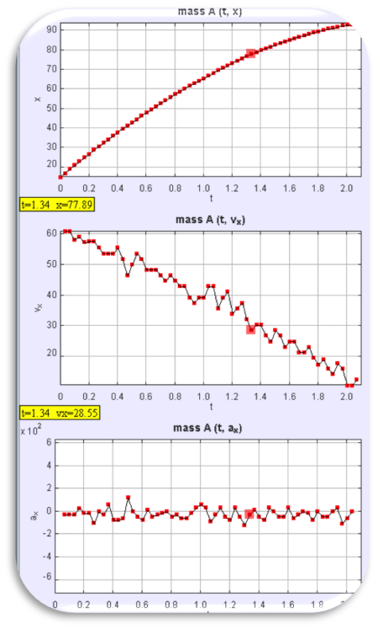
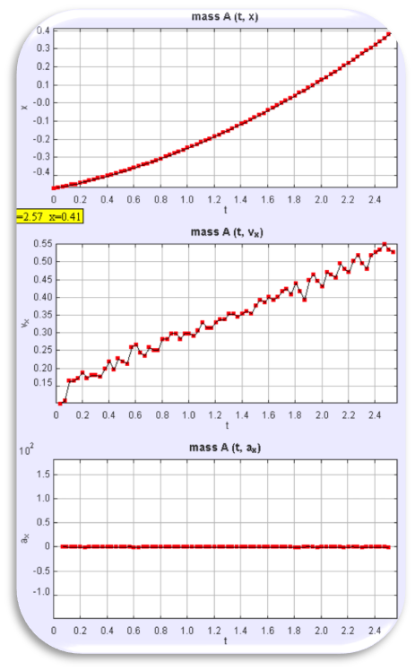
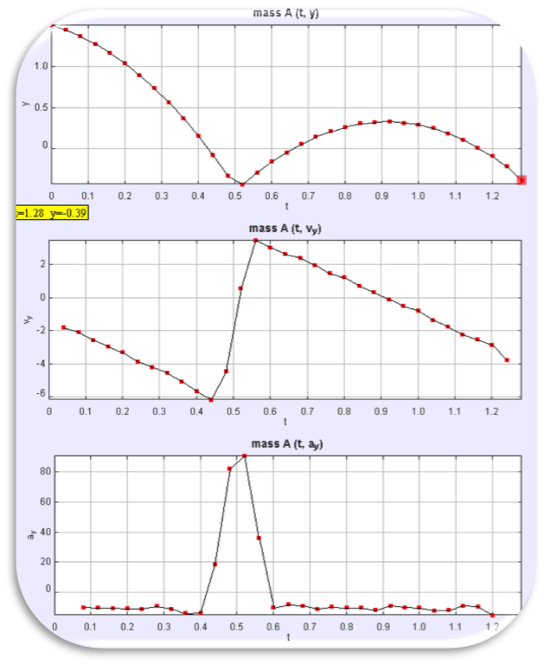
How?
2. The students were then given a set of video to analyse in groups. They will discuss and each group will present and critic on the other group presentations.
Cart with gentle push (Slowing down at constant acceleration)
Cart on slope (Speeding up at constant acceleration)
Bouncing Ball
(Motion divided into phase)
Notes:
In class, the students were then given...
All I needed to do was facilitate and summarise the discussion and highlight good presentation and misconceptions.
Every video are given with increasing difficulty and a certain thing to teach in mind.
For the projectile motion, the objective was to show students that motion occurs in phases and each phase are acted by different forces.

Slide 9
How?
4. Students given 1 track and several marbles and balls and were told to
a. Define a problem
b. Plan out an investigation
c. Analyse and interpret the data
d. Construct explanations
Some investigations include:
• Marble rolling up and down a ramp
• Bouncing Marble (even bouncing down the stairs or on a slope)
• Flying Marble colliding with wall
• Colliding Marble
Notes:
Once the students are familiar with the software and graph analysis, we gave them opportunity to practice as a scientist by providing them with a track and several marbles and balls.

Slide 10
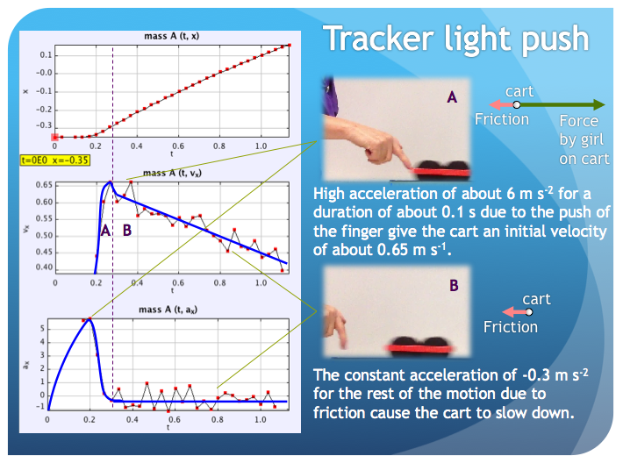
How?
5. Students were asked to suggest what causes the motion. All previous videos are revisited to discuss the dynamics.
Notes:
After they are familiar with kinematics, we revisited all the previous videos and ask them what causes the motion.
The students were able to verbalise that the force by the hand causes the motion and the force of the hand was no longer acting on the cart once it is no longer in contact. This used to be a very common misconception in the past and tracker.was able to address it.
Also the students understood that friction by the track was responsible for slowing down the cart.

Slide 11
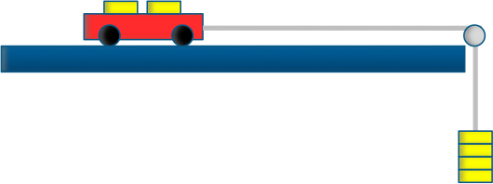
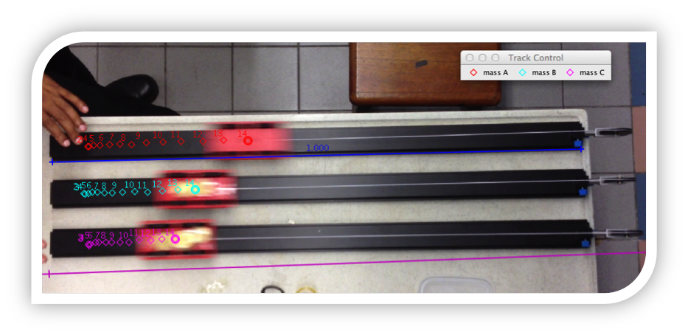
How?
6. 3 carts with different mass are pulled with pulley of equal mass. Students conclude that F = m a
Notes:
In order to teach newtons second law, I use 3 cart of different mass each attached to a pulley weighted by identical masses. The students were able to deduce that F = ma based on actual data

Slide 12
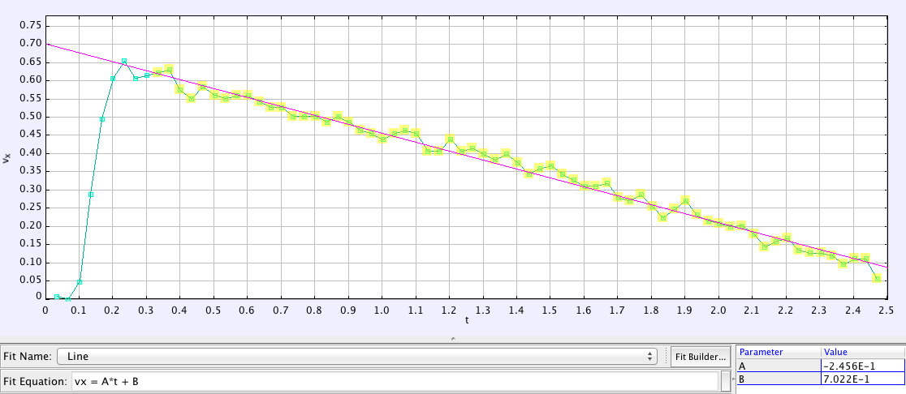
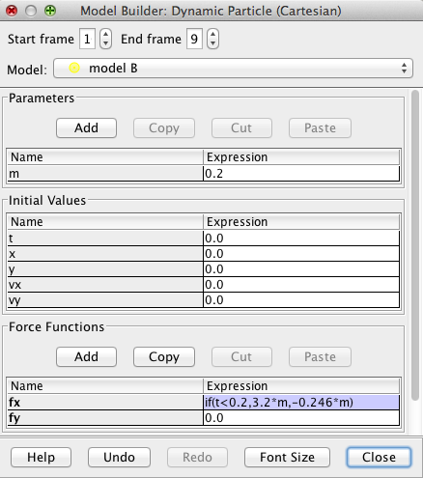
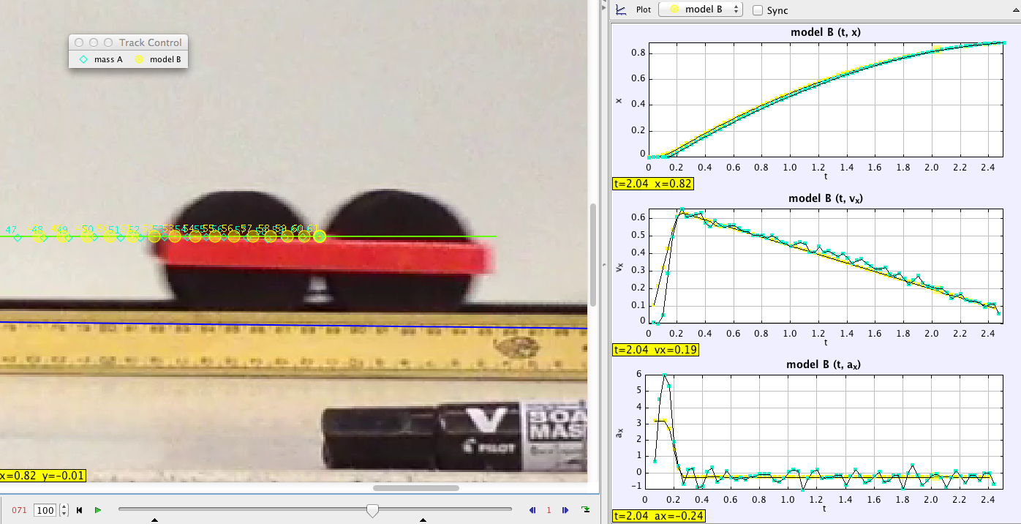
How?
7. Using the model builder, the students could determine aĺl the forces that causes the motion (such as the friction, weight, normal contact force by the track).
Notes:
Next we introduce the dynamic model builder to the students. From the best fit gradient of the graph the students can determine the deceleration of the cart to be 0.246 ms-2.
She can then key in the friction into the model. However, there is a push at the start so a if statement need to be used to include the force of the push.
By using the same technique the student can determine the average force of the push.

Slide 13
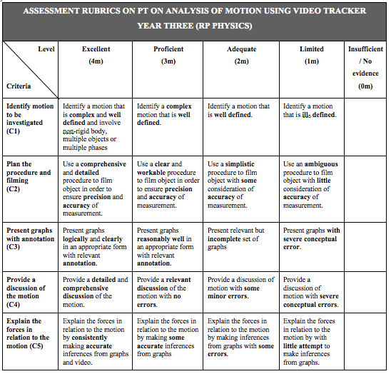
How?
8. Project task
(20% assessment)
You are a scientist who is tasked by A*Star to explain a complex motion and the cause of the motion. You are to record a video of a moving object and to analyze the kinematics and dynamics involved in the motion with the aid of Tracker software. Your report will help the scientific community better understand the complex motion.
Notes:
Once the students are competent in their kinematics and dynamics, it's time to up the challenge. We assigned them this project task which count towards 20% of their end of year result.
Even though the students are generally motivated, we have to assign a significant percentage if we want them to take it seriously.
The first strand allows some differentiation. Better students can stretch themselves while weaker or less motivated students can do simple task without being too heavily penalised and also show their understanding of the topics.

Slide 14
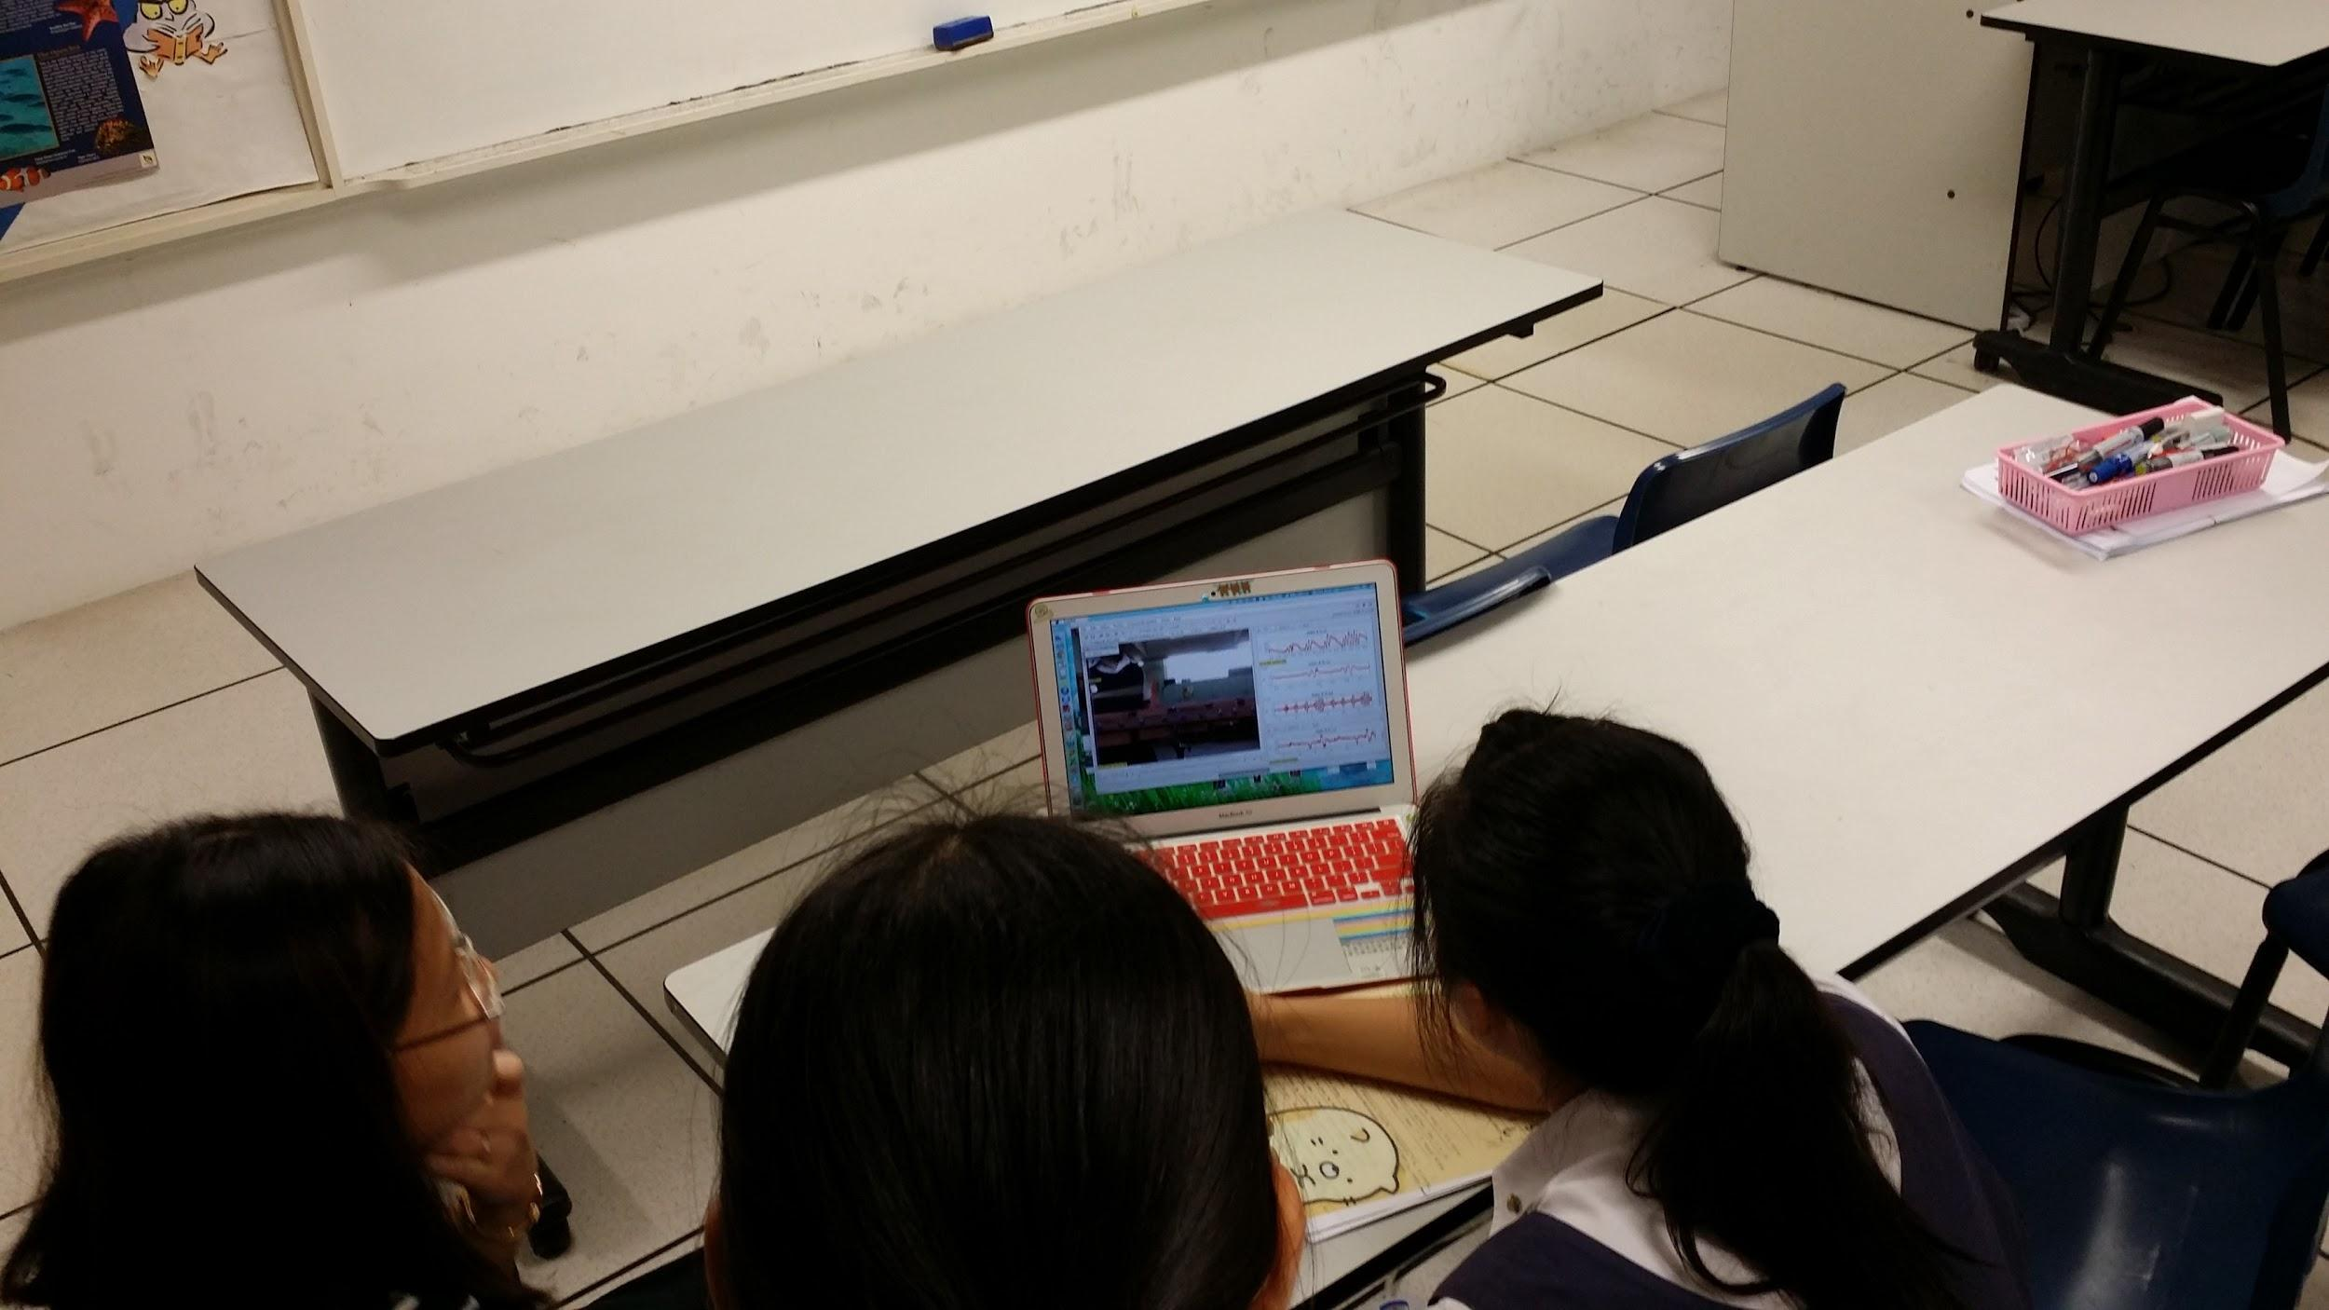
How?
9. Students are given opportunities to discuss their analysis with the teachers both in class and outside class. Suggestions were made by teachers to refine their video, given direction for further readings or suggestion on analysis.
Notes:
Consultations are very important because of the complexity of the task. Students are given opportunities to discuss their analysis with the teachers both in class and outside class. Suggestions were made by teachers to refine their video, given direction for further readings or suggestion on analysis.

Slide 15
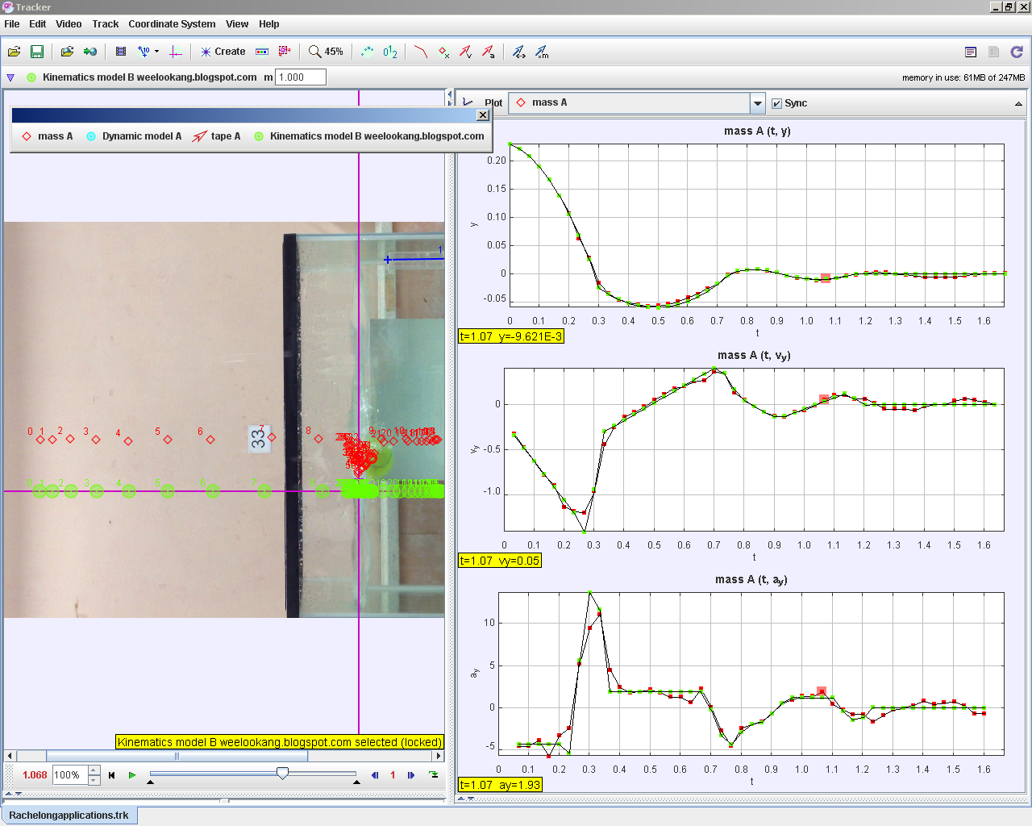
How?
10. Modelling included in students’ report (Not done due to time constraint. Will be implemented in future batches.)
http://weelookang.blogspot.sg/2014/05/tracker-rachelong-student-video-tennis.html
Notes:
Initially we wanted to ask the students to include modelling in their report but due to time constraints, we couldn't give them enough practice to have a fair assessments.
To see the power of modelling in tracker, we have a sample here. The students recorded a tennis ball dropped into water and bouncing off the water. The force include weight, up thrust and drag force. Through a nested if statement, you can see how close them model matches the original video. If the students could do this, their understanding of the motion will be very deep.

Slide 16
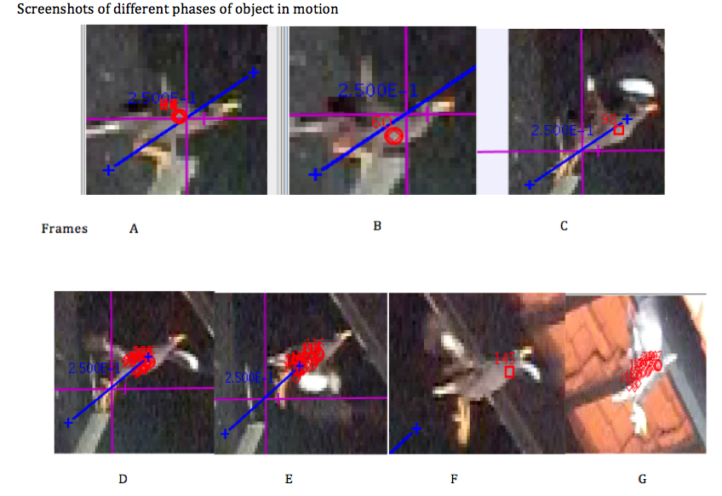
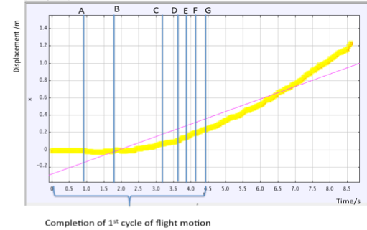
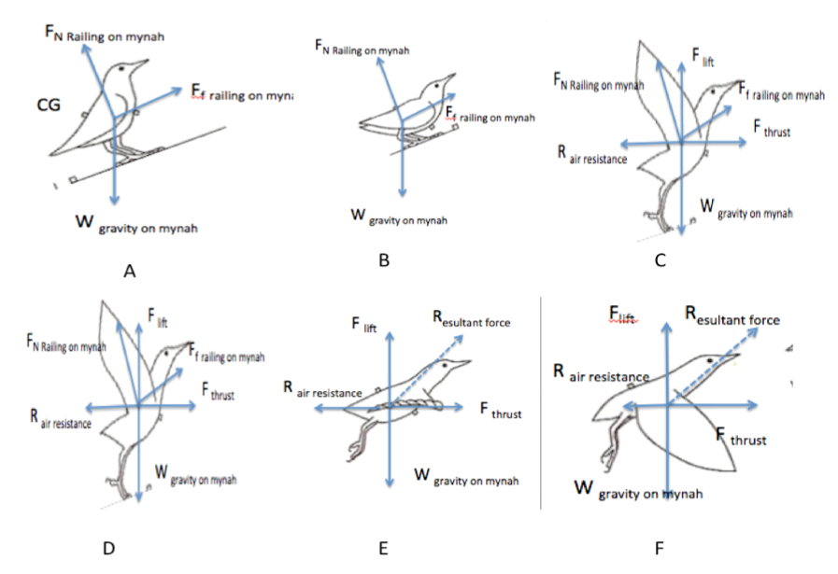
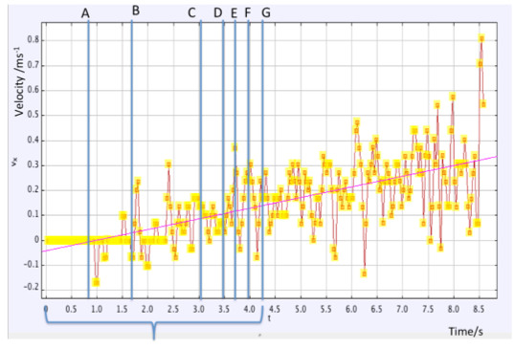
Sample Student Report
Zhao Yi Yan, “We are allowed to use physics to understand the movement around us, therefore it was very relatable. Apart from what we were taught, I did a lot of reading on the movement relating to the movement.”
Downward stroke exert more force, because the wings extend to the fullest and have the largest surface area in contact with the air. The up-stroke exert much less force and also takes less time. During up-stroke, the wings folds partially to have a smaller surface area, so less resistance against myna’s body.
Myna’s body is tilted upwards, and the head is always lifted during the down-stroke and falls a bit during the up-stroke, to reduce the air resistance coming against the myna.
When myna reaches a certain height, the beating of wing motion will be less frequent as it no longer need the extra force to gain positive vertical displacement and accelerate forward.
Notes:
The is a sample report by a student of course not the full report in order to squeeze into 1 slide.
"We were..."
Students are willing to invest their personal time to learn more about the motion because there is ownership in the research.
Look at the depth of the report. It's way beyond what I taught me or any k9 text books can teach.

Slide 17
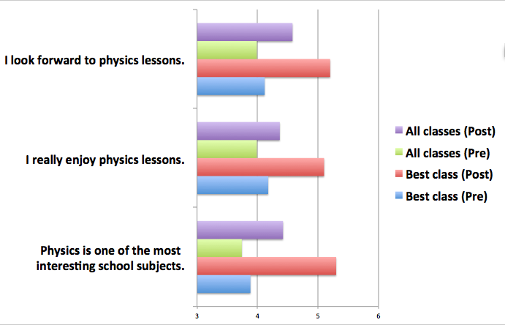
Perception Survey Results
All the students enjoyed the Physics lessons, especially the best class.
Notes:
We did a pre and post survey after the students completed their performance task.
It's very heartening to see the students enjoy the physics lessons so much. I have to remind everyone that I'm teaching in a girls school. In the past, the girls were not very keen in studying physics so this change is perception means a lot.

Slide 18
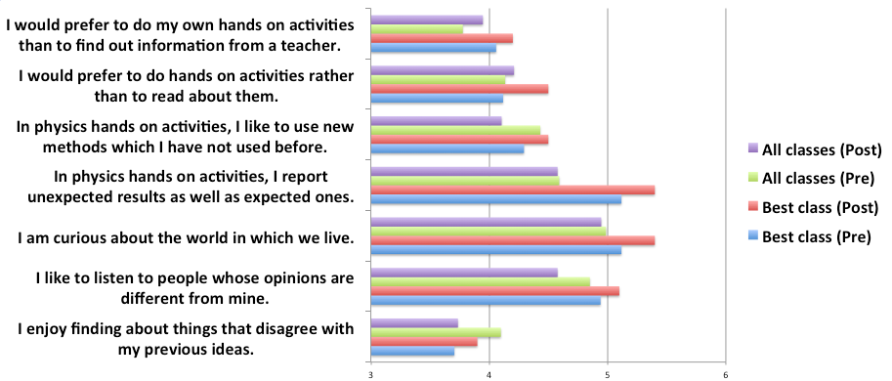
Perception Survey Results
All perception improve for the best class perception after the lesson.
The rest of the cohort only improve in perception score for the first 2 questions.
Notes:
All perceptions improve for the best class perception after the lesson.
The rest of the cohort only improve in perception score for the first 2 questions.
Although all students enjoyed the hands on process, only the best class truly behave like a scientist.
The preliminary results seems to suggest that this programme is more beneficial for better classes.
Further verbal interview and extensive research need to be conducted to draw better conclusions.

Slide 19
Q & A
tzekwang.leong@rgs.edu.sg
wee_loo_kang@moe.gov.sg
http://weelookang.blogspot.com
http://iwant2study.org/lookangejss/
http://iwant2study.org/lookangejss/indexTRZdl.php

Slide 20
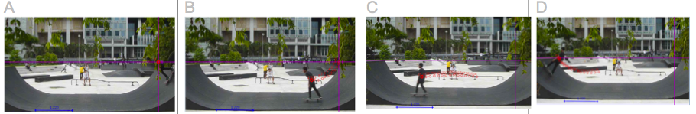
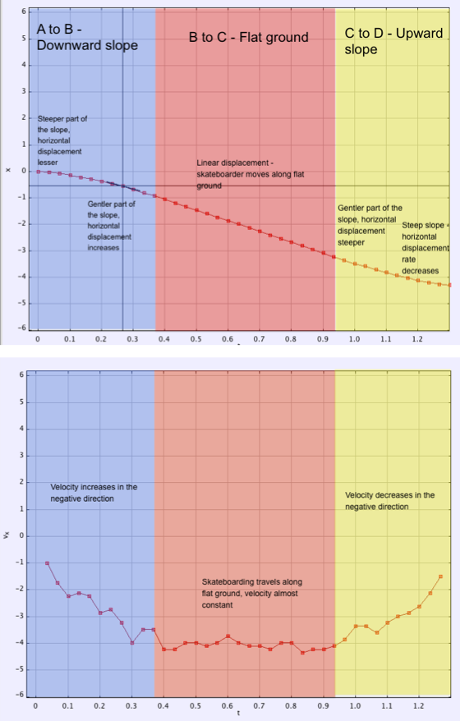
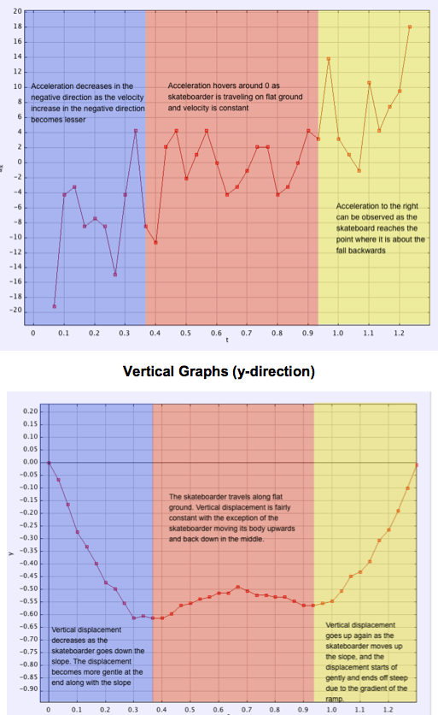
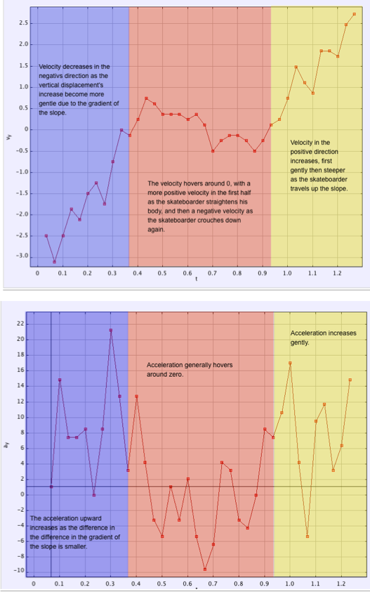
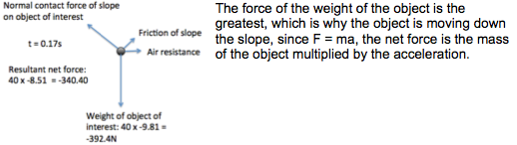
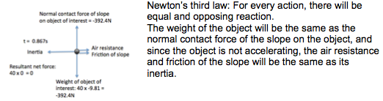
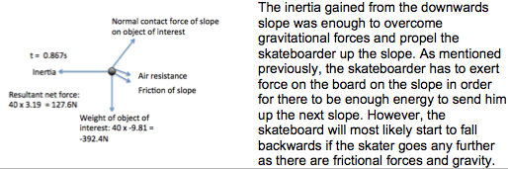
Sample Student Report

