Slide 1
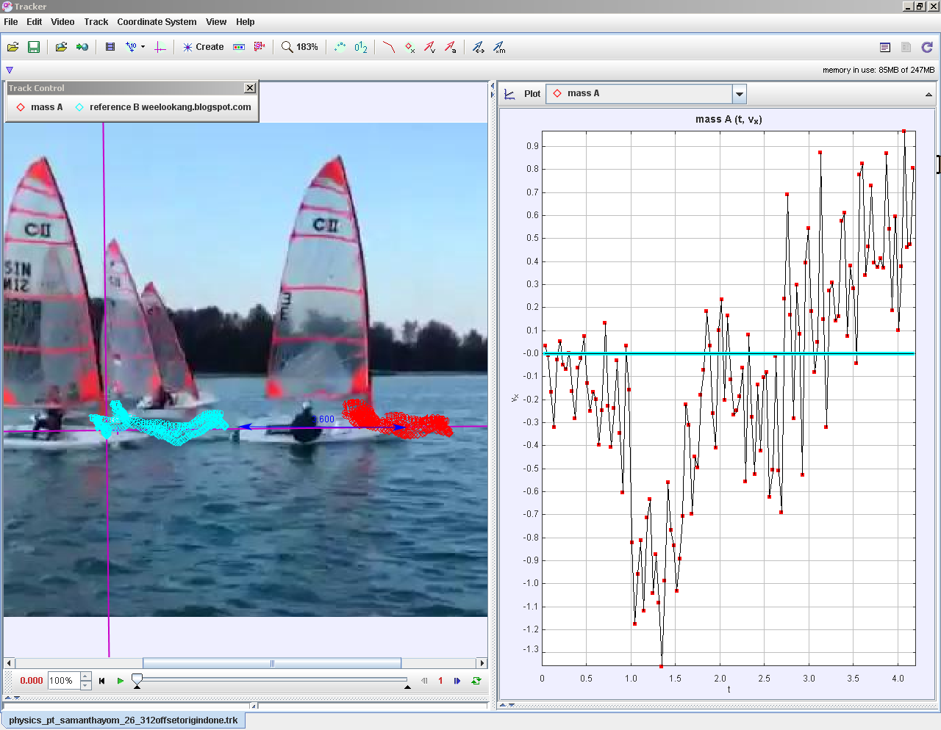

Becoming scientists through Video Analysis
Lawrence_WEE@moe.gov.sg
TzeKwang.LEONG@rgs.edu.sg
LEE_Tat_Leong@moe.gov.sg
Notes:
Our project seeks to allow students to be like scientists (obtain real data from physical phenomena, engage in making inference and deducing how the physical world work).
This is accomplished by using the k 12 8 practice approach supported by video analysis with Tracker.
At this point of sharing, project is ongoing..

Slide 2
Abstract
This 60 minutes hands-on workshop (extension of 3rd IPSG: Learning physics of sports science through video analysis and modelling by Lee Tat Leong and Wee Loo Kang Lawrence) aims to emphasis the Computer Modeling Pedagogy (Wee, Chew, Goh, Tan, & Lee, 2012) using Tracker as an appropriate method to understand Dynamics, Circular and Oscillations topics. The model building process using Tracker's Dynamics Particle Model in Cartesian and Polar Coordinate Systems allows students to iteratively come up with suitable Physics (recommended with nested if statements) computer models (Brown, 2007, 2008, 2009, 2012; Christian & Esquembre, 2012) to represent their video analysis.

Slide 3
What?: K12 eight practices of science by National Academy of Sciences
8 practices of scientists
(1) Asking Questions☺
(2) Using Models²
(3) Plan & Carry Out Investigations☺
(4) Analysing Data☺
(5) Mathematical & Computational² Thinking
(6) Explaining based on evidence☺
(7) Argumentation
(8) Communication☺
2 Wee, Loo Kang, Chew, Charles, Goh, Giam Hwee, Tan, Samuel, & Lee, Tat Leong. (2012). Using Tracker as a pedagogical tool for understanding projectile motion. Physics Education, 47(4), 448.
Notes:
The National Science Education Standards (NSES p. 23) defines scientific inquiry as
“the diverse ways in which scientists study the natural world and propose explanations
based on the evidence derived from their work.
Scientific inquiry also refers to the activities through which students develop knowledge and understanding of scientific ideas, as well as an understanding of how scientists study the natural world.”

Slide 4
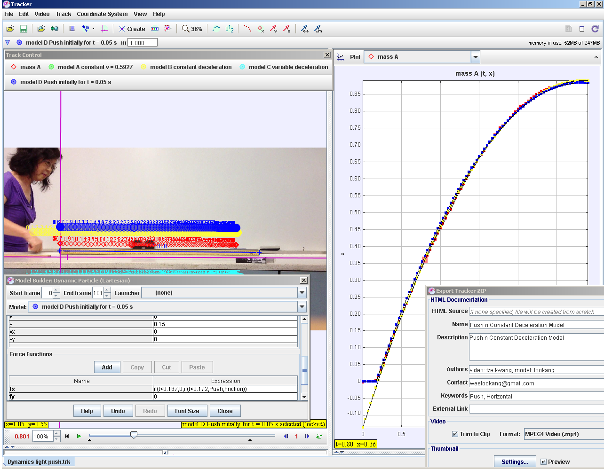
Tracker Push n Constant Deceleration Model
Model A constant v = 0.5927
Model C Fdrag = k*vx
Model B F = μ *R
Model D = fx = if(t<0.167,0,if(t<0.172,Push,Friction)) , Push = 134, Friction = -1.268E-1*2
Notes:
http://weelookang.blogspot.sg/2015/01/tracker-push-n-constant-deceleration.html

Slide 5
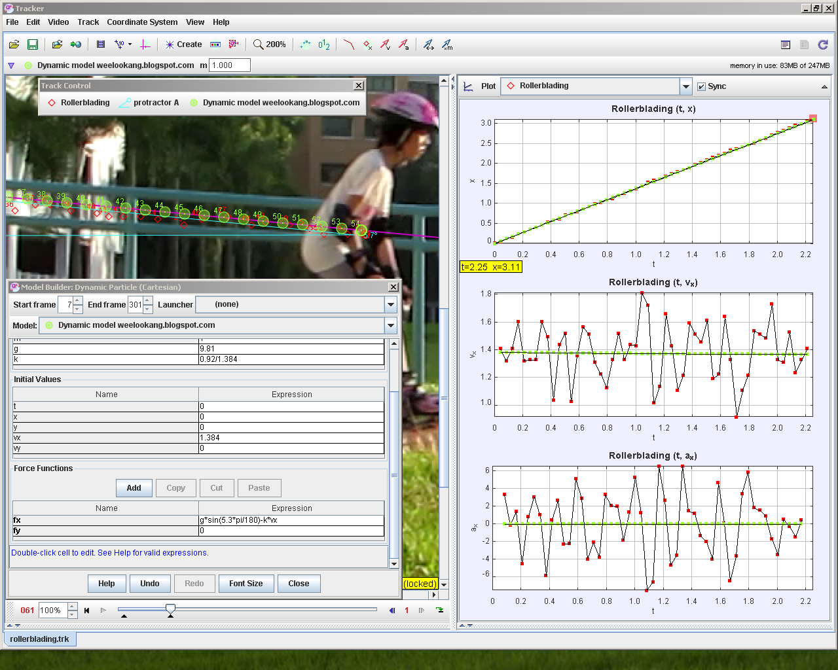
Slope Model. variables used: g = 9.81, k =0.708 initial values: vx = 1.384 , fx' = g*sin(5.7*pi/180)-k*vx ,fy' = 0
Notes:
http://weelookang.blogspot.sg/2014/05/tracker-koaytzemin-student-video-roller.html?q=roller

Slide 6
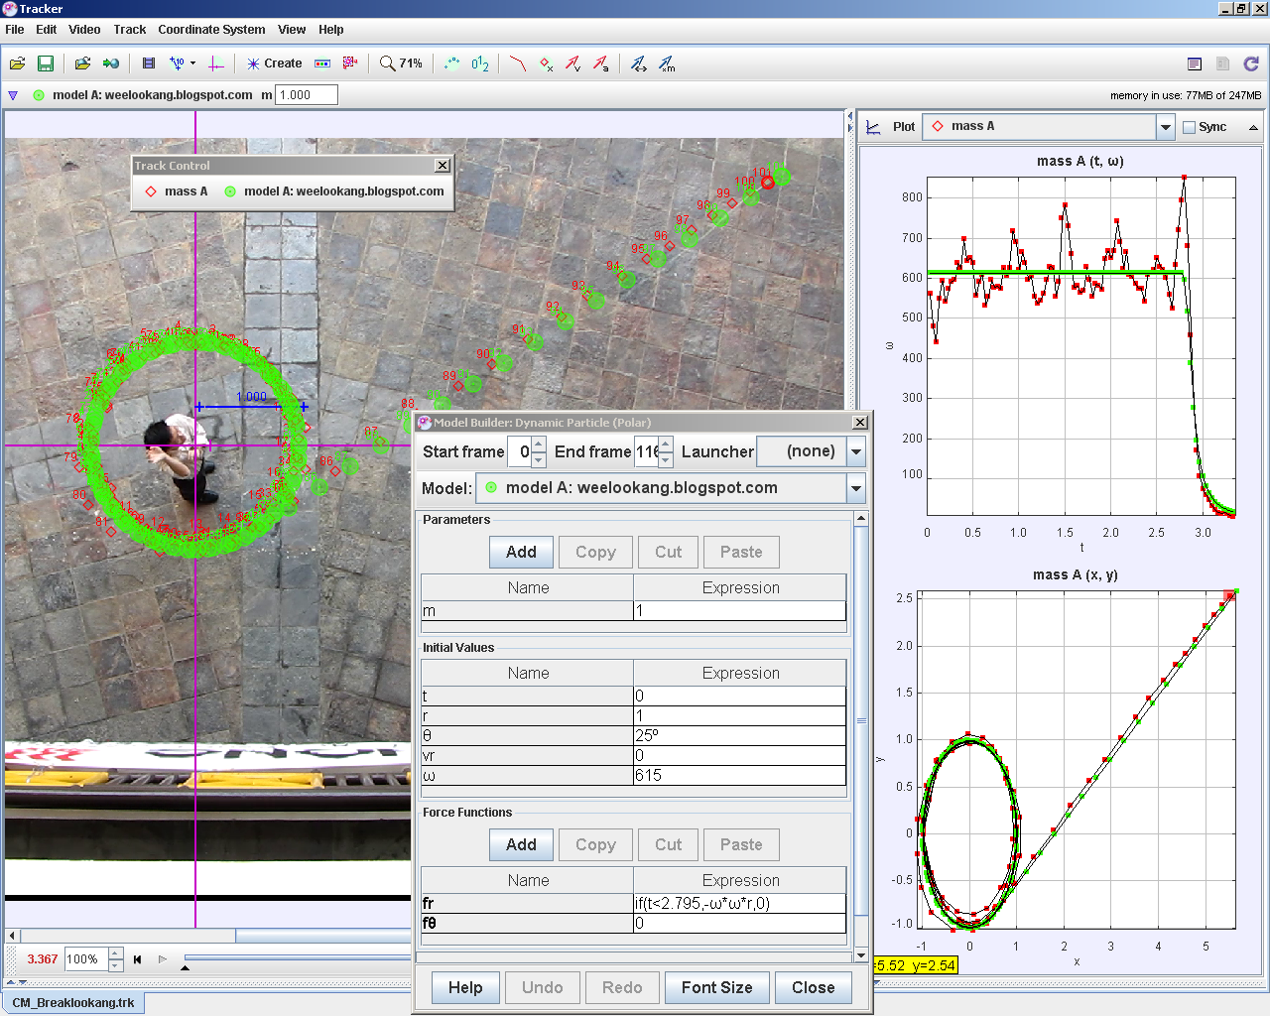
Circular: Motion Break Model initial values θ = 25 deg, ω = 615, fr = if(t<2.795,-ω*ω*r,0) , fθ = 0
Notes:
http://weelookang.blogspot.sg/2014/07/tracker-circular-motion-break-model.html

Slide 7
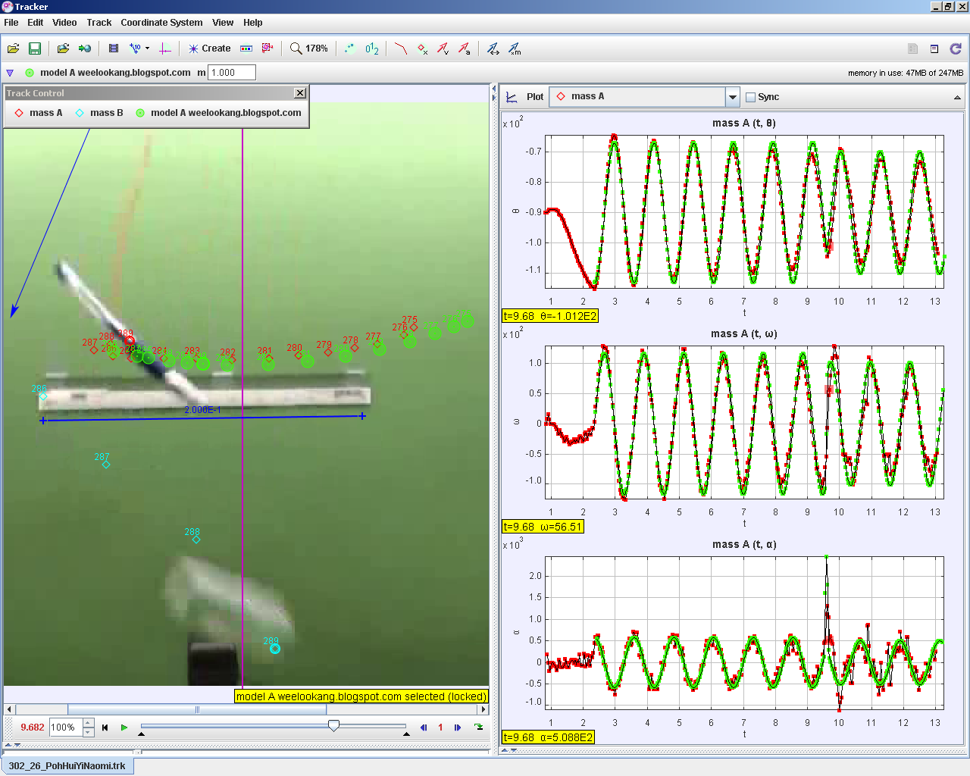
Simple Harmonic Motion with Collision Model variables used: g = 9.81, F=230, initial values: t = 2.345, r = 0.3737, θ= -113º, fr = -ω*ω*r ,fθ = if(t<9.581,-m*g*cos(θ),if(t<9.586,F-m*g*cos(θ),-m*g*cos(θ)))
Notes:
http://weelookang.blogspot.sg/2014/08/tracker-pendulum-collision-model.html

Slide 8
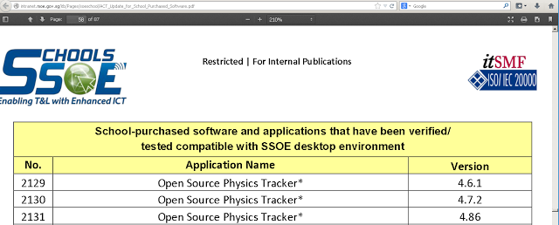
Tracker 4.87 is SSOE white listed
updated 13 Nov 2014. do a CONTROL-FIND (F) and look for "open source"
http://intranet.moe.gov.sg/itb/Pages/soeschool/ACT_Update_for_School_Purchased_Software.pdf
Notes:
http://weelookang.blogspot.sg/2014/08/ssoe.html

Slide 9
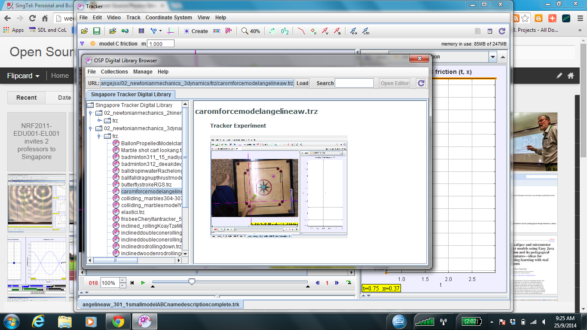
Singapore Teachers Shared Library in Tracker: http://iwant2study.org/lookangejss/

